Slide 1




























Slide 2

Draw a block diagram of a microprocessor-based
system and explain the functions of each component.
Define the terms bit, byte, word, instruction, software and hardware.
Explain the difference between the machine language and assembly language of a computer.
Explain the terms low-level and high-level languages.
Explain the advantages of an assembly language over high-level languages.

Slide 3
The first question comes in a mind "What is a microprocessor?”. Let us start with a more familiar term computer. A digital computer is an electronic machine capable of quickly performing a wide variety of tasks. They can be used to compile, correlate, sort, merge and store data as well as perform calculations.
Computers communicate and operate in binary numbers 0 and 1 also known as bits. It is the abbreviation for the term binary digit. The bit size of a microprocessor refers to the number of bit which can be processed simultaneously by the arithmetic circuit of the microprocessor. A number of bits taken as a group are this manner is called word.

Slide 4
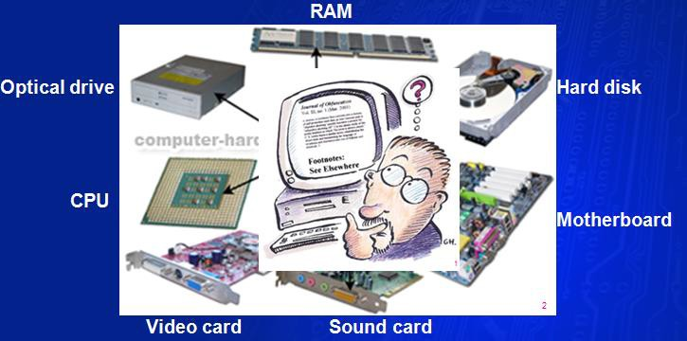
A Computer is a programmable machine. The two principal characteristics of a computer are:
1. It responds instructions manner.
to a specific
set of
in a well-defined
2. It can execute a prerecorded list of instructions (a program ).
Modern computers are electronic and
digital. The actual wires, transistors, and
circuits is instructions software.
called hardware. and data are
The called
4

Slide 5
•The computer we are using to read this page uses a microprocessor to do its work. The microprocessor is the heart of any normal computer, that we are using might be a Pentium or any of the many other brands and types of microprocessors.
•A microprocessor
also
known as
a CPU or
central
processing unit
(fig.1)
that is
a complete
computation
engine is fabricated on a single chip. Engineers built computers either from collections of chips or from discrete components (transistors wired one at a time).

Slide 6
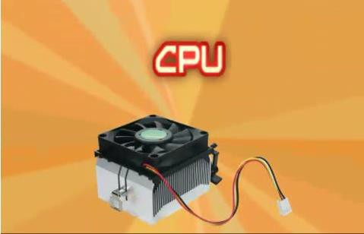
Figure 1: The control processing unit (CPU)

Slide 7
•Historically, according to the
digital
computers
have
been
categorized
size using the
words large, medium,
minicomputer and
microcomputer. It
has now become
possible to build the control processing unit (CPU) with its related timing functions on a single chip known as microprocessor. A microprocessor combined with memory and input/output devices forms a microcomputer.
•The Microprocessor Age: The fist microprocessor was developed at Intel Corporation in 1971. Table-1 lists the early and modern Intel microprocessor.

Slide 8
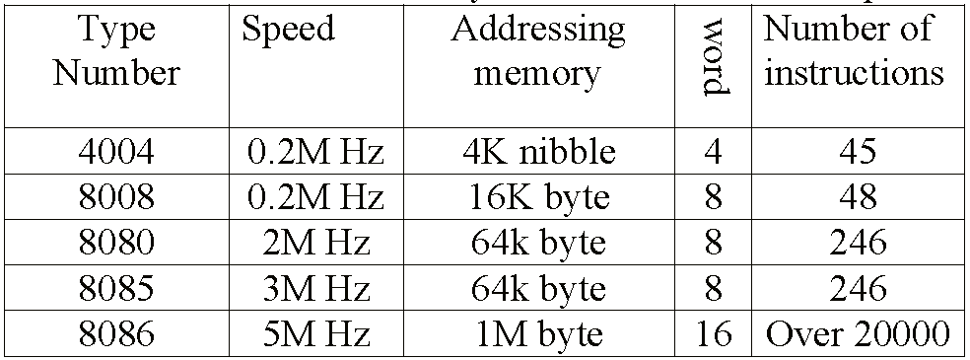
Table (1) Many Intel microprocessors

Slide 9
Microcomputer: a computer that depends on a microprocessor. It contains a CPU on a microchip (the microprocessor), a memory system (typically ROM and RAM), a bus system and I/O ports and typically housed in a motherboard.
Microprocessor: a silicon chip that contains a CPU. In the world of personal computers, the terms microprocessor and CPU are used interchangeably. It (sometimes abbreviated μP) is a digital electronic component with miniaturized transistors on a single semiconductor integrated circuit (IC).
Microprocessors also control the logic of almost all digital devices, from clock radios to fuel-injection systems for automobiles.

Slide 10
Three basic characteristics differentiate microprocessors:
Instruction set: The set of instructions that the microprocessor can execute.
Bandwidth: The number of bits processed in a single instruction.
3. Clock speed: Given in megahertz (MHz), the clock speed determines how many instructions per second the processor can execute.
Microcontroller: is a highly integrated chip that contains a CPU, RAM, some form of ROM, I/O ports, and timers. a microcontroller is designed for a very specific task - to control a particular system.
A microcontroller differs from a microprocessor, which is a general- purpose chip that is used to create a multi-function computer or device and requires multiple chips to handle various tasks.
10

Slide 11

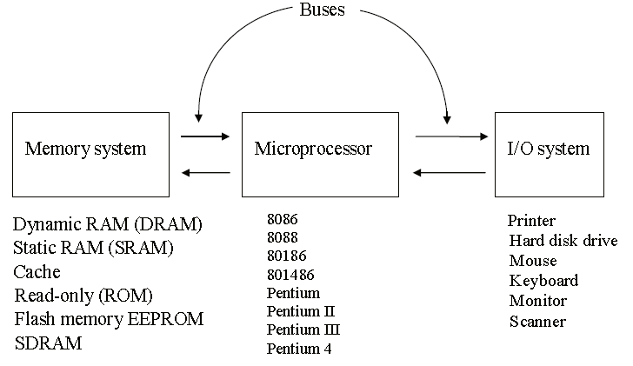
Fig.2 :The block diagram of a microprocessor-based computer system

Slide 12
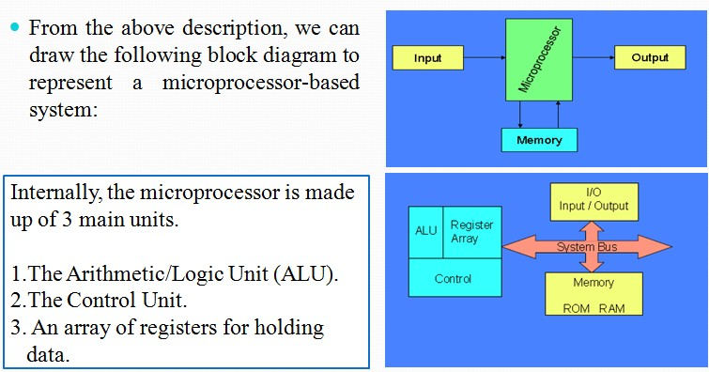

Slide 13

The user can enter instructions and data memory
through devices such as a keyboard or simple switches.
These devices are called input devices, similar to eyes and ears in a human body. The microprocessor reads the instructions from the memory and processes the data according to those instructions.
The result can be displayed by a device such as seven segment LEDs (Light Emitting Diodes) or printed by a printer. These devices are called output devices.

Slide 14




The 8085 (from Intel) is an 8-bit microprocessor.
•
The 8085 uses a total of 246 bit patterns to
form its
instruction set.
These 246 patterns represent only 74
instructions. The
reason for the difference is that some (actually
most)
instructions have multiple different formats.
Because it is very difficult to enter the bit patterns correctly, they are usually entered in hexadecimal instead of binary.
For example, the combination 0011 1100 which translates into “increment the number in the register called the
accumulator”, is usually entered as 3C.

Slide 15

Using the same example from before,
➢00111100 translates to 3C in hexadecimal (OPCODE).
➢Its mnemonic is: “INR A”.
➢INR stands for “increment register” and A is short for
accumulator.
Another example is:
➢1000 0000 translates to 80 in hexadecimal.
➢Its mnemonic is “ADD B”.
➢“Add register B to the accumulator and keep the result in
the accumulator”.

Slide 16

How does assembly language get translated into machine
language?
There are two ways:
1st there is “hand assembly”. The programmer translates each assembly language instruction into its equivalent hexadecimal code (machine language). Then the hexadecimal code is entered into memory.
The other possibility is a program called an “assembler”, which does the translation automatically
It is important to remember that a machine language and its associated assembly language (low level languages)are completely machine dependent. In other words, they are not transferable from one microprocessor to a different
one.

Slide 17

•Programming languages that they are intended to be machine-independent are called high level languages. These include such languages as BASIC, PASCAL, C, C ++, and Java, all of which have certain sets of rules and draw on symbols and conventions from English.
•Instructions written in these languages are known as
statements rather than mnemonics.
•Require large memory space because an instruction
requires several machine codes to translate it into binary.
•The primary advantage of high-level languages is in
troubleshooting (debugging) programs.

Slide 18

The interaction between the hardware and the software is managed by a set of programs called an operating system of a computer; it oversees all the operations of the computer.
The computer transfers information constantly between memory and various peripherals such as printer. Keyboard and video monitor and stores programs on disk.
The functional relationship between the operating system and the hardware of the computer is shown in Figure 3 (a).

Slide 19

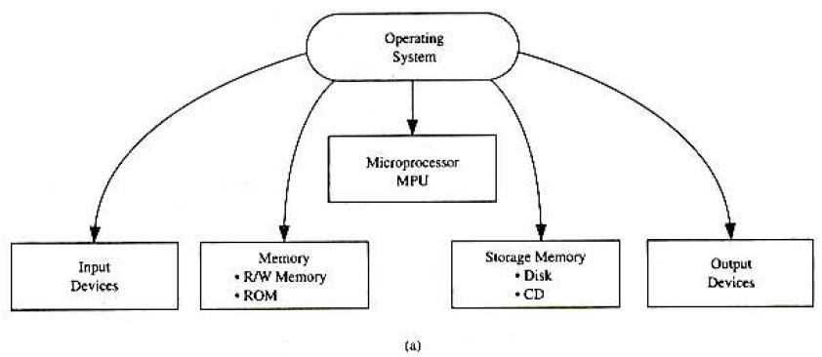
Figure 3: (a) Operating System and It’s Functional Relationship with Various Components

Slide 20
Figure 3 (b) shows the relationship and the hierarchy among the hardware, the operating system, high-level languages, and application programs.
The operating system is close to the hardware and applications programs are farthest from the hardware.
Each computer has its own operating system.
20

Slide 21
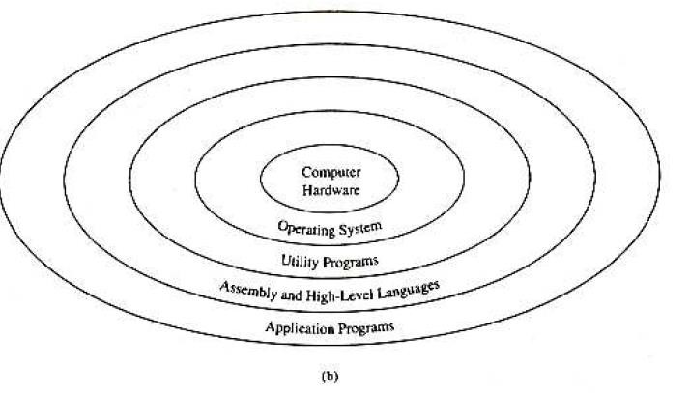
Figure 3: (b) Hierarchal Relationship Computer Hardware and Software

Slide 22
Bit: a binary digit, 0 or 1. Byte: a group of eight bits. Nibble: a group of four bits.
Word: a group of bits the computer recognized and processes it. Mnemonic: a combination of letters to suggest the operation of an instruction.
Low-level language: a medium of communication that is machine- dependent or specific to a given computer. The machine and the assembly languages of a computer are considered low-level languages. Programs written in these languages are not transferable to different types of machines.
Assembler: a computer program that translates an assembly language program from mnemonics to the binary machine code of a computer.
Manual assembly: a procedure of looking up the machine codes manually from the instruction set of a computer and entering those into the computer through a keyboard.
H.W: Questions and Problems of chapter 1.

Slide 23

It is a storage device. It stores program data and the results.
There are two kind of memories; semiconductor memories
& magnetic memories.
Semiconductor memories are faster, smaller, and lighter and consume less power. They are used as the main memory of a computer.
Magnetic memories are slow but they are cheaper than semiconductor memories. They are used as the secondary memories of a computer for largeness storage of data and information.

Slide 24
•If a memory stores N- words of information each word being of m bits, it is a N*m memory. e.g. 8x4 memory means there are 8 words 4 each word containing 4- bit of information (called nibble).
Memory locations are clearly identified by addresses, formulate by bit combinations available in wires known as address lines.
•To identify 8 memory locations we require 3 address lines designed A2A1A0.

Slide 25
•The capacity of a memory is specified terms of the maximum number of words the memory can store. In general.
If the memory has an R bit address and each word is of length m, then the memory has a capacity of 2R*m bits.
•Thus, 8-bit microprocessor provides a maximum of 216 or 64K memory addresses ranging from 0000 to FFFFH.

Slide 26
•An important characteristic of a memory is whether it is volatile or non volatile. The contents of volatile memory are lost if the power is turned off. On the other hand, a non volatile memory retains its contents after the power is switched off ( i.e: magnetic core).
•In the broad sense, a μC’s memory system can be logically divided into three groups:
1) Processor memory: refers to a set of μP registers. These registers hold temporary results when a computation is progress.

Slide 27
Primary or main memory: is the external memory to
store both program and data.
Secondary memory: refers to the storage medium compositing slow devices such as hard disks and floppies.
The most important factors of a memory system are:
The cost: A good design implies a very low cost per bit.
The speed: with which information can be transferred in and out of a memory.
The access mode: refers to the manner in which information can be accessed from the memory (random and sequential access modes).

Slide 28
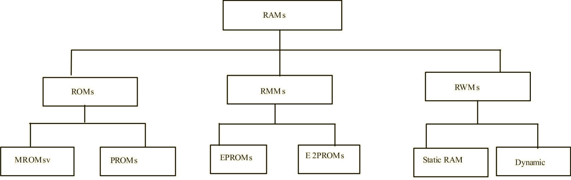
In general, semiconductor memories can be clarified in two main groups’ random access memories (RAM) and sequential access memories (SAM). RAM can be classified in three main groups as shown below.

Slide 29
ROM:
The content of an address location can only be read
and cannot be written into.
The contents of an address location are not destroyed whether the power is ON or OFF.
It is useful for the storage of computer operating
systems, software language computers, programs
for dedicated microprocessor applications.

Slide 30
MASK ROM:
It is programmed by the manufacturing process.
The contents of MROMs cannot be changed by the user.
Used in desktop computers to contain there
operating system.
PROM:
Programmable Read only memory.
User can program a PROM-once. Read the information out of PROM as often as one wish, but one can never write into it again.
30

Slide 31
EPROM:
Erasable PROM is the solution if a mistake is done in programming ROM and PROMs.
The contents are erased by ultra violet light.
One can read the contents of an EPROM as often as one like.
RMM:
It is read mostly memory.
Usually suited for operation where mostly reading rather than, sorting will be performed.

Slide 32
E2PROM:
It is electrically erasable PROM.
The stored information can be erased by applying a high voltage of about 21V.
One application of the E2PROM is in the tuner of a
modern TV set.
RWM:
It is normally known as Random Access Memory.
It is a volatile memory.
Use for either read or write the contents/data of/in the addressed memory location in a READ/WRITE operation.

Slide 33
Two general types of RAM, static and dynamic.
Static RAM consists of an array of flips flop. Special case of static RAM is nonvolatile RAM, use battery.
DRAM requires capacitor, DRAM density will be higher than SRAM.
DRAM stores information as a charge on a capacitor. It is less common in embedded design than Static RAM and typically is used where a lot of memory is needed.
DRAM has half as many address lines as needed.

Slide 34
•DRAM must be refreshed.
•The storage capacitor loses its charge quickly, typically in 15ms.
•Refresh is accomplished by accessing each row in the
DRAM.
•What happen if the DRAM is in the middle of refreshing and the processor wants to start a read cycle?
•There are several ways to handle the conflict between processors and refresh cycles:

Slide 35
1. Use wait states: It is a synchronize refresh to the processor, which allow to occur only for the cycles that do not use the DRAM.
Use DMA: it can be used for refresh by allowing the refresh logic to request a hold and do the refresh cycle when the processor acknowledges the hold request.
Use built in refresh: Internal timer generates refresh request at regular interval.

Slide 36
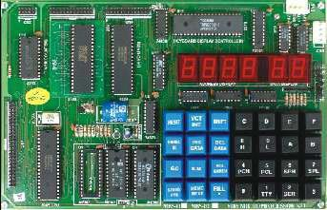
Intel 8085 Microprocessor

Slide 37
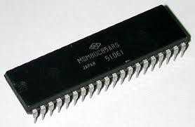
Intel 8085 Microprocessor
The microprocessor is a programmable device that takes in numbers performs on them arithmetic or logical operations according to the program stored in memory and then produces other numbers as a result.

Slide 38
Definition (Cont.)
Lets expand each of the underlined words:
Programmable device: The microprocessor can perform different sets of operations on the data it receives depending on the sequence of instructions supplied in the given program.
Instructions: Each microprocessor is designed to execute a specific group of operations. This group of operations is called an instruction set. This instruction set defines what the microprocessor can and cannot do.

Slide 39
Definition (Cont.)
Numbers: The microprocessor binary numbers.
only
understands
A binary digit is called a bit (which comes from
binary digit).
The microprocessor recognizes and processes a group
of bits together. This group of bits is called a “word”.
The number of bits in a Microprocessor’s word, is a measure of its “abilities”.

Slide 40
Definition (Cont.)
❖ Arithmetic and Logic Operations:
Every microprocessor has arithmetic operations such as add and subtract as part of its instruction set.
Most microprocessors will have operations such as multiply and divide.
Some of the newer ones will have complex operations such as
square root.
o In addition, microprocessors have logic operations as well. Such as AND, OR, XOR, shift left, shift right, etc.
o Again, the number and microprocessor’s instruction microprocessor.
types of operations define the
set and depends on the specific
40

Slide 41
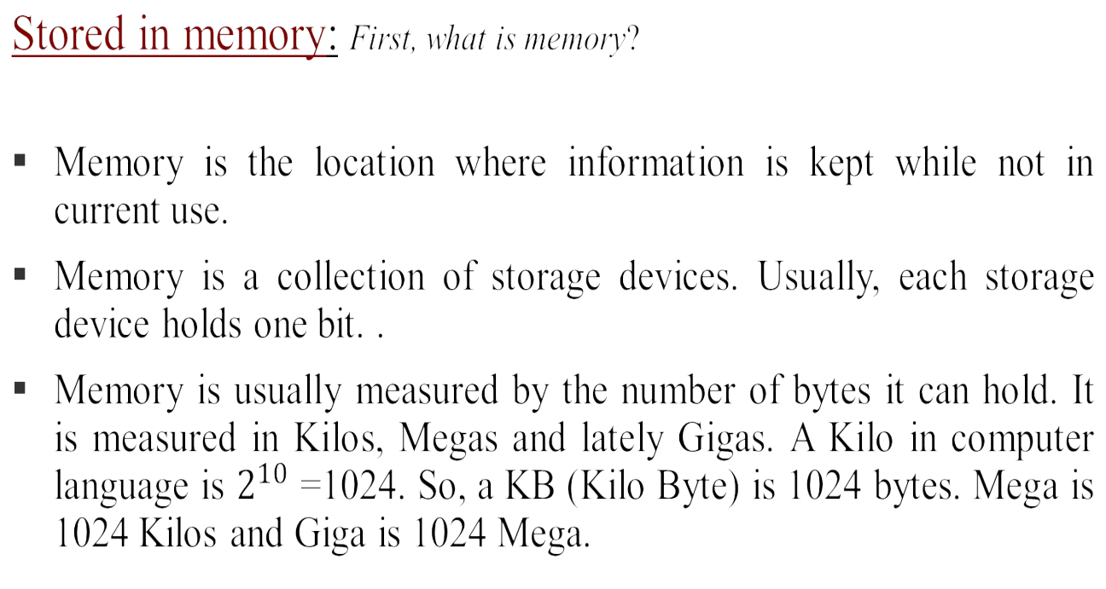
Definition (Cont.)

Slide 42
Definition (Cont.)
Stored in memory:
When a program is entered into a computer, it is stored in memory. Then as the microprocessor starts to execute the instructions, it brings the instructions from memory one at a time.
Memory is also used to hold the data.
The microprocessor reads (brings in) the data from memory when it needs it and writes (stores) the results into memory when it is done.

Slide 43
Microprocessor Architecture and it's Operation
❑ Computer system consist primary of :-
Microprocessor.
Memory.
Input.
Output.
❑ The internal logic design of the microprocessor called its "architecture", determine how and what various operations are performed by "µp".
❑ The microprocessor is programmable logic device designed with registers, flip-flops and timing elements.

Slide 44
Microprocessor Architecture and it's Operation
❑ All functions performed by a microprocessor can by classified in three general categories:-
Microprocessor initiated operations.
Internal data operations.
Peripheral (or externally) initiated operations.
❑ To performed these operations, the microprocessor requires a group of logic circuits and a set of signals called control signals.

Slide 45
Microprocessor Architecture and it's Operation
1- µp Initiated Operations:- Primarily microprocessor performs
four operations:-
Memory read (Reads data from memory).
Memory writes (Write data into memory).
I/O read (Accept data to output devices).
I/O writes (Sends data to output devices).
All these operations are part
of communication
process
between µp and peripheral devices.

Slide 46
Microprocessor Architecture and it's Operation
To communicate the µp with these devices needs to
perform the following steps:-
Identify the peripheral or the memory location (with its address).
Transfer data.
Provide timing or synchronization signals.
Microprocessor performs these functions using three sets of communication lines called buses: the data bus, address bus and Control bus. All together are shown in figure (1) as one group called the system bus.

Slide 47
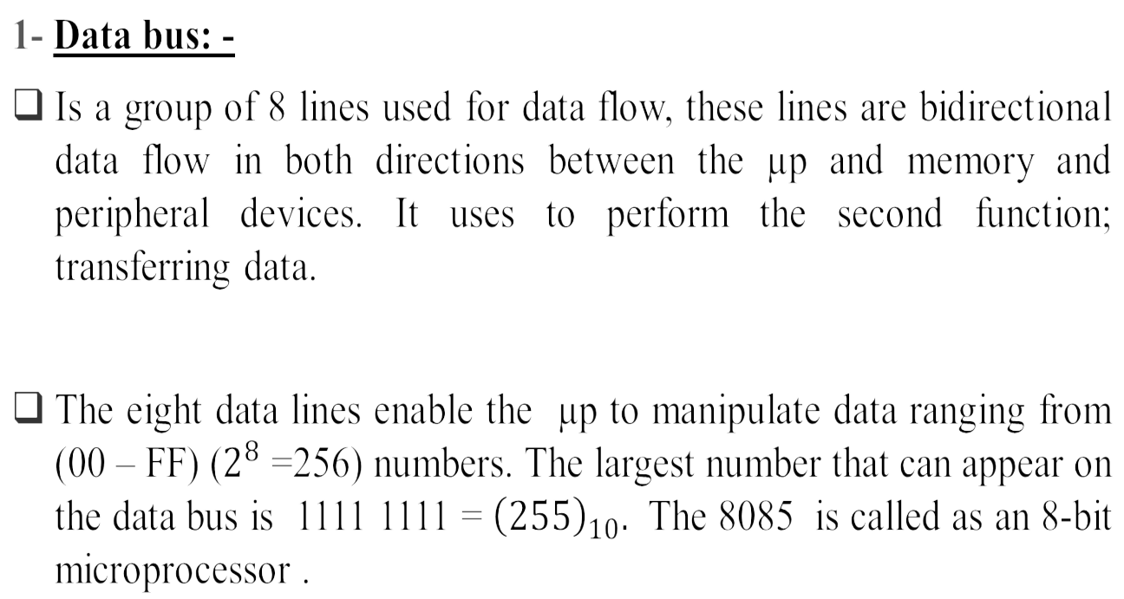
Microprocessor Architecture and it's Operation

Slide 48
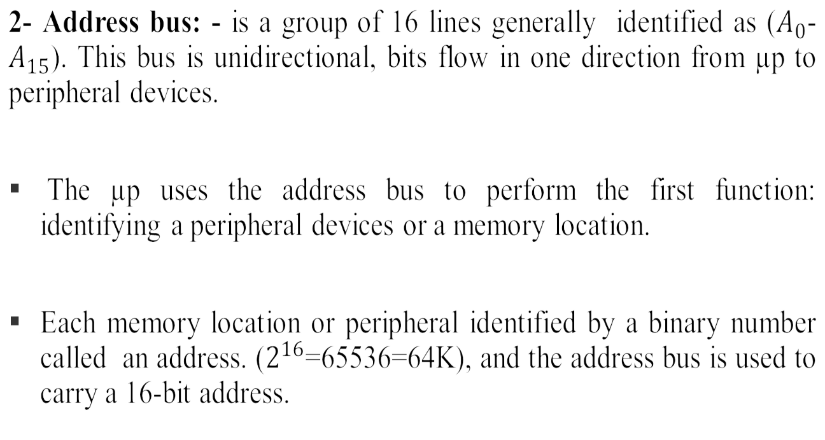
Microprocessor Architecture and it's Operation

Slide 49
Microprocessor Architecture and it's Operation
3- Control bus: - it is comprised of various single lines that carry synchronization signals.
The µp uses the address bus to perform the third function:
providing timing signals.
These are not groups of lines like address and data buses, but individual lines that provide a pulse to indicate an µp operations. The µp generates specific control signals for every operation it performs.

Slide 50
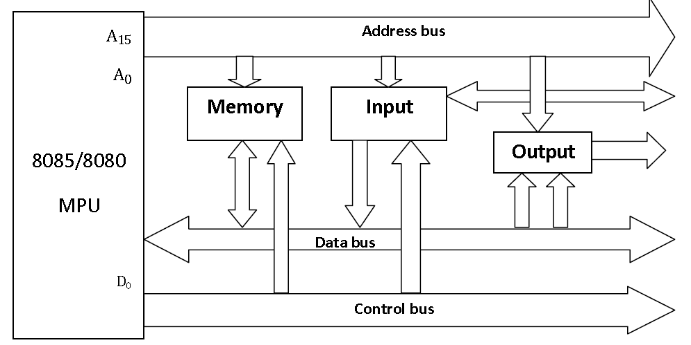
Microprocessor Architecture and it's Operation
Figure ( 1). The 8085 bus structure.
50

Slide 51
Microprocessor Architecture and it's Operation
To communication with a memory, for example to read
instruction from memory location:-
µp placed 16-bit address on address bus.
The address on the bus is decoded by an external logic
circuit.
The memory location is identified.
The µp sends a pulse called memory read as control signal.
The pulse activates the memory chip.
The contents of the memory location (8-bit data) are placed on the data bus as in fig. (2).

Slide 52
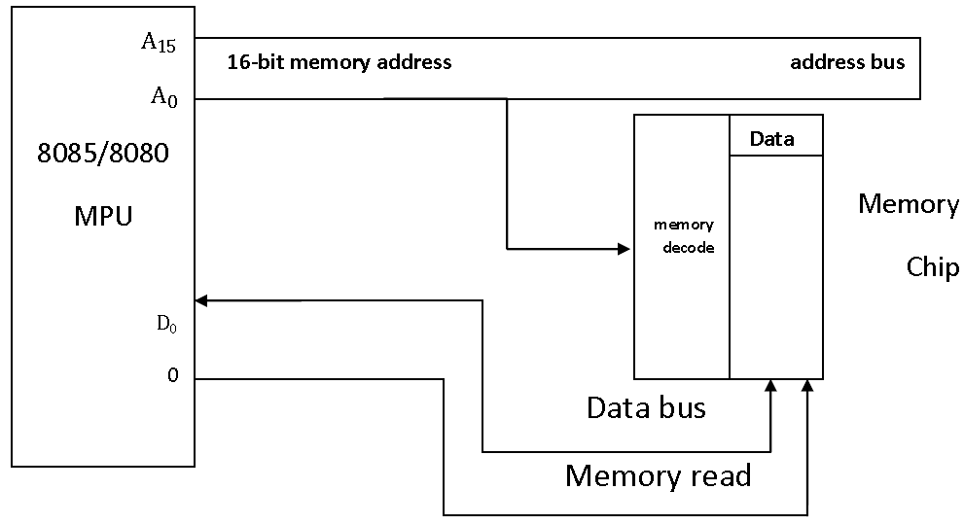
Microprocessor Architecture and it's Operation
Figure (2). Memory read operation

Slide 53
Microprocessor Architecture and it's Operation
2- Internal Data Operations:-The internal architecture of the 8085 microprocessor determines how and what operations can be performed with the data. These operations are:-
Store 8-bit data.
Performed arithmetic and logical operations.
Test for conditions.
Sequence the execution of instructions.

Slide 54
Microprocessor Architecture and it's Operation
e- Store data temporarily during execution
in the
defined R/W memory locations called the stack.
To perform these operations the µp requires:-
Registers.
An arithmetic logic unit (ALU) & control logic.
Internal buses (paths for information flow).

Slide 55
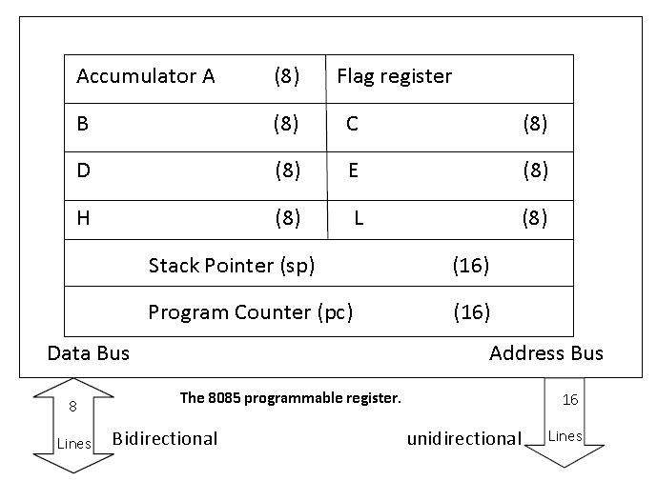
Microprocessor Architecture and it's Operation

Slide 56
Microprocessor Architecture and it's Operation
A) Registers:-
The 8085 has 6 general purpose registers to perform its operation (store 8-bit data during program execution) these are:-
(B, C, D, E, H & L) or in pair (BC, DE & HL) to perform some 16-bit operations. Registers can be viewed as memory locations except they are built inside the µp.
B) Accumulator:-
It is an 8-bit register that is part of (ALU), this register used to stored 8-bit data and in performing arithmetic & logic operations. The result of an operation is stored in the accumulator. It is also identified as register A.

Slide 57
Microprocessor Architecture and it's Operation
C) Program counters (pc):-
This 16-bit register used in sequencing the execution of instructions, this register is a memory pointer. The µp uses this register to sequence the execution of the instruction. The function of the program counter is to
point to the memory address for which the next byte is to be fetched. When a byte ( machine code) is being realized, the (pc) is incremented
by one to point to the next memory location.

Slide 58

Microprocessor Architecture and it's Operation
D) Stack pointer (sp):-
Its also16-bit register used as memory pointer. It points to a memory location in R/W memory called (the stack). The beginning of the stack is defined by loading a 16-bit address in stack pointer (register).
❑ Flags:-
The ALU includes 5 flip-fops that are set or reset according to data conditions in the accumulator and other registers. It is used by µp to perform the 3rd operation( testing for data conditions).

Slide 59
Microprocessor Architecture and it's Operation
Sign (S) flag: – If the MSB of the result of an operation is 1, this flag is set,
otherwise it is reset.
Zero (Z) flag:– If the result of an instruction is zero, this flag is set, otherwise reset.
Auxiliary Carry (AC ) flag:– If there is a carry out of bit 3 and into bit 4 resulting from the execution of an arithmetic operation, it is set otherwise reset. This flag is used for BCD operation and is not available to the programmer to change the sequence of an instruction.
Carry (CY) flag:– If an instruction results in a carry (for addition operation) or borrow (for subtraction or comparison) out of bit D7, then this flag is set, otherwise reset.
Parity (P) flag:– This flag is set when the result of an operation contains an even number of 1’s and is reset otherwise.

Slide 60
Microprocessor Architecture and it's Operation
3- Peripheral or Externally Initiated Operations:-
External devices (or signals) can initiate the following operation for which individual pins on µp chip are assigned: Reset, Interrupt, Ready, Hold.
A) Reset: when reset is activated all internal operations are postponed and the program counter is cleared ( it holds 0000H). Now the program execution can again begin at the zero memory address.
B) Interrupt: the µp can be interrupted from normal execution and asked to execution of instructions and asked to execute some other instructions called service routine. (i.e. Emergency procedure). µp resumes its operation after completing the service routine.
60

Slide 61
Microprocessor Architecture and it's Operation
Ready: The 8085 has pin called READY, if the signal at this pin is low, µp enters into a wait state. This signal used to synchronized slower peripherals with µp.
Hold: when HOLD pin activated by external signal, the µp turn down control of buses and allows the external peripheral to use them. For example: Hold signal is used in direct memory access (DMA) data transfer.

Slide 62
More on the 8085 machine cycles
The 8085 executes several types of instructions with each requiring a different number of operations of different types. However, the operations can be grouped into a small set.
The three main types are:
  Memory Read and Write.
  I/O Read and Write.
  Request Acknowledge.
These can be further divided into various smaller operations (machine cycles).

Slide 63
Opcode Fetch Machine Cycle
The first step of executing any instruction is the Opcode fetch cycle.
In this cycle, the microprocessor brings in the instruction’s Opcode from memory.
To differentiate this machine cycle from the very similar “memory
read” cycle, the control & status signals are set as follows:
  IO/M=0, s0 and s1 are both 1.
This machine cycle has four T-states.
The 8085 uses the first 3 T-states to fetch the opcode.
T4 is used to decode and execute it.

Slide 64
Memory Read Machine Cycle
The memory read machine cycle is exactly the same as the opcode fetch except:
  It only has 3 T-states
  The s0 signal is set to 0 instead.

Slide 65

Memory Read Machine Cycle
To understand the memory read machine cycle, let’s study the
execution of the following instruction:
  MVI A, 32
In memory, this instruction looks like:
  The first byte 3EH represents the opcode for loading a byte into the accumulator (MVI A), the second byte is the data to be loaded.
The 8085 needs to read these two bytes from memory before it can execute the instruction. Therefore, it will need at least two machine cycles.
  The first machine cycle is the opcode fetch discussed earlier.
  The second machine cycle is the Memory Read Cycle.

Slide 66
The Memory Write Operation
In a memory write operation:
The 8085 places the address (2065H) on the address bus
Identifies the operation as a ‘memory write’ (IO/M=0, s1=0,
s0=1).
Places the contents of the accumulator on the data bus and asserts the signal WR.
During the last T-state, the contents of the data bus are
saved into the memory location.

Slide 67
Review of Important Concepts
The microprocessor (MPU) primarily performs four operations: Memory Read, Memory Write, I/O Read, and I/O Write. For each appropriate, it generates the appropriate control signal.
To communicate with a peripheral (and memory), the MPU identifies peripheral or the memory location by its address, transfers data, and provides timing signals.
The 8085 microprocessor has six general –purpose 8 bit registers to store data and an accumulator to perform arithmetic and logical operations.

Slide 68
Review of Important Concepts
The 8085 has two 16-bit registers: the program counter and the stack pointer. The program counter is used to sequence the execution of a program, and the stack pointer is used as a memory pointer for the stack memory.
Memory is a group of registers, arranged in a sequence, to store bits; The 8085 MPU requires an 8-bit –wide memory word and uses the 16-bit address to select a register called a memory location.
To interconnect peripherals with the 8085 MPU, additional logic circuits, called interacting devices, are necessary. These circuits include devices such as buffers, decoders, encoders, and latches.

Slide 69
De-multiplexing the Bus AD7 – AD0
The need for de-multiplexing the bus AD7
– AD0
becomes easier to
understand after examining figure 4. It shows that the address
high-order bus (20H) remains on the bus for three clock periods.
on the
However, the low-order address (05H) is lost after the first clock period.
This address needs to be latched and used for identifying the memory
address.
If the bus AD7 – AD0 is used to identify the memory location (2005H), the address will change to 204FH after the first clock period.

Slide 70
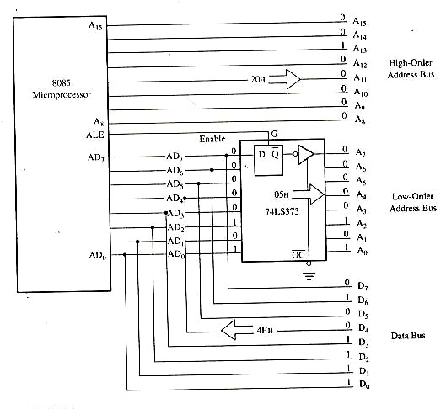
De-multiplexing the Bus AD7 – AD0
Figure4: Schematic of Latching Low-Order Address Bus
70

Slide 71
De-multiplexing the Bus AD7 – AD0
Figure 4 shows a schematic that uses a latch and the ALE signal to de- multiplexed the bus. The bus AD7–AD0 is connected as the input to the latch 74LS373. The ALE signal is connected to the Enable (G) pin of the latch, and the output control (OC) signal of the latch is grounded.
Figure 5 shows that the ALE goes high during T1. When the ALE is high, the latch is transparent; this means that the output changes according to input data.
During
T1, the output of the latch is 05 H. When the ALE goes low the
data byte 05 H is latched until the next ALE and the output of the latch
represents the low-order address bus A7 – A0 after the latching operation.

Slide 72
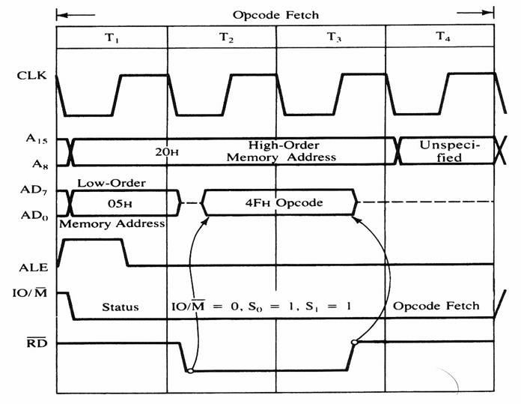
De-multiplexing the Bus AD7 – AD0
Figure 5: 8085 timing diagram for Opcode fetch cycle

Slide 73
De-multiplexing the Bus AD7 – AD0
Now we can define three terms – instruction cycle, machine cycle, and T-state – and use these terms later for examining timings of various 8085 operations.
Instruction cycle: is defined as the time required completing the execution of an instruction. The 8085 instruction cycle consists of one to six machine cycles or one to six operations.
Machine cycle: is defined as the time required to complete one operation of accessing memory, I/O, or acknowledging an external request. This cycle may consist of three to six T-sates. In Figure 5, the instruction cycle and the machine cycle are the same.

Slide 74
De-multiplexing the Bus AD7 – AD0
T-state:
Is defined as one subdivision of the operation performed in one clock period. These subdivisions are internal states synchronized with the system clock. and each T-state is precisely equal to one clock synonymously period. The terms T-state and clock period are often used

