Slide 1
Memory Address Decoding
The 8085 microprocessor has 16 address lines.
Therefore it can access 216 locations in the physical memory. If all these lines are connected to a single memory device, it will decode these 16 address lines internally and produces 216 different addresses from 0000H to FFFFH so that each location in the memory will have a unique address.

Slide 2
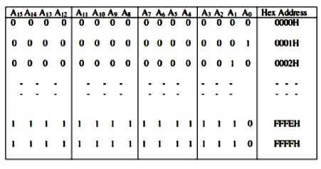
Memory Address Decoding
Fig. 1: Memory Address

Slide 3
74LS138 address decoder is used to generate the chip select signals for each memory block. In this decoder:-
when the address lines A13, A14 and A15 are 000, the output lineY0 will be activated as shown in Fig 2. This in turn selects the first memory block.
Similarly, when these lines are 001 (C=0, B=0 and A=1) Y1 will be activated and the second memory block will be selected.

Slide 4
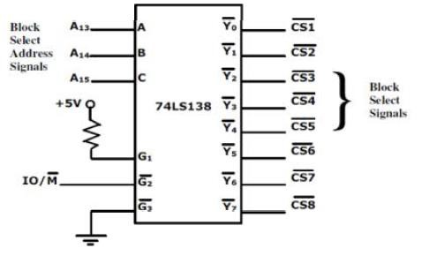
Fig 2: Memory block decoder

Slide 5
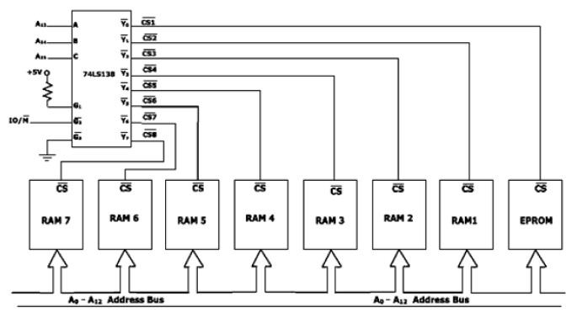
The complete picture of the interfacing:
Fig. 3: Memory Interface Diagram

Slide 6
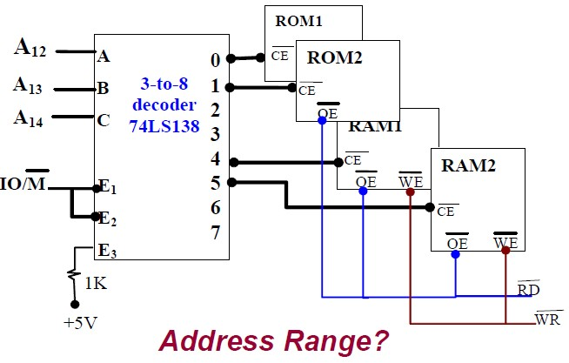

Slide 7
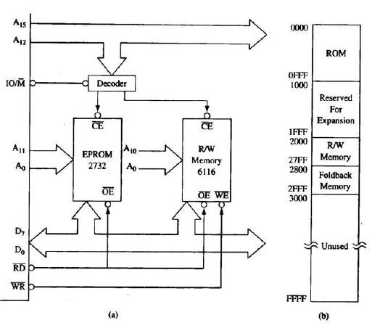

Slide 8
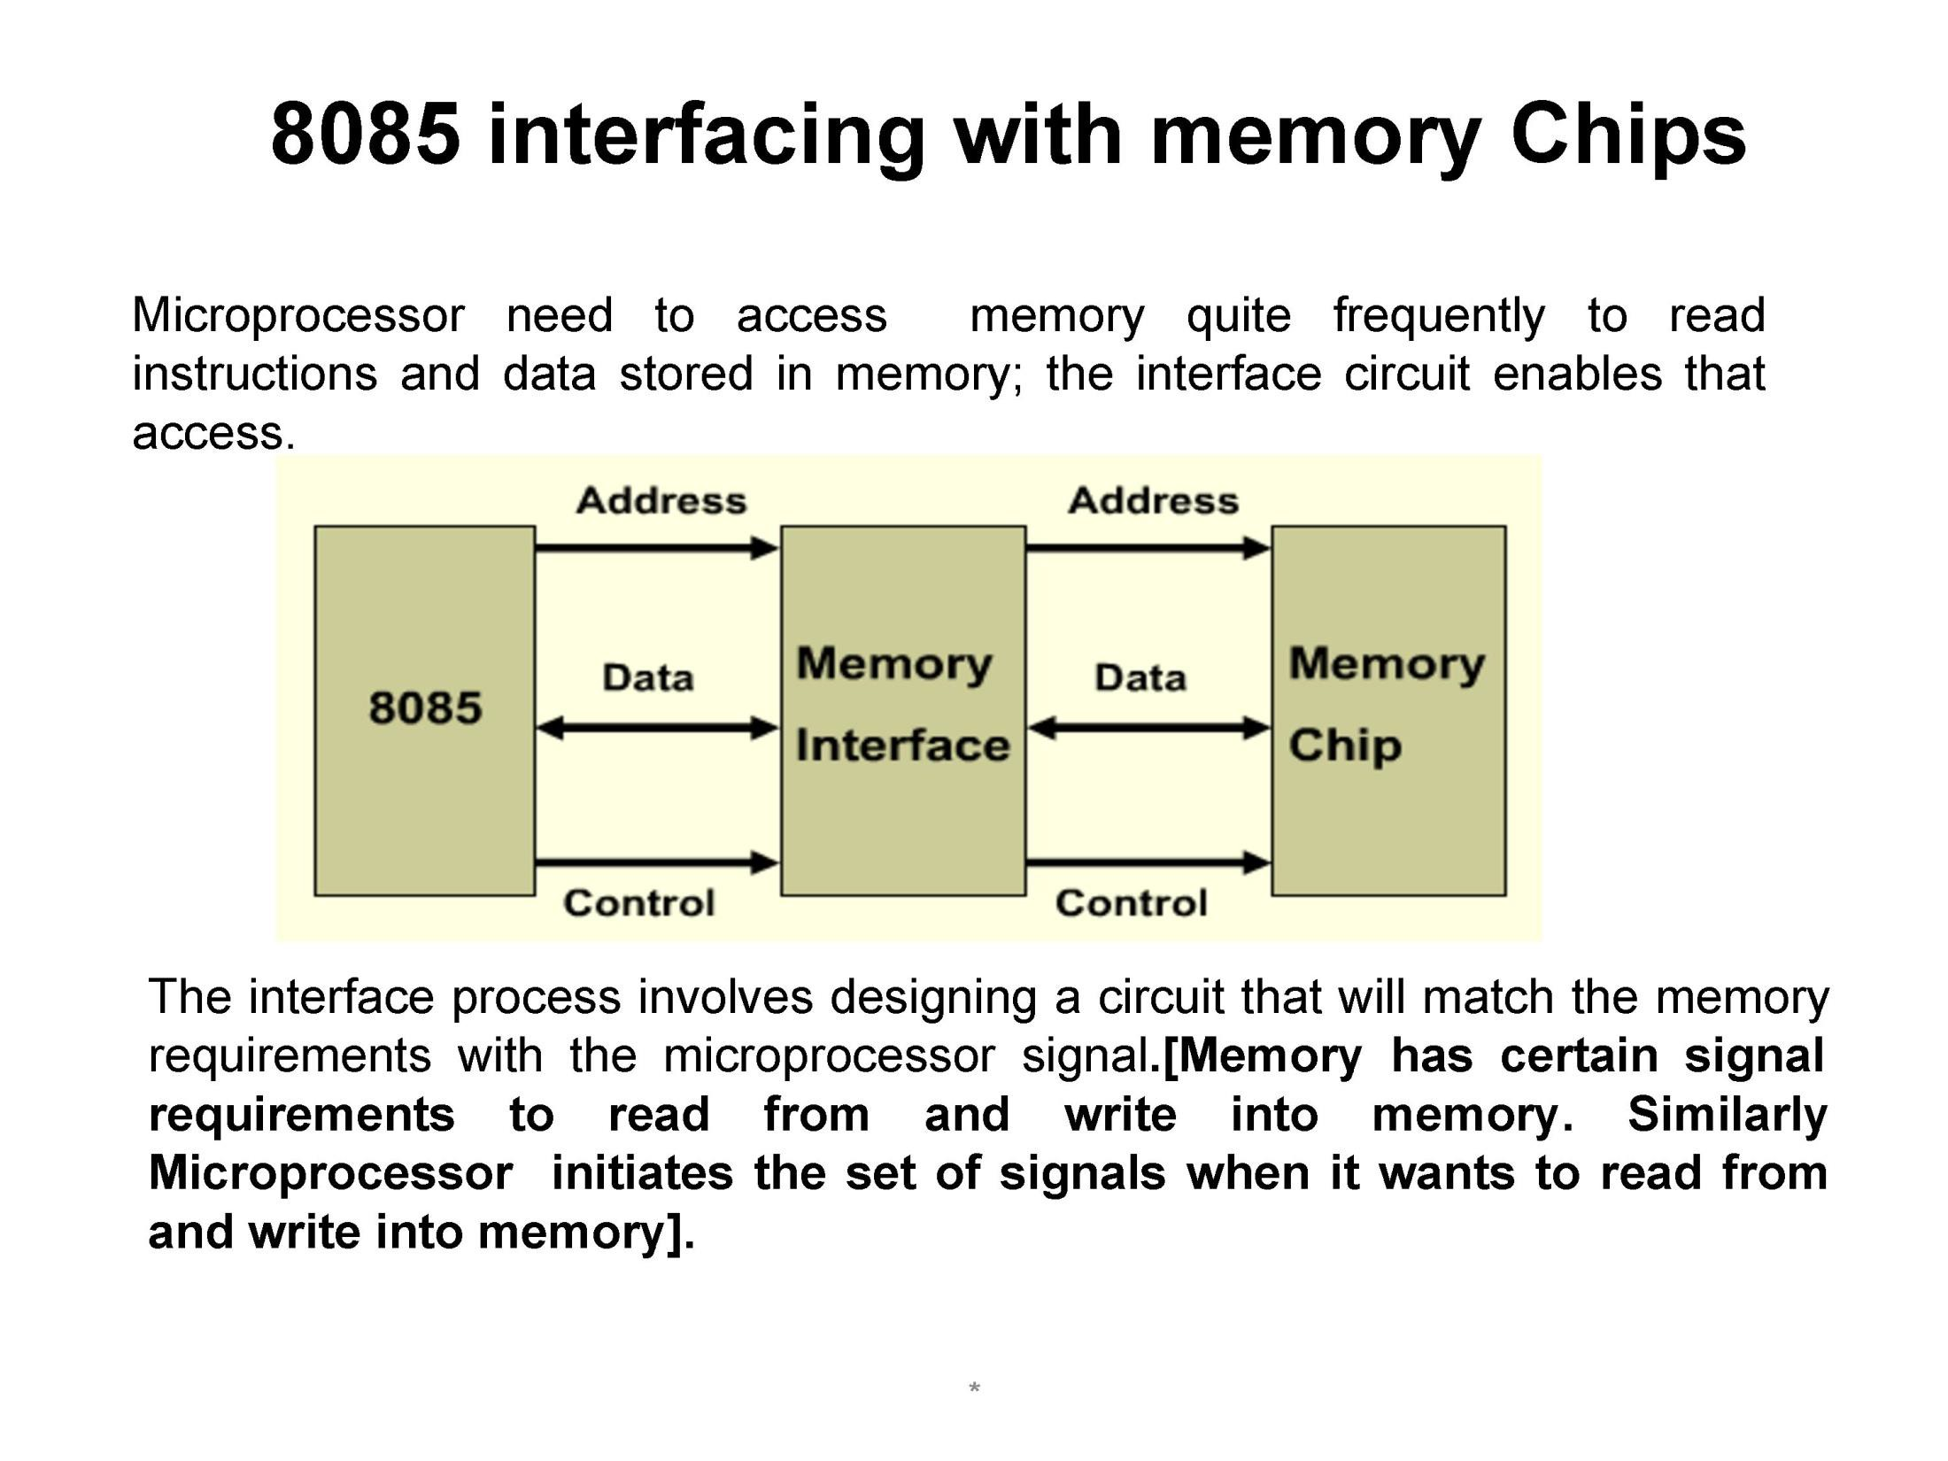

Slide 9
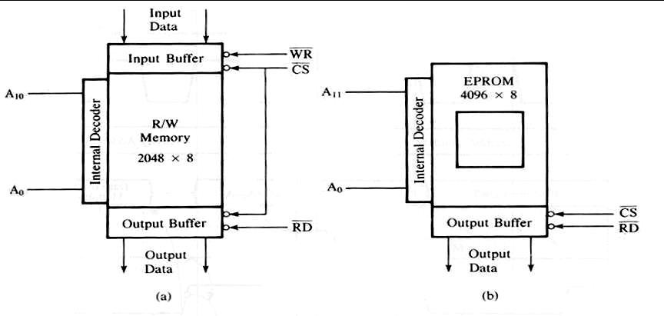
Requirement and memory structure

Slide 10
There are two types of memory:
RAM: read and write.
ROM: read only.
Figure (1a) shows the R/W memory chip:
1. | 2048 (2k) size.
2. | 8 bit data input line and 8 bit data output line.
3. | 11 address lines, A0-A10,
4. | one chip select, CS.
5. | RD: enable output buffer.
6. | WR: enable input buffer.
7. | The internal decoder is used to decode the address. | internal | memory
10

Slide 11
Figure 1b shows the typical diagram of EPROM (Erasable
Programmable ROM):
1. | 4096 (4k) size.
2. | A quartz window on it, program. | that use | to receive | direct light to erase | the
3. | 8 bit data output line.
4. | 12 address lines, A0-A11,
5. | One chip select, CS.
6. | RD: enable output buffer.
7. The internal decoder is used to decode the internal memory address.
The technique to interface R/W and EPROM is the same
except the EPROM does not require WR control signals.

Slide 12
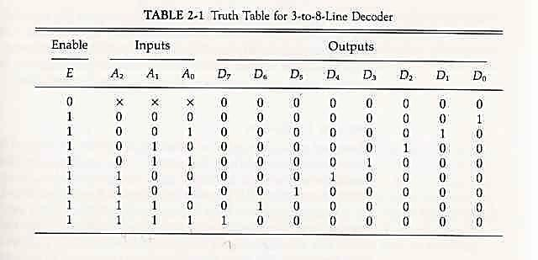

Slide 13
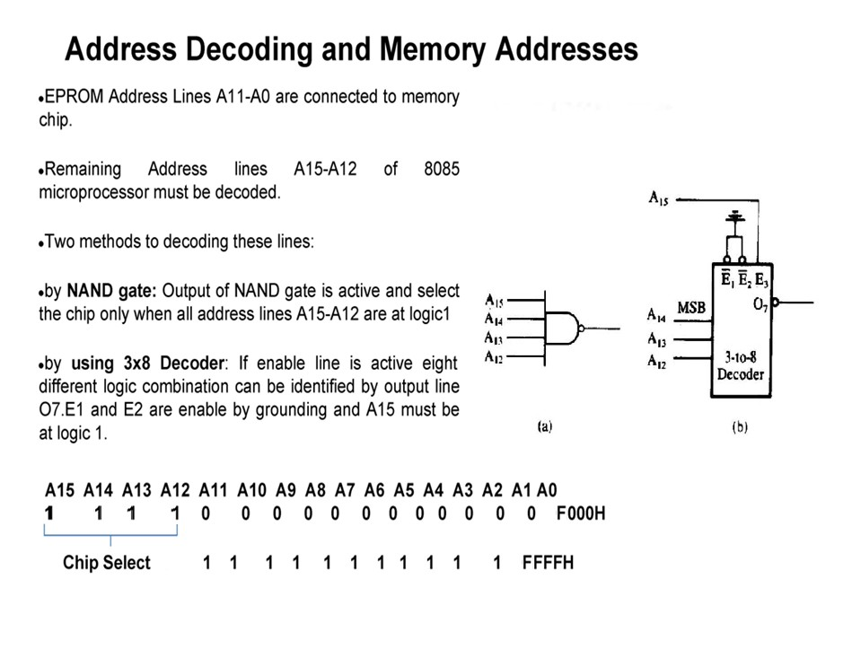

Slide 14
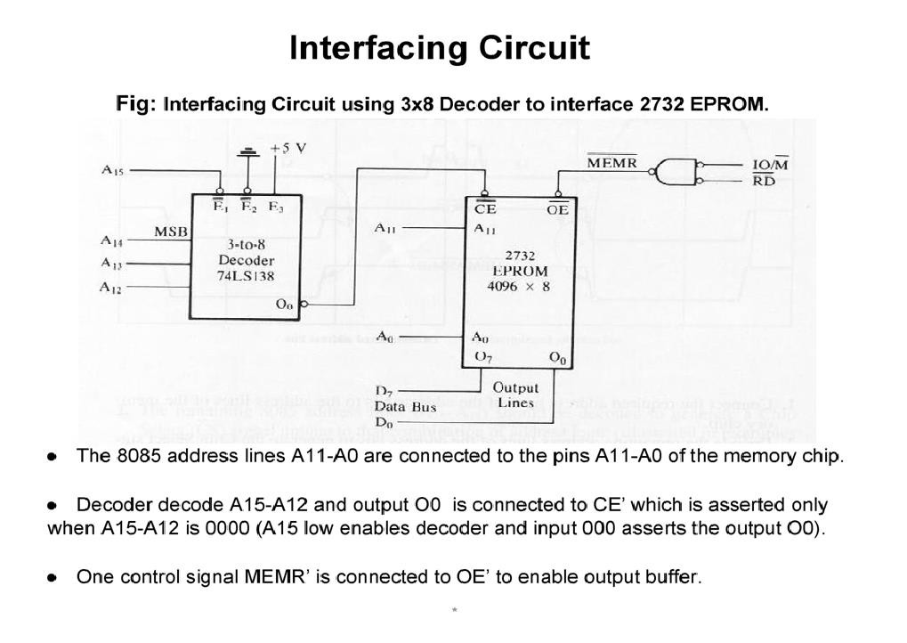

Slide 15
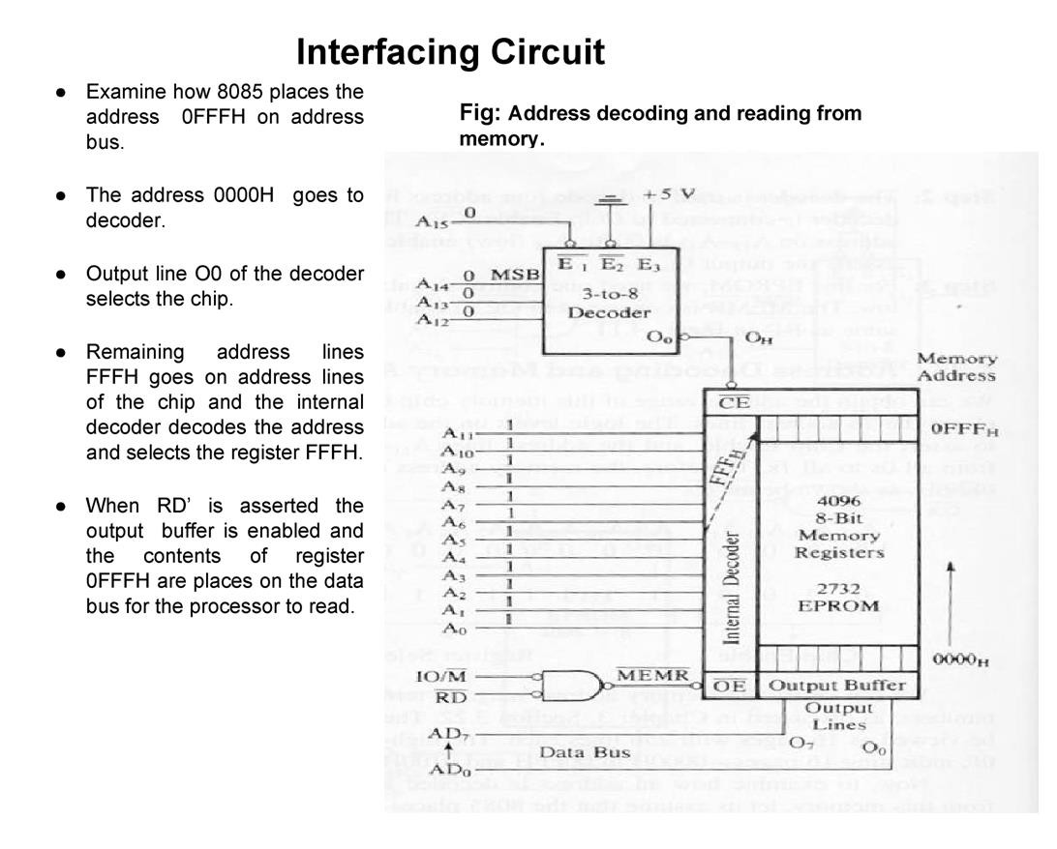

Slide 16
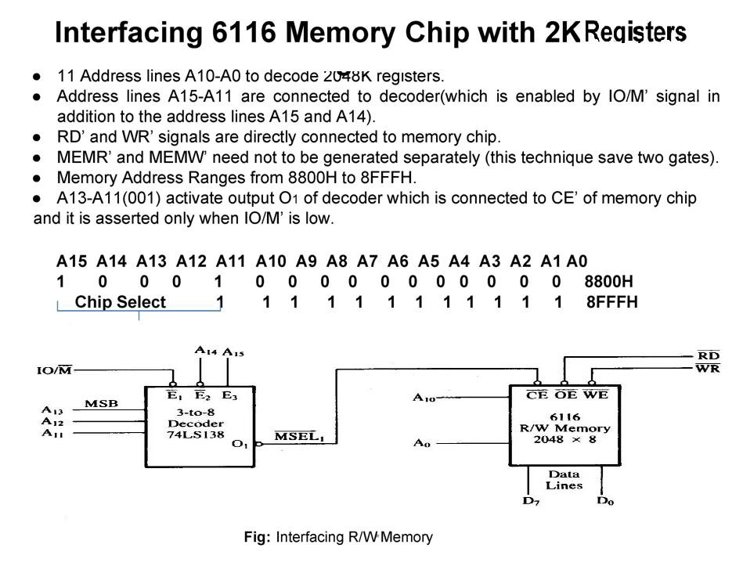

Slide 17
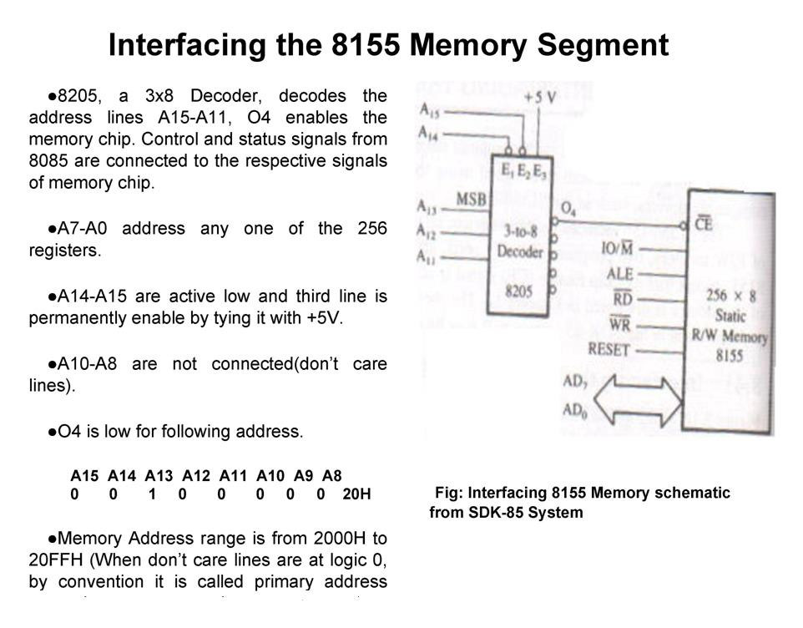

Slide 18
Interfacing Assignment:-
1. if in the interfacing 8155 memory schematic from SDK-85 system figure (Slide 17), the address lines A10 and A9 are assumed to be 0 , A8 is 1 and the O/P line is O5 . find the new memory address rang.
List the steps that are summarized to interface a memory with the 8085 microprocessor. (illustrate the general interfacing concept)
Interface 2Kbytes of Memory to 8085 with starting address
8000H. How memory interfacing can be achieved?

