Slide 1
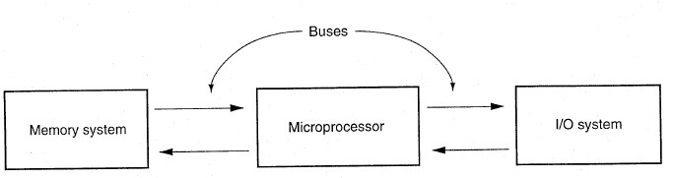
Introduction
A Microprocessor incorporates most or all of the functions of a computer's central processing unit (CPU) on a single integrated circuit. It is the part of the microcomputer that executes instructions of the program and processes data. It is responsible for performing all arithmetic operations and making the logical decisions initiated by the computer’s program. In addition to arithmetic and logic functions, the MPU controls overall system operation.
Figure 1 Microprocessor Based Microcomputer System
The hardware of a microcomputer system can be divided into four functional sections: the Input unit, Microprocessing Unit, Memory Unit, and Output Unit. Input and Output units are the means by which the MPU communicates with the outside world. Input unit can be: keyboard, mouse, scanner, etc. Output unit can be: monitor, printer, etc. Memory unit can be divided into two types Primary which is normally smaller in size and is used for temporary storage of active information (typically ROM, RAM). And Secondary which is normally larger in size and used for long-term storage of information (like Hard disk, Floppy, CD, etc.).
Memory Unit Primary Storage Unit
Program Storage Memory
Data Storage Memory
Secondary Storage Unit
Input Unit
MPU
Output Unit
Figure 2 General Architecture of a Microcomputer System

Slide 2
Basic Definitions
Bit or binary digit is the basic unit of information in computing and telecommunications; it is the amount of information that can be stored by a digital device.
Byte is an ordered collection of bits, in which each bit denotes the binary value of 1 or 0. The size of a byte is typically hardware dependent, but the modern de facto standard is 8 bits, as this is a convenient power of 2. Most of the numeric values used by many applications are representable in 8 bits and processor designers optimize for this common usage.
Word is the maximum number of binary bits in the data that the microprocessor processes. Over time, five standard data widths have evolved for microprocessors: 4-bit, 8-bit, 16-bit, 32-bit, 64-bit.
History of Microprocessors
Microprocessors generally are categorized in terms of their word length. There are so many manufacturers of Microprocessors, but only two companies have been producing popular microprocessors: Intel and Motorola. Table 1 lists some of types that belong to these companies (families) of microprocessors.
The 8086 has data bus width of 16-bit, and is able to address 1Megabyte of memory.
It is important to note that 80286, 80386, 80486, and Pentium-Pentium4 microprocessors are upward compatible with the 8086 Architecture. This means that 8086 code will run on the 80286, 80386, 80486, and Pentium Processors, but the reverse is not true if any of the new instructions are in use.
Beside to the general-purpose microprocessors, these families involve another type called special-purpose microprocessors that used in embedded control applications. This type of embedded microprocessors is called microcontroller. The 8080, 8051, 8048, 80186, 80C186XL are some examples of microcontroller.

Slide 3
Table 1 Some Types of Microprocessors
Type | Data bus width | Memory size
Intel family:
8085 | 8 | 64K
8086 | 16 | 1M
8088 | 8 | 1M
80186 | 16 | 1M
80188 | 8 | 1M
80286 | 16 | 16M
80386SX | 16 | 16M
80386DX | 32 | 4G
80386EX | 16 | 64M
80486 | 32 | 4G + 8 (16 in later models)K cache
Pentium | 64 | 4G + 16K cache
PentiumIII , Pentium4 | 64 | 64G +32K L1 cache +256 L2 cache
Motorola family:
6800 | 8 | 64K
68060 | 64 | 4G + 16K cache
Software Architecture
The 8086 microprocessor employs parallel processing – that implemented with several simultaneously operating processing contains two processing units: the Bus Interface Unit (BIU)
is, it is units. It and the
Execution Unit (EU). Each unit has dedicated functions and both operate at the same time. This parallel processing makes the fetch and execution of instructions independent operations. This results in efficient use of the system bus and higher performance for the microcomputer system.

Slide 4
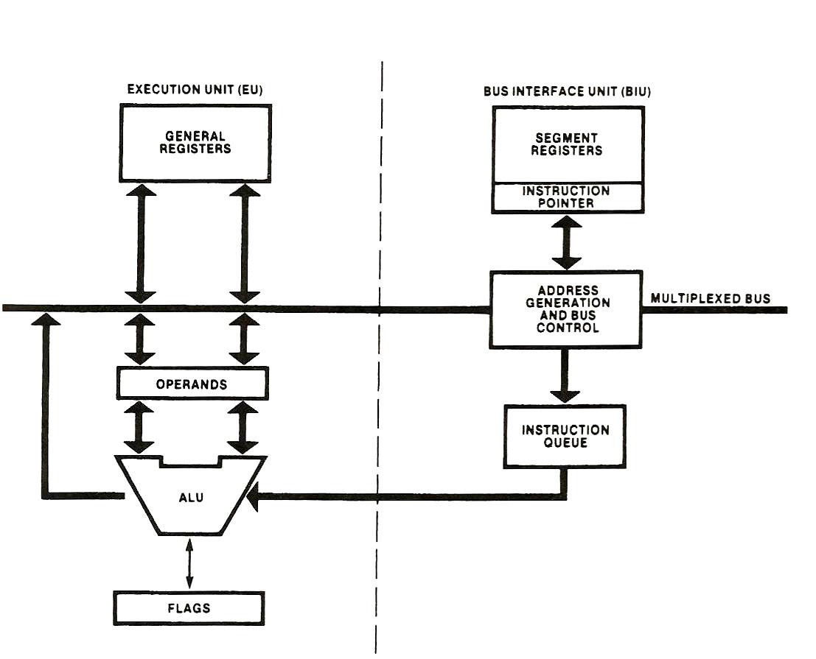
Figure 1 Execution & Bus Interface Units
The BIU is responsible for performing all external bus operations, such as instruction fetching, reading and writing of data operands for memory, address generating, and inputting or outputting data for input/output peripherals. These operations take place over the system bus. This bus includes 16-bit bidirectional data bus, a 20-bit address bus, and the signals needed to control transfer over the bus. It is also responsible for instruction queuing.
The BIU uses a mechanism known as instruction queue to implement a pipelined architecture. This queue permits the 8086 to prefetch up to 6 bytes of instruction code. Whenever the queue is not full, the BIU is free to look ahead in the program by prefetching the next sequential instructions.
The EU is responsible for decoding and executing instructions. It accesses instructions from the output end of the instruction queue and data from the general-purpose registers or memory. It reads one instruction byte after the other from the output of the queue, decodes them, generates data addresses if necessary, passes them to the BIU and requests it to perform the read or write operations to memory or I/O, and perform the operation specified by the instruction.

Slide 5
Input and Output Address Space
The 8086 has separate memory and input/output (I/O) address spaces. The I/O address space is the place where I/O interfaces, such as printer and monitor ports, are implemented. This address range is form 000016 to FFFF16. This represents just 64 Kbyte addresses; therefore, unlike memory, I/O addresses are only 16-bits long.
Memory Address Space and Data Organization
The 8086 supports 1Mbyte of external memory organized as individual bytes of data stored at consecutive addresses over the address range 0000016 to FFFFF16. Therefore, the memory is actually organized as 8-bit bytes. Any two consecutive bytes can be accessed as a word of data (the lower-addressed byte is the least significant byte of the word, and the higher- addressed byte is its most significant byte).
Memory Address | Memory Content
0072416 | 0216
0072516 | 5516
0072616 | D816
0072716 | 1316
0072816 | AF16
0072916 | CC16
0072A16 | 7616
Figure 2 Storing of Data in Memory
The storage location at the lower address 0072416 contains the value 0216. The content of the next higher address storage location 0072516 is 5516. These two bytes represent the word 550216. This word has its least significant byte stored at even address 0072416 so it is called aligned word, otherwise if the least significant byte is stored at odd address, it is called misaligned word. A double word corresponds to four consecutive bytes of data stored in memory.
Memory Segmentation
Even though the 8086 has a 1Mbyte address space, not all this memory is active at one time. Actually, the 1Mbytes of memory are partitioned into

Slide 6
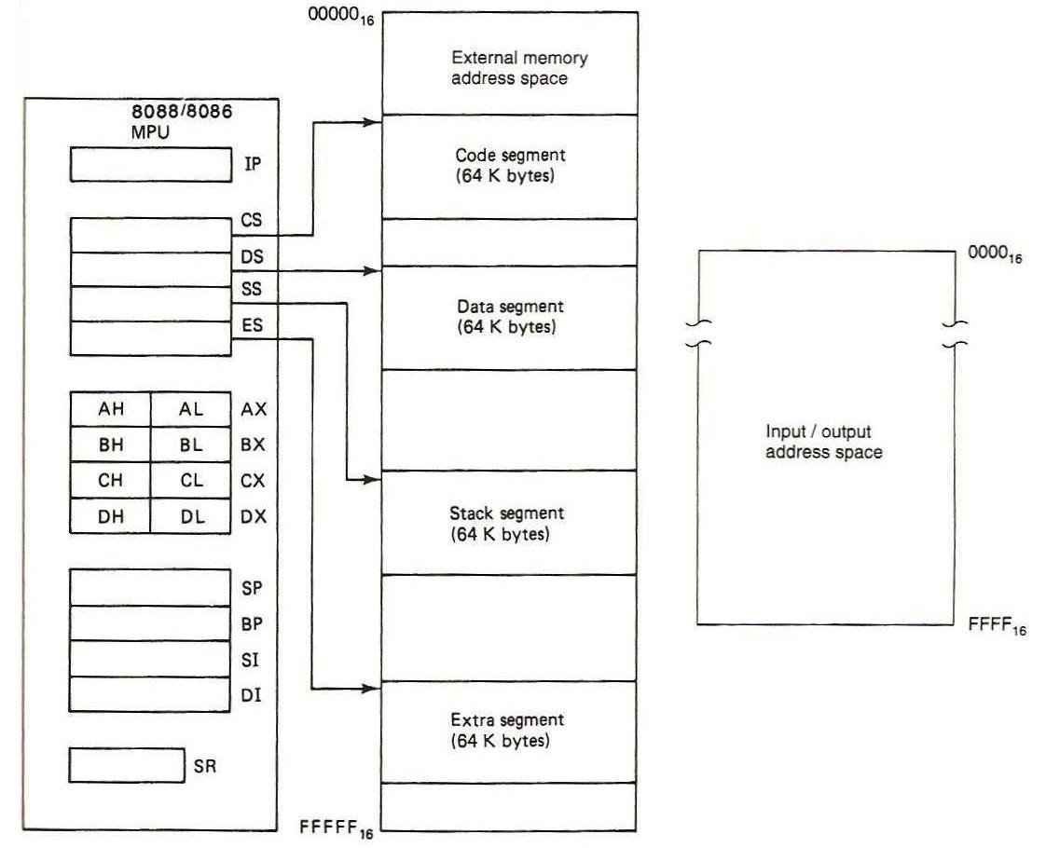
64Kbyte (65,536) segments. A segment represents an independently addressable unit of memory consisting of 64 K consecutive byte-wide storage locations. Each segment is assigned a base address that identifies its starting point (its lowest address byte-storage location). Only four of these 64 Kbytes segments are active at a time: the code segment, stack segment, data segment, and extra segment.
Software Model
The software model of 8086 includes 13 16-bit internal registers: the instruction pointer, four data registers, two pointer registers, two index registers, and four segment registers. In addition, there is status register with nine of its bits implemented as status & control flags.
Figure 3 Software Model of 8086
As can be shown in Figure 3, the 8086 architecture implements independent memory and input/output spaces; the memory address space is 1048576 bytes (1Mbyte) in length and I/O address space is 65536 bytes (64Kbyte) in length.
Internal Registers
o Segment Registers The segments of memory that are active are

Slide 7
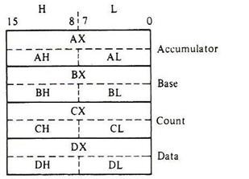
segment registers: CS (code segment), SS (stack segment), DS (data segment), and ES (extra segment). Each of these registers contains a 16-bit base address that points to the lowest addressed byte of the segment in memory.
Instruction Pointer Register It is also 16-bit in length and identifies the location of the next word of instruction code to be fetched from the current code segment of memory. It contains the offset of the next word of instruction code instead of its actual address. Every time a word of code is fetched from memory, the 8086 updates the value in IP such that it points to the first byte of the next sequential word of code (IP incremented by 2).
Data Registers The 8086 has four general purpose data registers: the accumulator register (A), the base register (B), the count register (C), and the data register (D). These names imply special functions they are meant to perform.
Figure 4 General Purpose Data Registers
During program execution they hold temporary values of frequently used intermediate results. The advantage of storing these data in internal registers instead of memory during processing is that they can be accessed much faster. Each of these registers can be accessed either as a whole 16-bit (for word data operations) or as two 8-bit registers (for byte wide data operations). When software places a new value in one byte of a register, for instance AL, the value in the other byte (AH), does not change.
Table 1 Dedicated Registers Functions

Slide 8
Register | operation
AX | Word multiply, word divide, word I/O
AL | Byte multiply, byte divide, byte I/O, translate, decimal arithmetic
AH | Byte multiply, byte divide
BX | Translate
CX | String operations, loops
CL | Variable shift and rotate
DX | Word multiply, word divide, indirect I/O
Pointer Registers They store offset addresses (the displacement of a storage location in memory from the segment base address in a segment register). Software uses the value held in a pointer register to access memory locations relative to the stack segment register. They are only accessed as words. The two pointer registers are: the stack pointer (SP) and base pointer (BP). The value in SP always represents the offset of the next stack location that is to be accessed (Top of Stack). BP also represents an offset relative to the SS. One common use of BP is to reference parameters that are passed to a subroutine by way of the stack.
Indexed Registers They also store offset addresses from the data segment or extra segment registers. They are only accessed as words. For some operations, an operand that is to be processed may be located in memory instead of the internal registers. In this case, an index address is used to identify the location of the operand in memory. The source index (SI) register holds an offset address that identifies the location of a source operand, and the destination index (DI) register holds an offset for a destination operand.
Status Register (flag register) Is 16-bit register in which only nine of its bits are implemented. Six of these bits represent status flags: the carry flag (CF), parity flag (PF), auxiliary flag (AF), zero flag (ZF), sign flag (SF), and overflow flag (OF). The logic state of these status flags indicate conditions that are produced as the result of executing an instruction. The other three flags that provide control functions are: the direction flag (DF), interrupt flag (IF), and trap flag (TF). The instruction set of the 8086 includes instructions for saving, loading, or manipulation the flags.

Slide 9
15 | 14 | 13 | 12 | 11 | 10 | 9 | 8 | 7 | 6 | 5 | 4 | 3 | 2 | 1 | 0
X | X | X | X | OF | DF | IF | TF | SF | ZF | X | AF | X | PF | X | CF
Figure 5 Status Register
The status flags:
The carry flag: CF is set if there is a carry-out or a borrow-in for the most significant bit of the result during the execution of an instruction. Otherwise CF is reset.
The parity flag: PF is set if the result produced by the instruction has even parity (if it contains an even number of bits at the 1 logic level). If parity is odd, PF is reset.
The auxiliary flag: AF is set if there is a carry-out from the low nibble into the high nibble or a borrow-in from the high nibble into the low
nibble of the lower byte in a 16-bit word. Otherwise, AF is reset.
The zero flag: ZF is set if the result produced by an instruction is zero.
Otherwise, ZF is reset.
The sign flag: The MSB of the result is copied into SF. Thus, SF is set if the result is a negative number or reset if it is positive.
The overflow flag: When OF is set, it indicates that the signed result is out of range. If the result is not out of range, OF remains reset.
The control flags:
The trap flag: If TF is set, the 8086 goes into the single-step mode of operation. When in the single-step mode, it executes an instruction and then jumps to a special service routine that may determine the effect of executing the instruction. This type of operation is very useful for debugging programs.
The interrupt flag: For the 8086 to recognize maskable interrupt
requests at its interrupt (INT) input, the IF flag must be set. When IF is reset, requests at INT are ignored and the maskable interrupt interface is disabled.
The direction flag: The logic level of DF determines the direction in which string operations will occur. When set, the string instructions automatically decrement the address; therefore the string data transfers proceed from high address to low address. On the other hand, resetting
DF causes the string address to be incremented (data transfers proceed from low address to high address).

Slide 10
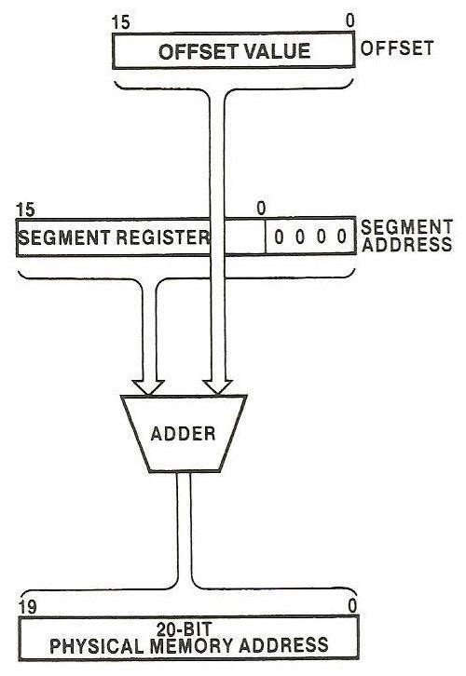
Generating a Memory Address
A segment base and an offset describe a logical address; both are 16-bit quantities. However, the physical address that is used to access memory is 20- bits in length. The generation of the physical address involves combining a 16-bit offset value (located in IP, BX, SI, DI, SP, or BP) and a 16-bit segment base value (located in CS, DS, SS, or ES).
The segment base address represents the starting location of the 64 Kbyte segment in memory – that is, the lowest address byte in the segment. The offset identifies the distance in bytes that the storage location of interest resides from this starting address. Therefore, the lowest address byte in a segment has an offset of 000016, and the highest address byte has an offset of FFFF16.
To obtain the physical address, the value in the segment register is shifted left by four bits (with its LSBs filled with zeros). The offset value is then added. The result of this addition is 20-bit physical address.
Figure 6 Generating a Physical Address
Ex. 1 What is the physical address if a segment base value is 123416 and an offset value 002216?
Sol.
First, express the segment base value in binary form
123416 = 00010010001101002
Then, shift it left four positions
000100100011010000002 = 1234016
10

Slide 11
Then add the offset
1234016 + 002216 = 1236216
Note that the result is 20-bit. This address calculation is done automatically within 8086 microprocessor each time a memory access is initiated.
Ex. 2 What would be the offset required to map to physical address location 002C316 if the content of the corresponding segment register is 002A16?
Sol.
The offset value can be obtained by shifting the content of the segment register left by four bit positions and then subtracting from the physical address. Shifting left gives
002A016
Now subtract it from the physical address
002C316 – 002A016 = 002316
Many different logical addresses map to the same physical address location in memory. If a segment register contains 002B16 with offset 001316, it will map to the same physical address in the above example. Try base segment 002C16 with a new offset of 000316.
Software
A microcomputer does not know how to process data, it must be told where to get data, what to do with the data, and where to put the results when it is done. These are the jobs of the software. The sequence of commands to tell a microcomputer what to do is called a program. Each command in a program is an instruction.
Programs must always be coded in machine language before they can be executed by the microprocessor. A program written in machine language is often referred to as machine code (instruction is encoded using 0s and 1s). It is almost impossible to write programs directly in machine language. For this

Slide 12
reason, programs are normally written in 8086 assembly language or a high- level language such as C. In assembly language, each of the operations is described with alphanumeric symbols instead of 0s and 1s.
An instruction can be divided into two parts: operation code (opcode) and operands. The opcode is the part of instruction that identifies the operation that is to be performed (add, subtract, move, …). Each opcode is assigned a unique letter combination called a mnemonic (ADD, SUB, MOV, …). Operands describe the data are to be processed as the microprocessor carries out the operation specified by the opcode. They identify whether the source and destination of the data are registers within the MPU or storage locations in data memory.
The assembler is the program that translates the assembly language programs to an equivalent machine language program for execution by microprocessor. The compiler is the program that converts high-level language statements to machine code instructions.
Addressing modes
An addressing mode is a method of specifying an operand. The 8086 is provided with various addressing modes to access operands. The data may be part of the instruction, may reside in one of the internal registers, may be stored in memory, or may be held at an I/O port. The addressing modes are categorized as following:
Register operand addressing mode.
Immediate operand addressing mode. 3- Memory operand addressing modes;
  Direct addressing mode.
  Register indirect addressing mode. c- Based addressing mode.
Indexed addressing mode.
Based-indexed addressing mode.

Slide 13
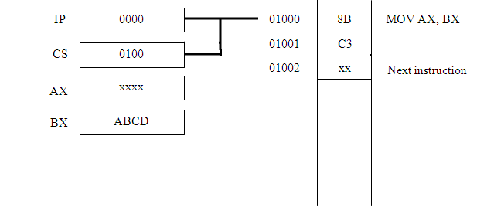
o Register operand addressing mode the operand to be accessed is specified as residing in an internal register. For example:
MOV AX, BX
This stands for “move the content of BX (source operand) to AX (destination operand)”. Both operands have been specified as the word content of internal registers. Assume the following values in registers and memory just prior to execute the above instruction
Address
Memory Instruction content
The result of executing the instruction is that the content of BX (the value ABCD) is copied into AX as shown below
Address
Memory content
Instruction

Slide 14
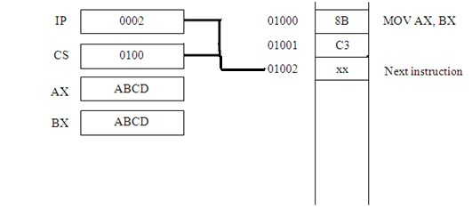
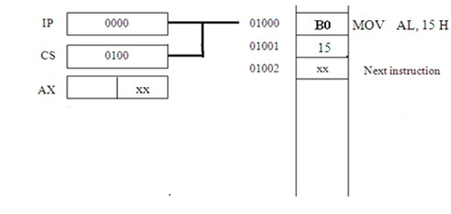
o Immediate operand addressing mode the operand to be accessed is part of instruction instead of the content of a register or memory location. It can be 8-bit or 16-bit in length. This addressing mode can only be used to specify a source operand. For example:
MOV AL, 15H
Address
Memory Instruction content
The result produced by executing this instruction is that the immediate operand (15H) is loaded into the lower byte of accumulator (AL).
Address
Memory content
Instruction

Slide 15
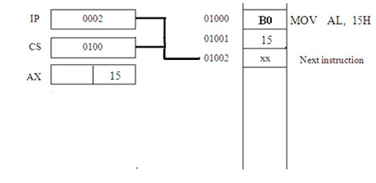
o Memory operand addressing modes to reference an operand in memory, the 8086 must calculate the physical address of the operand and then initiate a read or write operation of this storage location. 8086 is provided with group of memory addressing modes:
a- Direct addressing mode the instruction op-code is followed by effective address. For example:
MOV CX, [1234H]
This stands for “move the content of memory location with offset 1234H in the current data segment to CX”. Assume the following values in registers and memory just prior to execute the above instruction
Address
Memory
Instruction

Slide 16
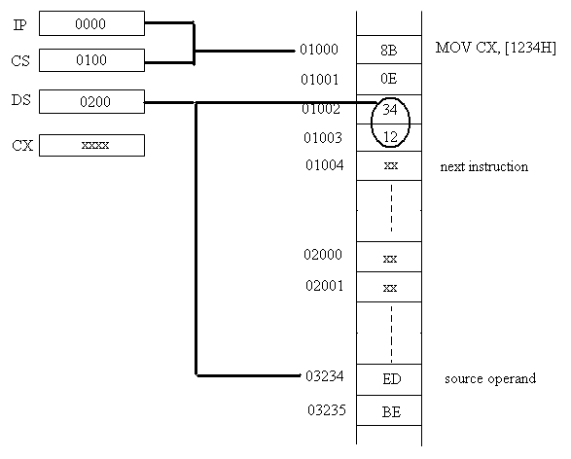
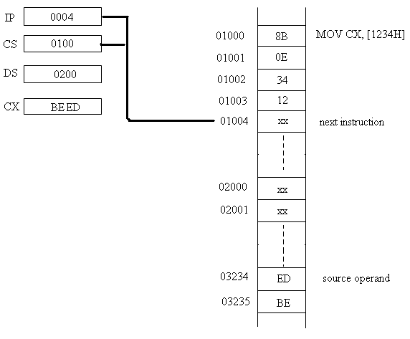
content
As the instruction is executed, the 8086 combines 1234H with 0200H to get physical address of source operand. Then it reads the word of data starting at this address (BEEDH) and loads it to the CX register.
Address
Memory Instruction content
b- Register indirect addressing mode the effective address resides in either a base register (BX or BP) or an index register (SI or DI). For example:

Slide 17
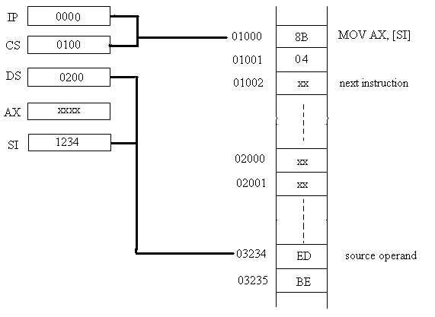
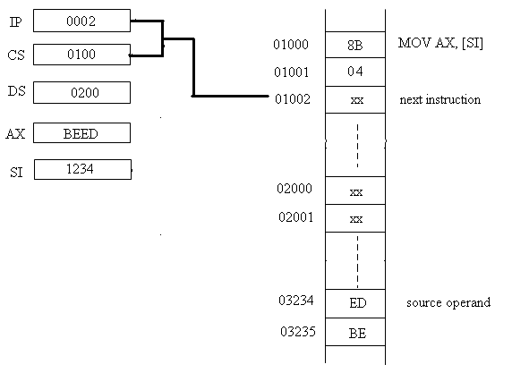
MOV AX, [SI]
Execution of this instruction moves the content of memory location whose offset is in register SI into AX register.
Address
Memory Instruction content
Address
Memory content
Instruction
c- Based addressing mode the effective address of the operand is obtained by adding a direct displacement to the content of either BX or BP register. For example:

Slide 18
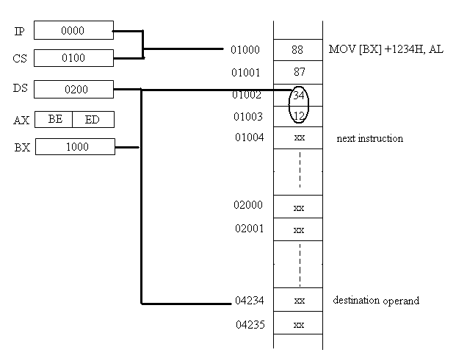
MOV [BX] + 1234H, AL
The physical address of the destination operand is obtained from the contents of DS, BX, and the direct displacement then the content of AL is written into this location.
Address
Memory Instruction content
If BP is used instead of BX, the calculation of the physical address is performed using the content of the stack segment register instead of data segment.
Address
Memory content
Instruction

Slide 19
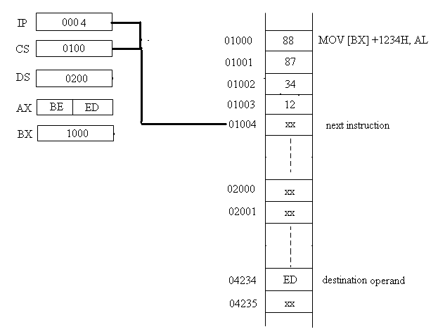
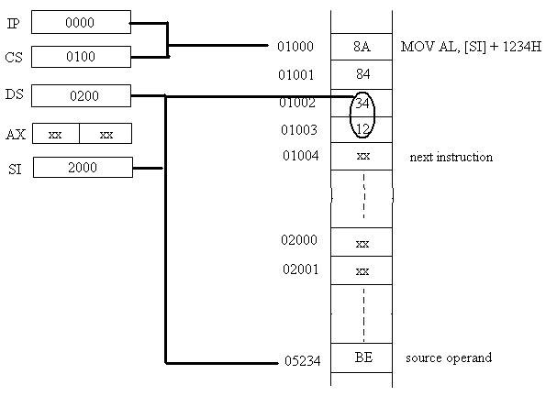
d- Indexed addressing mode the physical address is obtained from the value in a segment register, an index register (SI or DI), and a displacement. For example:
MOV AL, [SI] + 1234H
Address
Memory Instruction content
First the physical address of the source operand is calculated from the contents of DS, SI, and the direct displacement. The byte stored at this location is read into AL.

Slide 20
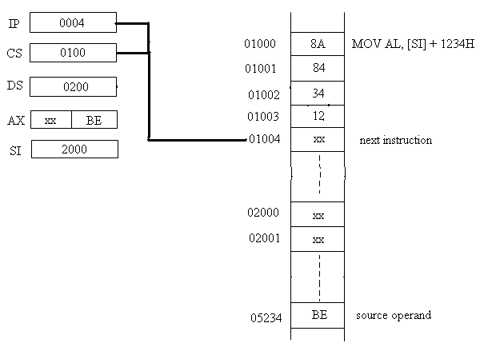
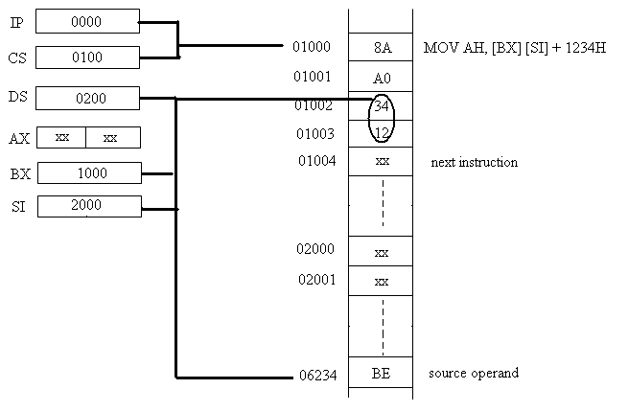
Address
Memory content
Instruction
e- Based-indexed addressing mode combines the based and addressing modes. For example:
MOV AH, [BX] [SI] + 1234H
indexed
Address
Memory Instruction content
The physical address of the source operand is computed from the current content of DS, BX, SI, and the direct displacement. Execution of the
instruction causes the value stored at this location to be read into AH.
20

Slide 21
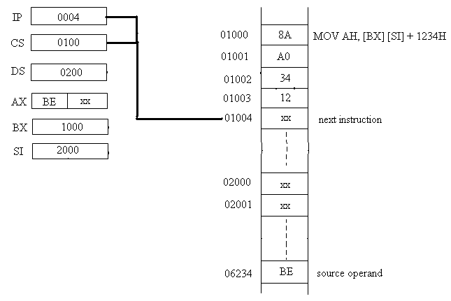
Address
Memory content
Instruction
The 8086 Instruction Set
The microprocessor’s instruction set defines the basic operations that a programmer can specify to the device to perform. The instructions are

Slide 22
organized into groups of functionality related instructions. The instruction set is categorized as following
8086 Instruction Set
Integer instructions
1- Data transfer instructions 2- Arithmetic instructions
Logic instructions
Shift instructions
Rotate instructions
Control flow instructions
Flag-control instructions
Compare instruction
Jump instructions
Subroutine-handling instructions
Loop-handling instructions
String-handling instructions
Integer Instructions
1- Data Transfer Instructions
The 8086 has group of data-transfer instructions provided to move data either between its internal registers or between an internal register and a storage location in memory. This group includes:
o MOV Instruction transfers data from a source operand to a destination operand. It cannot transfer data directly between a source and a destination which both reside in memory; instead, the data must first be moved from memory into an internal register with one MOV instruction and then moved to the new location in memory with a second MOV instruction. The fact that the instruction corresponds to byte or word data is designated by the way in which operands are specified.

Slide 23
Mnemonic | Meaning | Format | Operation | Flags affected
MOV | Move | MOV D, S | (S) (D) | None
The immediate data cannot be directly loaded into a segment register; it must be first loaded to AX then copied into the appropriate segment register.
Examples on MOV instruction:
MOV DX, CS
it stands for “move the content of CS into DX”.
Assume CS= 0100H, execution of this instruction makes DX= CS= 0100H
MOV [1212H], AX
it stands for “move the content of AX to the memory
location whose offset is 1212H from the starting of the current data segment”. Assume DS= 0200H, then the effect of this instruction is:
(AL)
(Memory location 03212H) and
(AH)
(Memory location 03213H)
Ex. 1 What is the effect of executing the instruction: MOV CX, [0020H] where DS= 1A00H?
Sol.
((DS)0 + 0020H) (CL) ((DS)0 + 0020H + 1H)
(CH)
In other words CL is loaded with the content of memory location 1A020H, and CH with the content of memory location 1A021H.

Slide 24
o XCHG Instruction is used to exchange the contents of two registers or register with storage location in memory (this can also be done using multiple MOV instructions). It is used to swap data between source and destination operands.
Mnemonic | Meaning | Format | Operation | Flags affected
XCHG | Exchange | XCHG D, S | (S) (D) | None
Ex. 2 What is the result of executing the instruction: XCHG [1234H], BX where DS= 1200H, BX= 11AAH, content of memory at offset [1234H]=
FFH, and at [1235H]= 00H?
Sol.
((DS)0 + 1234H) (BX)
Execution of this instruction performs the following 16-bit swap
(13234H) (13235H)
(BL)
(BH)
BX= 00FFH, [13234H]= AAH, and [13235H]= 11H
o XLAT Instruction the translate instruction is provided to simplify implementation of the look-up table operation. When using XLAT, the content of BX represents the offset of the starting address of the look- up table from the beginning of the current data segment. The content of AL represents the offset of the element to be accessed from the beginning of the look-up table. This 8-bit element address permits a table with up to 256 elements. The values in both registers must be initialized prior to execution of XLAT instruction.
Mnemonic | Meaning | Format | Operation | Flags affected
XLAT | Translate | XLAT | ((AL) + (BX) + (DS)0) (AL) | None

Slide 25
Execution of XLAT replaces the content of AL by the content of the accessed look-up table location. It is used for code conversions.
Ex. 3 What is the result of executing the instruction: XLAT
where DS= 0300H, BX= 0100H, AL= 3FH, and the content of memory location [0313FH]= 6FH?
Sol.
((DS)0 + (BX) + (AL)) (AL) (03000H + 0100H + 3FH) (AL) (0313FH) (AL)
AL= 6FH
o LEA, LDS, LES Instructions these instructions give the programmer the ability to load a segment and general purpose register with an address directly from memory. They are: load register with effective address (LEA), load register and data segment register (LDS), and load register and extra segment register (LES). They either load a 16-bit offset address into general purpose register or a 16-bit offset address into general purpose register together with a 16-bit segment address into either DS or ES.
Mnemonic | Meaning | Format | Operation | Flags affected
LEA | Load effective address | LEA reg16, EA | EA (Reg16) | None
LDS | Load register & DS | LDS reg16, EA | EA (Reg16) EA + 2 (DS) | None
LES | Load register & ES | LES reg16, EA | EA (Reg16) EA + 2 (ES) | None
LDS and LES are able to load a complete address pointer that is stored in memory (executing them can activate a new data segment and extra segment).

Slide 26
Ex. 4 What is the result of executing the instruction: LEA SI, [DI + BX + 5H]
where DI= 1000H, and BX= 0020H?
Sol.
SI= 1000H + 20H + 5H SI= 1025H
Ex. 5 What is the result of executing the instruction: LDS SI, [0200H]
where DS= 1200H, content of memory location [12200H]= 20H, at [12201H]= 00H, at [12202H]= 00H, and at [12203H]= 13H?
Sol.
((DS)0 + 0200H)
(SI)
(1200H + 0200H) (12200H) (SI)
(SI)
SI= 0020, DS= 1300H
2- Arithmetic Instructions

Slide 27
The instruction set of 8086 contains a variety of arithmetic instructions; they include instructions for addition, subtraction, multiplication, and division operations.
Addition Instructions
Mnemonic | Meaning | Format | Operation | Flags affected
ADD | Addition | ADD D, S | (S) + (D) (D) Carry (CF) | OF, SF, ZF, AF,PF, CF
ADC | Add with carry | ADC D, S | (S) + (D) + (CF) (D) Carry (CF) | OF, SF, ZF, AF,PF, CF
INC | Increment by 1 | INC D | (D) + 1 (D) | OF, SF, ZF, AF,PF
AAA | ASCII adjust for addition | AAA |  | AF, CF (OF, SF, ZF, PFundefined)
DAA | Decimal adjust for addition | DAA |  | (SF, ZF, AF, PF, CF, OF undefined)
o ADD Instruction used to add an immediate operand to the content of the accumulator, the content of another register, or the content of a storage location in memory. It also allows addition of the content of two registers or the content of a register and a storage location in memory.
Ex. 1 Assume AX= 1100H, BX= 0ABCH. What is the result of executing the instruction ADD AX, BX?
Sol.
(AX) + (BX) = 1100H + 0ABCH = 1BBCH AX = 1BBCH, CF = 0

Slide 28
ADC Instruction works similarly to the ADD instruction, but in this case, the content of the carry flag is also added. It is primarily used for multiword add operations.
(S) + (D) + (CF) (D)
INC Instruction adds 1 to the specified operand. It is typically used to increment the values of a count or address. Its operands can be the content of a 16-bit register or 8-bit register or a storage location in memory. For example
INC AH
Ex. 2 Assume AX= 1234H, BL= ABH, the word-size memory location SUM = 00CDH, CF = 0H. Describe the result of executing the following sequence of instructions.
ADD AX, [SUM] ADC BL, 05H
INC WORD PTR [SUM]
Sol.
Executing the first instruction adds the word in accumulator and the word in the memory location pointed to by address SUM. The result is placed in accumulator.
(AX) (AX) + (SUM) AX = 1234H + 00CDH
AX = 1301H, CF = 0
The second instruction adds to the lower byte of the base register (BL) the immediate data operand 5H and the carry flag (which equals 0H).

Slide 29
(BL)
(BL) + immediate (8-bit) + (CF)
BL = ABH + 5H + 0H BL = B0H, CF = 0
The last instruction increments the content of memory location SUM by 1. (SUM) (SUM) + 1H
(SUM) = 00CDH + 1H (SUM) = 00CEH
o AAA Instruction the previous addition instructions can also be used to add numbers expressed in ASCII code, provided the binary result that is produced is converted back to its equivalent ASCII representation. The AAA instruction should be executed immediately after the ADD instruction that adds ASCII data. AAA can adjust only data that are in AL, therefore; the destination register for ADD instructions that process ASCII numbers should be AL. Executing AAA instruction causes the content of AL to be replaced by its equivalent decimal value. It can affect the AF and CF.
Ex. 3 Assume AL= 32H (the ASCII code for number 2), BL= 34H (the ASCII code for number 4), what is the result of executing the following instructions sequence?
ADD AL, BL AAA
Sol.
Executing the first instruction gives

Slide 30
AL = 32H + 34H AL = 66H
Next, the result is adjusted to give its equivalent decimal number by executing AAA instruction. The equivalent of adding 2 and 4 is decimal 6 with no carry.
AL = 06H, CF = 0, AF = 0
o DAA Instruction used to perform an adjust operation similar to AAA but for the addition of packed BCD numbers instead of ASCII numbers. The adjustment is performed on the value in AL. For example
ADD AL, BL DAA
The contents of AL and BL must be packed BCD numbers (two BCD digits packed into a byte). The adjusted result in AL is again a packed BCD byte.
Ex. 4 Write a program that performs the addition of FEDCBA98H (32-bit addition).
01234567H and
Sol.
(DX, CX) = FEDCBA98H (BX, AX) = 01234567H
(DX, CX)
(DX, CX) + (BX, AX)
MOV DX, 0FEDCH MOV CX, 0BA98H MOV BX, 0123H
30

Slide 31
MOV AX, 4567H ADD CX, AX ADC DX, BX
The first add instruction adds the least significant 16-bits of the 32-bit numbers. Note that the result is in CX and CF. To add the most significant 16- bits, we must account for the possibility of a carry in from the addition of least significant 16-bits. For this reason, the ADC instruction was used.
Subtraction Instructions
Mnemonic | Meaning | Format | Operation | Flags affected
SUB | Subtract | SUB D, S | (D) - (S) (D) Borrow (CF) | OF, SF, ZF, AF,PF, CF
SBB | Subtract with borrow | SBB D, S | (D) - (S) - (CF) (D) Borrow (CF) | OF, SF, ZF, AF,PF, CF
DEC | Decrement by 1 | DEC D | (D) - 1 (D) | OF, SF, ZF, AF,PF
NEG | Negate | NEG D | 0 – (D) (D) 1 (CF) | OF, SF, ZF, AF,PF, CF
DAS | Decimal adjust for subtraction | DAS |  | SF, ZF,AF, PF, CF (OF undefined)
AAS | ASCII adjust for subtraction | AAS |  | AF, CF (OF, SF, ZF, PF undefined)
o SUB Instruction used to subtract the value of a source operand from a destination operand. The borrow-in that may occur from the most significant bit is reflected in the carry flag.

Slide 32
o SBB Instruction it is similar to the SUB (subtracts source operand from destination operand), it also subtract the carry flag from the destination. SBB is primarily used for multiword subtract operations.
Ex. 5 BX = 1234H, CX = 0123H, and CF = 0. What is the result of executing SBB BX, CX?
Sol.
(BX) – (CX) – (CF) (BX) 1234H – 0123H – 0 = 1111H
BX = 1111H, CF = 0
(since no borrow needed)
DEC Instruction used to subtract 1 from its operand.
NEG Instruction it causes the value of its operand to be replaced by its negative (the operand is subtracted from zero). The subtraction is performed by the processor hardware using 2’s-complement arithmetic. To obtain the correct value of the carry flag that results from a NEG operation, the carry flag generated by the add operation used in the 2’s- complement subtraction must be complemented. NEG instruction can work on operands in general-purpose register or a storage location in memory.
Ex. 6 BX = 003AH. What is the result of executing NEG BX?
Sol.
(BX) = 0000H – (BX)

Slide 33
BX= 0000H + 2’s complement (003AH)
= 0000H + FFC6H
BX = FFC6H, CF = 1
(since no carry is generated by the 2’s comp.,
the carry flag is complemented)
DAS Instruction used to adjust the result of subtracting two packed BCD numbers to produce the corresponding decimal number. The result of subtraction must be stored in AL register.
AAS Instruction used to adjust the result of subtracting two ASCII numbers to produce the corresponding decimal number. The result of subtraction must be stored in AL register.
Ex. 7 Write program to subtract two 32-bit numbers (X – Y) stored in memory as
X = (DS:0203H)(DS:0202H)(DS:0201H)(DS:0200H) Y = (DS:0103H)(DS:0102H)(DS:0101H)(DS:0100H)
The result is to be saved in the place where X is stored in memory.
Sol.
MOV AX, [0200H] SUB AX, [0100H] MOV [0200H], AX
MOV AX, [0202H]
SBB AX, [0102H] MOV [0202H], AX

Slide 34
Multiplication and Division Instructions
Mnemonic | Meaning | Format | Operation | Flags affected
MUL | Multiplication (unsigned) | MUL S | (AL).(S8) (AX) (AX).(S16) (DX),(AX) | OF, CF (SF, ZF, AF, PF undefined)
DIV | Division (unsigned) | DIV S | (1) Q((AX)/(S8)) (AL) R((AX)/(S8)) (AH) (2) Q((DX,AX)/(S16)) (AX) R((DX,AX)/(S16) (DX) If Q exceeds FFH in case (1) or FFFFH in case (2), then type0 interrupt occurs | (OF, SF, ZF, AF, PF, CF undefined)
IMUL | Integer multiplication (signed) | IMUL S | (AL).(S8) (AX) (AX).(S16) (DX),(AX) | OF, CF (SF, ZF, AF, PF undefined)
IDIV | Integer division (signed) | IDIV S | (1) Q((AX)/(S8)) (AL) R((AX)/(S8)) (AH) (2) Q((DX,AX)/(S16)) (AX) R((DX,AX)/(S16) (DX) If Q is positive and exceeds 7FFFH or if Q is negative and becomes less than 8001H, then type0 interrupt occurs | (OF, SF, ZF, AF, PF, CF undefined)
AAM | Adjust AL for multiplication | AAM | Q((AL)/10) (AH) R((AL)/10) (AL) | SF, ZF, PF (OF, AF, CF undefined)
AAD | Adjust AX for division | AAD | (AH).10 + (AL) (AL) 00 (AH) | SF, ZF, PF (OF, AF, CF undefined)
CBW | Convert byte to word | CBW | (MSBit of AL) (All bits of AH) | None
CWD | Convert word to double word | CWD | (MSBit of AX) (All bits of DX) | None
MUL Instruction used to multiply unsigned numbers. A single byte- wide or word-wide source operand is specified in a multiplication instruction, the other operand (destination) is already assumed to be in AL for 8-bit multiplication or AX for 16-bit multiplication. The result is stored in AX for 8-bit multiplication, and in DX, AX for 16-bit multiplication. The source operand can be register or content of memory location.
IMUL Instruction same as MUL instruction but used to multiply signed numbers.

Slide 35
Ex. 8
AX = 0F195H, BX = 8147H. What result is produced in AX by
executing MUL BL ; IMUL BL ; IMUL BX?
Sol.
MUL BL
AX AL * BL AX = 95H * 47H
AX = 2953H
IMUL BL
AX 2’s-comp.(AL) * BL
AX = 6BH * 47H AX = 1DADH
(Since multiplying different sign numbers gives negative result, take the 2’s-comp. of result)
AX = E253H
IMUL BX DX,AX
2’s- comp.(AX) * 2’s-comp.(BX)
DX,AX = 0E6BH * 7EB9H
(Since multiplying similar sign numbers gives positive result, no need to take the 2’s-comp.)
DX,AX = 7231553H
AX = 1553H DX = 0723H
o DIV Instruction used to divide unsigned numbers. Again just the source operand is specified. The other operand is either AX for 16-bit dividends or both DX and AX for 32-bit dividends. The quotient of dividing 16-bit dividend by 8-bit divisor is stored in AL and the remainder stored in AH. The quotient of dividing 32-bit dividend by

Slide 36
16-bit divisor is stored in AX and the remainder stored in DX. The source operand can be register or content of memory location.
o IDIV Instruction same as DIV instruction but used to divide signed numbers.
Ex. 9
AX = 1250H, BX = 0190H. What result is produced in AX by
executing DIV BL ; IDIV BL?
Sol.
DIV BL
AL Q(AX /BL)
AH R(AX /BL) AL = 20H
AH = 50H
AX = 5020H
IDIV BL
AL Q(AX/ 2’s-comp.(BL))
AH R(AX/ 2’s-comp.(BL)) AL = Q(1250H/70H)
AH = R(1250H/70H) AL = 29H
AH = 60H
(Since dividing different sign numbers gives negative result, take the 2’s-comp.(29H))
AL = D7H
AX = 60D7H

Slide 37
AAM Instruction adjusts AL after multiplying unpacked BCD numbers. It must be included directly after the multiply instruction of BCD numbers.
AAD Instruction adjusts AX before dividing unpacked BCD numbers.
It must be included directly before the divide instruction of BCD numbers.
CBW Instruction extends the sign of the dividend to fill AX register (the sign extension does not change the value for the data).
CWD Instruction extends the sign of the dividend to fill DX register (the sign extension does not change the value for the data).
The last two instructions are used to allow division of 8-bit dividend in AL by 8-bit divisor and 16-bit dividend in AX by 16-bit divisor
Ex. 10 What is the result of executing the following instructions? MOV AL, 0A1H
CBW CWD
Sol.
AL = A1H = 1010 00012
CBW extends the MSBit of AL into all bits of AH AX = FFA1H = 1111 1111 1010 00012
CWD extends the MSBit of AX into all bits of DX DX = FFFFH = 1111 1111 1111 11112

Slide 38
3- Logic Instructions
The 8086 has instructions for performing the logic operations AND, OR, exclusive-OR, and NOT bit-wise on byte-wide and word-wide data.
Mnemonic | Meaning | Format | Operation | Flags affected
AND | Logical AND | AND D, S | (S) . (D) (D) | OF, SF, ZF, PF, CF (AF undefined)
OR | Logical OR | OR D, S | (S) + (D) (D) | OF, SF, ZF, PF, CF (AF undefined)
XOR | Logical Exclusive-OR | XOR D, S | (S) (D) (D) | OF, SF, ZF, PF, CF (AF undefined)
NOT | Logical NOT | NOT D | (D) (D) | None
AND Instruction causes the content of source operand to be ANDed with the contents of destination operand. The result is reflected by the new content of destination. AND instruction is used to clear certain bit(s) of a byte or word.
OR Instruction used to set bit(s) in register or a storage location in memory.
XOR Instruction used to reverse the logic level of bit(s) in register or a storage location in memory (toggling the bit).
NOT Instruction used to obtain the 1’s complement of destination operand (internal register or a location in memory).
Ex. 1 Describe the result of executing the following sequence of instructions.
MOV AL, 55H AND AL, 1FH OR AL, 0C0H

Slide 39
XOR AL, 0FH NOT AL
Sol.
First instruction loads the data that are to be manipulated with the logic instructions.
AL = 55H
Second instruction performs a bit-by-bit AND operation of the content of AL with the immediate operand;
0101 01012
.
0001
11112
0001
01012
AL = 15H
(The 3 MSBits of AL were masked off by this instruction)
Third instruction performs a bit-by-bit logical OR of the present content of AL with the immediate operand;
0001 01012
+
1100
00002
1101
01012
AL = D5H
(This operation set the 2 MSBits of AL)
The fourth instruction is an exclusive-OR operation of the content of AL with the immediate operand;

Slide 40
1101
01012
0000
11112
1101 10102
AL = DAH
(This operation complements the logic level of those
bits in AL that are 1s in the immediate operand) The last instruction inverts each bit of AL;
1101 10102 = 0010 01012
AL = 25H
4- Shift Instructions
The four shift instructions of 8086 can perform two basic types of shift operations; the logical and arithmetic shifts. Each of these operations can be performed to the right or to the left. These instructions are used to align data, isolate bits of a byte or word so that it can be tested, and to perform simple multiply and divide computations.
Mnemonic | Meaning | Format | Operation | Flags affected
SAL/SHL | Shift arithmetic left/ Shift logical left | SAL/SHL D, Count | Shift the (D) left by the number of bit positions equal to Count and fill the vacated bits positions on the right with zeros | CF, PF, SF, ZF (AF undefined) (OF undefined if count ≠ 1)
SHR | Shift logical right | SHR D, Count | Shift the (D) right by the number of bit positions equal to Count and fill the vacated bits positions on the left with zeros | CF, PF, SF, ZF (AF undefined) (OF undefined if count ≠ 1)
SAR | Shift arithmetic right | SAR D, Count | Shift the (D) right by the number of bit positions equal to Count and fill the vacated bits positions on the left with the original MSBit | CF, PF, SF, ZF (AF undefined) (OF undefined if count ≠ 1)
40

Slide 41



o SAL/SHL Instruction shifts the destination operand (register or storage location in memory) to the left by number of bits specified by count. The count can be either 1 for 1-bit shift, or the value in CL for more than 1-bit shift. The vacated LSBit locations is filled with zero and the last bit shifted out of the MSBit is saved in CF.
o SHR Instruction shifts the destination operand (register or storage location in memory) to the right by number of bits specified by count. The vacated MSBit locations is filled with zero and the last bit shifted out of the LSBit is saved in CF.
o SAR Instruction shifts the destination operand (register or storage location in memory) to the right by number of bits specified by count. The vacated MSBit locations is filled with the original MSBit and the last bit shifted out of the LSBit is saved in CF.
Ex. 2 AX = 091AH, CL = 02H. Determine the new contents of AX and the carry flag after the instruction SAR AX, CL is executed.

Slide 42
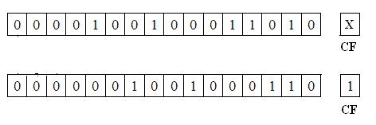
Sol.
AX = 0246H, CF = 1
Note that shifting to the right is equivalent to division by the powers of 2.
A frequent need in programming is to isolate the value of one of the bits of a byte or word of data by shifting it into the carry flag, shift instructions may perform this operation. Once the bit is in CF it can be tested by other instructions and based on this value initiate another software operation.

Slide 43

5- Rotate Instructions
The rotate instructions are similar to the shift instructions; they perform many of the same programming functions such as alignment of data and isolation of a bit of data.
Mnemonic | Meaning | Format | Operation | Flags affected
ROL | Rotate left | ROL D, Count | Rotate the (D) left by the number of bit positions equal to Count. Each bit shifted out from the left most bit goes back into the right most bit position | CF (OF undefined if count ≠ 1)
ROR | Rotate right | ROR D, Count | Rotate the (D) right by the number of bit positions equal to Count. Each bit shifted out from the right most bit goes into the left most bit position | CF (OF undefined if count ≠ 1)
RCL | Rotate left through carry | RCL D, Count | Same as ROL except carry is attached to (D) for rotation | CF (OF undefined if count ≠ 1)
RCR | Rotate right through carry | RCR D, Count | Same as ROR except carry is attached to (D) for rotation | CF (OF undefined if count ≠ 1)
o ROL Instruction rotates the destination operand (register or storage location in memory) to the left by number of bits specified by count. The bits moved out at MSBit are not lost; instead they are reloaded at the other end.
o ROR Instruction rotates the destination operand (register or storage location in memory) to the right by number of bits specified by count. The bits moved out at LSBit are reloaded at the other end.

Slide 44
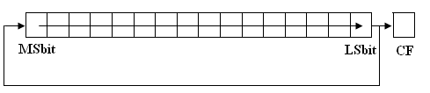

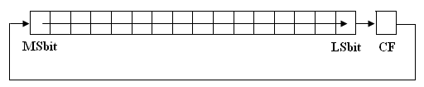
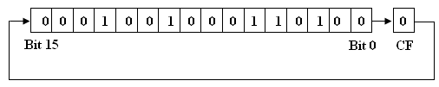
o RCL Instruction rotates the destination operand (register or storage location in memory) to the left through the carry flag by number of bits specified by count. The bits moved out at MSBit are reloaded at the other end.
o RCR Instruction rotates the destination operand (register or storage location in memory) to the right through the carry flag by number of bits specified by count. The bits moved out at MSBit are reloaded at the other end.
Ex. 3 BX = 1234H, CL = 04H, CF = 0. What is the result in BX and CF after executing RCR BX, CL.
Sol.

Slide 45

BX = 8123H, CF = 0
An example of a software operation that can be performed with the rotate instructions is the disassembly of the two hexadecimal digits in a byte of data so that they can be added.
Ex. 4 Write program to add the two digits in AL.
Sol.
MOV BL, AL MOV CL, 04H
ROR BL, CL
AND AL, 0FH AND BL, 0FH ADD AL, BL
First a copy of data is made to BL. Next, the 4 MSBits in BL are moved to the 4 LSBits by the rotate operation. This repositions the most significant digit of the original byte in the least significant digit position in BL. Then the most significant digits in AL and BL are masked off. Finally, the two digits are added together in AL.

Slide 46
Control Flow Instructions
The control flow instructions give the ability to alter the sequence in which instructions of a program execute.
1- Flag-Control Instructions
The instruction set includes a group of instructions that, when executed, directly affect the state of the flags.
Mnemonic | Meaning | Operation | Flags affected
LAHF | Load AH from flags | (AH) (Flags) | None
SAHF | Store AH into flags | (Flags) (AH) | SF, ZF, AF, PF, CF
CLC | Clear carry flag | (CF) 0 | CF
STC | Set carry flag | (CF) 1 | CF
CMC | Complement carry flag | (CF) (CF) | CF
CLI | Clear interrupt flag | (IF) 0 | IF
STI | Set interrupt flag | (IF) 1 | IF
o LAHF Instruction loads the flags into AH to read them. The format of the flags information in AH is as shown below (bits 1, 3, and 5) are not used.
AH
b7 | b6 | b5 | b4 | b3 | b2 | b1 | b0
SF | ZF | x | AF | x | PF | x | CF
o SAHF Instruction stores AH into flags to change them, used to start an operation with certain flags set or reset. The format in AH is same as above.

Slide 47
Ex. 1 Write a program to save the current contents of flags in the memory location at offset MEM1and then reload the flags with the content of memory storage location at offset MEM2.
Sol.
LAHF
MOV [MEM1], AH MOV AH, [MEM2] SAHF
CLC, STC, CMC Instructions used to manipulate the carry flag, they permit CF to be cleared, set, or complemented, respectively.
CLI, STI Instructions used to manipulate the interrupt flag. CLI instruction clears the interrupt flag (IF = 0, disables the interrupt interface). STI instruction sets the interrupt flag (IF = 1, microprocessor is enabled to accept interrupts).
2- Compare Instruction
Mnemonic | Meaning | Format | Operation | Flags affected
CMP | Compare | CMP D, S | (D) - (S) is used in setting or resetting the flags | CF, AF, OF, PF,SF, ZF
o CMP Instruction used to compare two 8-bit or 16-bit numbers. It gives the ability to determine the relationship between two numbers; whether they are equal or unequal, and when they are unequal, which one is larger. The operands can reside in a storage location in memory, a register, or be part of the instruction (immediate value). The process of comparison is basically subtraction operation. The result of subtraction is not saved, instead based on the result of subtraction; the appropriate

Slide 48
flags are set or reset. The new logic state of flags can be used by the instructions that follow to make a decision whether or not to alter the sequence in which the program executes.
Ex. 2 Describe what happens to the status flags as the sequence of instructions that follow is executed.
MOV AX, 1234H MOV BX, 0ABCDH CMP AX, BX
Sol.
The MOV instruction does not change flags.
123416 | 0001 | 0010 | 0011 | 01002
ABCD16 | 1010 | 1011 | 1100 | 11012 | -
666716 | 0110 | 0110 | 0110 | 01112
The flags are either set or reset based on the result of subtraction.
PF = 0 (odd parity)
OF = 0
AF = 1
(no overflow)
(there is borrow in from b4 to b3) (there is borrow in to b15)
(result is positive b15 = 0) (result is not zero)
CF = 1
SF = 0
ZF = 0

Slide 49
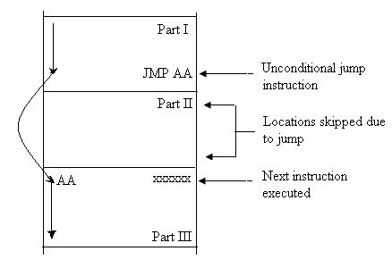
3- Jump Instructions
In the 8086, the code segment register and instruction pointer keep track of the next instruction to be fetched for execution. Thus to initiate a change in control flow, a jump instruction must change the content of these registers. In this way, execution continues at an address other than that of the next sequential instruction. There are two types of jump operations; conditional and unconditional jump.
a- Unconditional Jump
In an unconditional jump, no status requirements are imposed for the jump to occur.
Figure 1 Execution Sequencing of Program with Unconditional Jump Instruction
Mnemonic | Meaning | Format | Operation | Flags affected
JMP | Unconditional jump | JMP Operand | Jump is initiated to the address specified by the operand | None

Slide 50
There are two basic kinds of unconditional jumps:
Intrasegment jump limited to addresses within the current code segment (just modifying IP). The operands can be Short-label, Near-label, Memptr 16, or Regptr 16.
∗ Short-label the jump-to address is specified by an 8-bit number (immediate operand). JMP 12H
∗ Near-label the jump-to address is specified by a 16-bit number (immediate operand). JMP 1234H
∗ Memptr 16 the jump-to address is specified indirectly by the content of a memory location. JMP [BX]
∗ Regptr 16 the jump-to address is specified indirectly by the content of a register. JMP BX
Intersegment jump permits jumps from one code segment to another (modifies both CS and IP). The operands can be Far-label, Memptr 32.
∗ Far-label uses a 32-bit immediate operand to specify the jump-to address, the least significant 16 bits are loaded into IP and the most significant 16 bits are loaded into CS. JMP 1234:5678H
∗ Memptr 32 four consecutive memory bytes starting at the specified address contain the offset and new code segment addresses. The first word of memory is loaded into IP; the second word of memory is loaded into CS. JMP DWORD PTR [DI]
b- Conditional Jump
For a conditional jump, status conditions that exist at the time the jump instruction is executed decide whether or not the jump will occur. If the conditions are met, the jump takes place; otherwise, execution continues with the next sequential instruction. The conditions that can be referenced by a conditional jump instruction are status flags.
Table 1 shows the conditional jump instruction set. Each of these instructions tests for the presence or absence of certain status conditions. For some of the instructions, two different mnemonics can be used (this improves the program readability).
50

Slide 51
Table 1 Conditional Jump Instructions
Mnemonic |  | Meaning | Condition
JA | Above |  | CF = 0 and ZF = 0
JAE | Above or equal |  | CF = 0
JB | Below |  | CF = 1
JBE | Below or equal |  | CF = 1 or ZF = 1
JC | Carry |  | CF = 1
JCXZ | CX register is zero |  | (CF or ZF) = 0
JE | Equal |  | ZF = 1
JG | Greater |  | ZF = 0 and SF= OF
JGE | Greater or equal |  | SF = OF
JL | Less |  | (SF xor OF) = 1
JLE | Less or equal |  | ((SF xor OF)or ZF) = 1
JNA | Not above |  | CF = 1 or ZF = 1
JNAE | Not above nor equal |  | CF = 1
JNB | Not below |  | CF = 0
JNBE | Not below nor equal |  | CF = 0 and ZF = 0
JNC | Not carry |  | CF = 0
JNE | Not equal |  | ZF = 0
JNG | Not greater |  | ((SF xor OF)or ZF) = 1
JNGE | Not greater nor equal |  | (SF xor OF) = 1
JNL | Not less |  | SF = OF
JNLE | Not less nor equal |  | ZF = 0 and SF= OF
JNO | Not overflow |  | OF = 0
JNP | Not parity |  | PF = 0
JNS | Not sign |  | SF = 0
JNZ | Not zero |  | ZF = 0
JO | Overflow |  | OF = 1
JP | Parity |  | PF = 1
JPE | Parity even |  | PF = 1
JPO | Parity odd |  | PF = 0
JS | Sign |  | SF = 1
JZ | Zero |  | ZF = 1
Above and below are used to describe the comparison of unsigned numbers; while less and greater to describe comparison of signed numbers. For example, the number ABCDH is above the number 1234H if they are considered to be unsigned numbers. On the other hand, ABCDH is less than 1234H if they are treated as signed numbers.

Slide 52
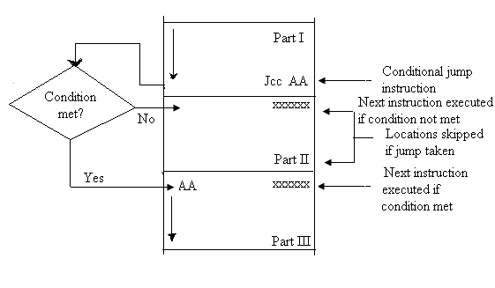
When signed numbers are compared, use the JG, JL, JGE, JLE, JE, and JNE instructions. When unsigned numbers are compared, use the JA, JB, JAE, JBE, JE, and JNE instructions.
Figure 1 Execution Sequencing of Program with Conditional Jump Instruction
Ex. 3 Write a program to add 50H numbers stored at memory locations starting at 4400:0100H, then store the result at address 200H in the same data segment.
Sol.
MOV AX, 4400H MOV DS, AX MOV CX, 0050H MOV BX, 0100H
AGAIN: ADD AL, [BX]
INC BX DEC CX
JNZ AGAIN
MOV [0200H], AL

Slide 53
4- Subroutines Instructions
A subroutine is a special segment of program that can be called for execution from any point in a program. The subroutine is written to provide a function that must be performed at various points in the main program.
Main program
Subroutine A
. . .
Call subroutine A
Next instruction
. . .
Call subroutine A
Next instruction
. . .
First instruction
. . .
Return
Figure 1 Execution Sequencing of a Program That Includes Subroutine Calling
There are instructions provided to transfer control from the main program to a subroutine and return control back to the main program.
Mnemonic | Meaning | Format | Operation | Flags affected
CALL | Subroutine call | CALL operand | Execution continues from the address of the subroutine specified by the operand. Information required to return back to the main program such as IP and CS are saved to stack. | None
RET | Return | RET or RET operand | Return to the main program by restoring IP (and CS for far-proc). If operand is present, it is added to the contents of SP. | None

Slide 54
PUSH | Push word onto stack | PUSH S | ((SP)) (SP) | (S) (SP)-2 | None
POP | Pop word off stack | POP D | (D) (SP) | ((SP)) (SP)+2 | None
PUSHF | Push flags onto stack | PUSHF | ((SP) (SP) | (Flags) (SP)-2 | None
POPF | Pop flags off stack | POPF | (Flags) (SP) | ((SP)) (SP)+2 | OF, DF, IF, TF, SF, ZF, AF, PF, CF
o CALL Instruction provides the mechanism to call a subroutine into operation by modifying either the value of IP or IP and CS to branch to a subroutine. The operand initiates either an intrasegment or intersegment call.
Intrasegment call causes the content of IP to be saved on the stack and a new 16-bit value to be loaded into IP. The operands can be Near-proc, Memptr 16, or Regptr 16.
∗ Near-proc the 16-bit immediate operand is loaded to IP. CALL 1234H
∗ Memptr 16 the content of a memory location (word) specified by the operand is loaded into IP. CALL [BX]
∗ Regptr 16 the content of a register is loaded into IP. CALL BX
Intersegment call permits the subroutine to reside in another code segment. The contents of CS and IP are saved on the stack, and then new values are loaded to them. The operands can be Far-proc, Memptr 32.
∗ Far-proc a 32-bit immediate operand is loaded into IP and CS. CALL 1234:5678H
∗ Memptr 32 the pointer for the subroutine is stored as four consecutive bytes in data memory. The first word of memory is loaded into IP; the second word of memory is loaded into CS. CALL DWORD PTR [DI]

Slide 55
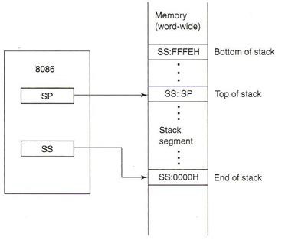
RET Instruction returns control to the main program. It causes the value of IP or both IP and CS that were saved on the stack to be returned back to their corresponding registers. Program control is returned to the instruction that immediately follows the call instruction.
PUSH Instruction used to save parameters on the stack. These data correspond to registers and memory locations that are used by the subroutine. In this way, their original contents are kept intact in the stack segment during the execution of the subroutine.
POP Instruction used to retrieve parameters from the stack. Before a return to the main program takes place, the parameters are restored.
The operands for push and pop instructions can be a general-purpose register, a segment register (excluding CS), or a storage location in memory.
The Stack
The stack is used for temporary storage of information such as data or address. It is 64 Kbytes long and is organized as 32 Kwords.
Figure 2 Stack segment of memory

Slide 56
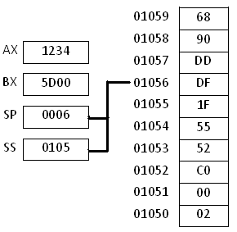
The address obtained from the contents of SS and SP (SS:SP) is the address of the last storage location in the stack to which data were pushed, it is called top of the stack. The highest-addressed word location in the stack (SS:FFFE16) is called bottom of the stack. The lowest-addressed word location in the stack (SS:000016) is called end of the stack.
When a CALL instruction is executed, the 8086 automatically pushes the current values in CS and IP onto the stack. As part of the subroutine, the contents of other registers may also be saved on the stack by executing PUSH instructions. Near the end of the subroutine, POP instructions are included to pop values from the stack back into their corresponding internal registers. At the end of the subroutine, a RET instruction causes the values of CS and IP to be popped off the stack and put back into the internal register where they originally resided.
Data transferred to and from the stack are word wide (not byte-wide). Each time a word is to be pushed onto the top of stack, the value in SP is first automatically decremented by two, and then the content of the register is written into the stack.
When a value is popped from the top of stack, the reverse occurs. Its content is first popped off the stack and put into the specific register, and then SP is automatically incremented by two.
Ex. 1 What is the result of executing the following instructions, assuming the values shown on the right?
PUSH AX POP BX POP AX
The stack

Slide 57
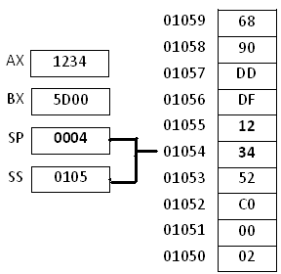
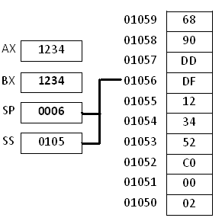
Sol.
o AX is to be pushed onto the top of stack, the value in SP is first automatically decremented by two, and then the content of AX is written into the stack.
The stack
o BX is to be popped from the top of stack. Its content is first popped off the stack and put into BX, and then SP is automatically incremented by two.
The stack
o AX is to be popped from the top of stack. Its content is first popped off the stack and put into BX, and then SP is automatically incremented by two.

Slide 58
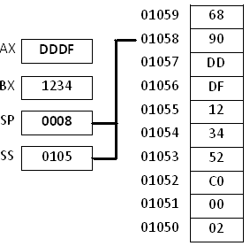
The stack
Ex. 2 Write a procedure that squares the content of BL and places the result in BX.
Sol.
PUSH AX MOV AL, BL IMUL BL
MOV BX, AX
POP AX RET
Since AX will be used as destination of multiplication operation in the subroutine; its original content (from the main program) must be saved in the stack. AL should be loaded with the content of BL (for multiplication). The result is produced in AX so it should be moved to BX. Before returning to the main program, the original content of AX is restored from

Slide 59
stack. Finally, a return instruction is used to pass control back to the main program.
PUSHF Instruction saves the content of flag register on the top of stack.
POPF Instruction returns the flags from the top of stack to the flag register.
5- Loops Instructions
The 8086 microprocessor has instructions specifically designed for implementing loop operations. These instructions can be used in place of certain conditional jump instructions and give the programmer a simpler way of writing loop sequences.
Mnemonic | Meaning | Format | Operation
LOOP | Loop | LOOP short-label | (CX) (CX) - 1 Jump is initiated to location defined by short-label if (CX) ≠ 0; otherwise, execute next sequential instruction
LOOPE/ LOOPZ | Loop while equal/ Loop while zero | LOOPE/ LOOPZ short-label | (CX) (CX) - 1 Jump to location defined by short-label if (CX) ≠ 0 and ZF = 1; otherwise, execute next sequential instruction
LOOPNE/ LOOPNZ | Loop while | LOOPNE/ LOOPNZ short-label | (CX) (CX) - 1
 |  |  | Jump to location
 | not equal/ Loop while |  | defined by short-label if (CX) ≠ 0 and ZF = 0;
 | not zero |  | otherwise, execute next
 |  |  | sequential instruction
o LOOP Instruction works with respect to the content of CX register.
CX must be preloaded with a count that represents the number of times the loop is to repeat. Whenever LOOP is executed, the content of CX is

Slide 60
first decremented by 1 and then checked to determine if they are equal to zero. If equal to zero, the loop is complete and the instruction following LOOP is executed; otherwise, control is returned to the instruction at the label specified. (LOOP is a single instruction that functions the same as DEC CX instruction followed by JNZ instruction).
Ex. 3 Write a program that moves a block of data (10H bytes) in data segment starting at 1000H from offset 0010H to offset 00A0H.
Sol.
MOV AX, 1000H MOV DS, AX
MOV SI, 0010H MOV DI, 00A0H
MOV CX, 0010H
NEXT:
MOV AH, [SI] MOV [DI], AH
INC SI INC DI
LOOP NEXT HLT
o LOOPE/ LOOPZ Instructions check the contents of both CX and ZF. Each time the loop instruction is executed, CX decrements by 1 without affecting the flags. ZF that results from execution of the previous instruction is tested. If CX is not 0 and ZF is 1, a jump is initiated to the location specified with the short-label operand and the loop continues.

Slide 61
If either CX or ZF is 0, the loop is complete and the instruction following the loop instruction is executed.
o LOOPNE/ LOOPNZ Instructions work similarly as above, the difference is that it checks that ZF is 0 and CX is not 0. If these conditions are met, the loop continues; otherwise it ends.

Slide 62
Question: Explain the function of the following sequence of instructions MOV DL, 05
MOV AX, 0A00H MOV DS, AX
MOV SI, 0 MOV CX, 0FH INC SI
CMP [SI], DL LOOPNE AGAIN HLT
AGAIN:
Sol.
The first 5 instructions initialize internal registers and set up a data segment the loop in the program searches the 15 memory locations starting from Memory location A001Hfor the data stored in DL (05H). As long as the value In DL is not found the zero flag is reset, otherwise it is set. The LOOPNE Decrements CX and checks for CX=0 or ZF =1. If neither of these conditions is met the loop is repeated. If either condition is satisfied the loop is complete. Therefore, the loop is repeated until either 05 is found or all locations in the address range A001H through A00F have been checked and are found not to contain 5.

Slide 63
6- Strings Instructions
A string is a series of data words (or bytes) that reside in consecutive memory locations. The string instructions of 8086 permit programmer to implement operations such as to move data from one block of memory to a block elsewhere in memory, scanning a string of data elements stored in memory to look for a specific value, comparing the elements of two strings in order to determine whether they are the same or different, and initializing a group of consecutive memory locations. These operations must be repeated to handle a string of more than one element.
Mnemonic | Meaning | Format | Operation | Flags affected
MOVS | Move string | MOVSB/ MOVSW | ((ES)0+(DI)) ((DS)0+(SI)) (SI) (SI) ± 1 or 2 (DI) (DI) ± 1 or 2 | None
CMPS | Compare string | CMPSB/ CMPSW | Set flags as per ((DS)0+(SI)) - ((ES)0+(DI)) (SI) (SI) ± 1 or 2 (DI) (DI) ± 1 or 2 | CF, PF, AF, ZF, SF, OF
SCAS | Scan string | SCASB/ SCASW | Set flags as per (AL or AX) - ((ES)0+(DI)) (DI) (DI) ± 1 or 2 | CF, PF, AF, ZF, SF, OF
LODS | Load string | LODSB/ LODSW | (AL or AX) ((DS)0+(SI)) (SI) (SI) ± 1 or 2 | None
STOS | Store string | STOSB/ STOSW | ((ES)0+(DI)) (AL or AX) (DI) (DI) ± 1 or 2 | None
CLD | Clear DF | CLD | (DF) 0 | DF
STD | Set DF | STD | (DF) 1 | DF
o MOVSB/ MOVSW Instructions an element of the string specified by SI register with respect to DS is moved to the location specified by DI register with respect to ES. The move can be performed on a byte or a word of data. After the move is complete, the content of both SI and DI are automatically incremented or decremented by 1 for a byte move and by two for a word move. The address pointers in SI and DI increment or decrement depending on how the direction flag (DF) is set.

Slide 64
Ex. 1 Write a program that moves a block of data (10H bytes) from data segment starting at 1000:0010H to extra segment at 2000:00A0H using string instructions.
Sol.
MOV AX, 1000H MOV DS, AX
MOV AX, 2000H
MOV ES, AX MOV SI, 0010H MOV DI, 00A0H MOV CX, 0010H
CLD MOVSB
NEXT:
LOOP NEXT HLT
MOV AH, [SI] MOV [DI], AH
Note that the instructions used in Ex.3 of lecture 8
INC SI INC DI
are replaced by MOVSB instruction
o CMPSB/ CMPSW Instructions subtracts the destination string operand from the source string operand and adjusts the flags accordingly. The result of subtraction is not saved. When these instructions are executed the operands are compared, the flags are adjusted, and both SI and DI

Slide 65
are updated so that they point to the next elements in their respective strings.
o SCASB/ SCASW Instructions compares the byte or word element of the destination string at the physical address derived from DI and ES to the content of AL or AX, respectively. The flags are adjusted based on this result and DI is incremented or decremented.
Ex. 2 Write a program that scans a block of data (FH bytes) in extra segment at 0A00:0001H for the value 5H using string instructions.
Sol.
MOV AX, 0A00H MOV ES, AX
MOV DI, 0001H MOV AL, 05H
MOV CX, 000FH CLD
AGAIN:
SCASB
LOOPNE AGAIN
HLT
o LODSB/ LODSW Instructions LODSB loads a byte from a string in memory into AL. The address in SI is used relative to DS to determine the address of the memory location of the string element; SI is incremented or decremented by 1 after loading. LODSW indicates that the word-string element at physical address derived from DS and SI is

Slide 66
to be loaded into AX. Then the index in SI is automatically incremented or decremented by 2.
o STOSB/ STOSW Instructions stores a byte from AL or a word from AX into a string location in memory. ES and DI are used to form the address of storage location in memory.
Ex. 3 Write a program that loads a block of memory locations from 0A000H through 0A00FH with number 5H using string instructions.
Sol.
MOV AX, 0000H MOV ES, AX
MOV DI, 0A000H
MOV AL, 05H MOV CX, 0010H
CLD STOSB
AGAIN:
LOOP AGAIN HLT
o CLD Instruction clears DF, this selects auto-increment mode in string operations so that each time a string operation is performed, SI and/ or DI are incremented by 1 if byte data are processed and by 2 if word data are processed.

Slide 67
o STD Instruction sets DF, this selects auto-decrement mode in string operations so that each time a string operation is performed, SI and/ or DI are decremented by 1 if byte data are processed and by 2 if word data are processed.
String Prefixes
In most applications, the basic string operations must be repeated in order to process arrays of data. Inserting a repeat prefix before the instruction that is to be repeated does this.
∗ REP Prefix causes the basic string operation to be repeated until the contents of CX become = 0. Each time the instruction is executed, it causes CX to be tested for 0. If CX is found ≠ 0, it is decremented by 1 and the basic string operation is repeated. On the other hand, if it is 0, the repeat string operation is done and the next instruction in the program is executed. The repeat count must be loaded into CX prior to executing the repeat string instruction. The REP prefix is used with the MOVS and STOS instructions.
∗ REPE/ REPZ Prefixes the basic compare or scan operation repeats as long as both the count in CX ≠ 0 and ZF = 1. The first condition, CX ≠ 0, indicates that the end of the string has not yet been reached and the second condition, ZF = 1, indicates that the elements that were compared are equal. The REPE and REPZ prefixes are used with the CMPS and SCAS instructions.
∗ REPNE/ REPNZ Prefixes works similarly as the REPE/REPZ, except that now the operation is reached as long as CX ≠ 0 and ZF = 0. That is, the comparison or scanning is performed as long as the string elements are unequal and the end of the string is not yet reached. The REPNE and REPNZ prefixes are used with the CMPS and SCAS instructions.

Slide 68
Ex. 4 Repeat example 3 using REP prefix.
Sol.
MOV AX, 0000H MOV ES, AX
MOV DI, 0A000H MOV AL, 05H
MOV CX, 0010H
CLD REPSTOSB HLT

Slide 69
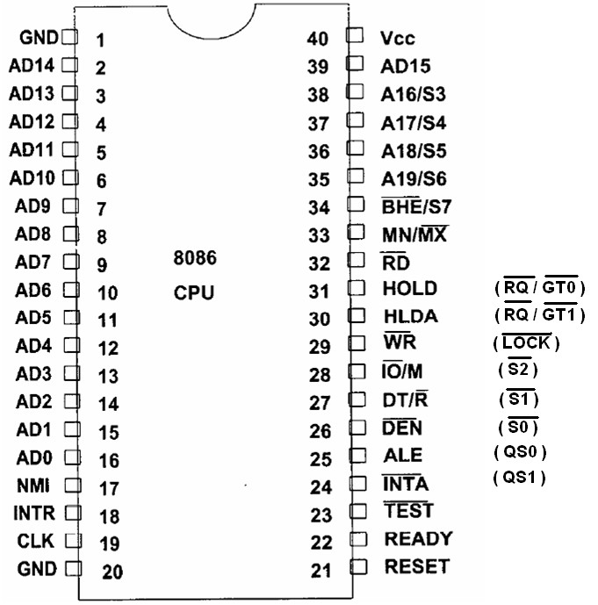
8086 Pin Diagram
The 8086, announced in 1978, was the first 16-bit microprocessor introduced by Intel Corporation. The 8086 is manufactured using high-performance metal-oxide semiconductor (HMOS) technology, and the circuitry on its chips is equivalent to approximately 29000 transistors. It is housed in a 40-pin dual in-line package (figure 1).
Figure 1 8086 Pin Diagram
As seen above, many of 8086’s pins have multiple functions. For example, we see that address bus lines A0 through A15 and data bus lines D0 through D15 are multiplexed. For this reason, these leads are labeled AD0 through AD15. By multiplexed we mean that the same physical pin carries an address bit at one time and the data bit at another time.

Slide 70
8086 Modes of Operation
The 8086 can be configured to work in either of two modes:
Minimum Mode is selected by applying logic 1 to the MN/M̅̅̅X̅ input lead. Minimum mode 8086 systems are typically smaller and contain a single microprocessor.
Maximum Mode is selected by applying logic 0 to the MN/M̅̅̅X̅ input lead. Maximum mode configures 8086 systems for use in larger systems and with multiple processors.
Depending on the mode of operation selected, the assignments for a number of pins on the microprocessor package are changed. As shown above, the pin function of the 8086 specified in parentheses relate to a maximum-mode system.
Table 1 8086 Common Signals
Common Signals
Name |  | Function | Type
AD15-AD0 | Address /data bus |  | Bidirectional
A19/S6-A16/S3 | Address / status |  | Output
MN/M̅̅̅X̅ | Minimum/Maximum mode control |  | Input
_{R}̅̅̅_{D}̅ | Read control |  | Output
_{T}̅̅_{E}̅̅_{S}̅̅_{T}̅ | Wait on test control |  | Input
READY | Wait state control |  | Input
RESET | System reset |  | Input
NMI | Non-maskable interrupt request |  | Input
INTR | Interrupt request |  | Input
CLK | System clock |  | Input
VCC | +5 volt |  | Input
GND | Ground |  | Input
70

Slide 71
Minimum Mode Interface Signals
The minimum-mode signals are shown in Table 1. They can be divided into the following basic groups:
Table 2 Minimum Mode Signals
Minimum Mode Signals (MN/�̅̅̅̅�̅=VCC)
Name | Function | Type
HOLD | Hold request | Input
HLDA | Hold acknowledgment | Output
_{W}̅̅̅̅_{R}̅ | Write control | Output
M/̅I̅O̅ | IO/memory control | Output
DT/R̅ | Data transmit /receive | Output
_{D}̅̅̅_{E}̅̅_{N}̅ | Data enable | Output
_{B}̅̅̅_{H}̅̅_{E}̅ _{/S7} | Bank high enable/Status line 7 | Output
ALE | Address latch enable | Output
̅_{I}̅_{N}̅̅_{T}̅̅_{A}̅ | Interrupt acknowledgment | Output
Address/Data Bus the address bus is 20 bits long and consists of signal lines A0 (the LSb) to A19 (the MSb).
The data bus is 16 bits long and consists of signals lines D0 (the LSb) to D15 (the MSb). When acting as a data bus, they carry read/write data for memory, input/output data for I/O devices, and interrupt-type codes from an interrupt controller.
Status Signals the four most significant address lines, A16 through A19 are also multiplexed, but with status signals S3 through S6. These status bits are output on the bus at the same time that data are transferred over the other bus
lines. Bits S3 and S4 together form a 2-bit binary code that identifies which of the internal segment registers was used to generate the physical address that was output on the address bus during the current bus cycle. Status line S5 reflects the status of logic level of the internal interrupt enable flag.

Slide 72
Table 3 S3 and S4 Signals Binary Code
S4 | S3 | Address Status
0 | 0 | Alternate(relative to the ES)
0 | 1 | Stack (relative to the SS)
1 | 0 | Code/None (relative to the CS or a default of zero)
1 | 1 | Data (relative to the DS)
Control Signals these are provided to support the memory and I/O interfaces of the 8086:
  ALE Signal is a pulse to logic 1 that signals external circuitry when a valid address is on the bus. This address can be latched in external circuitry on the 1-to-0 edge pulse at ALE.
  M/̅�̅�̅̅ Signal tells external circuitry whether a memory or I/O transfer is taking place over the bus. (Logic 1 for memory operation, logic 0 for I/O operation).
  DT/�̅ Signal when this line is logic 1 the bus is in Transmit Mode (data are either written into memory or output to an I/O device). When this line is logic 0 the bus is in Receive Mode (data are either read from memory or input from an I/O device).
  �̅̅̅�̅̅̅�̅ Signal logic 0 on this line is used as a memory enable signal for the most significant byte half of the data bus, D8 through D15.
  �̅̅̅�̅̅ Signal indicates that a read bus cycle is in progress.
  �̅̅̅̅�̅ Signal indicates that a write bus cycle is in progress.
  �̅̅̅�̅̅�̅̅ Signal during read operations, this signal is also supplied to enable external devices to supply data to the microprocessor.
  READY Signal used to insert wait states into the bus cycle so that it is extended by a number of clock periods.
Interrupt Signals (INTR, I̅̅N̅̅T̅̅A̅, T̅̅E̅̅S̅̅T̅, RESET, NMI)
Direct Memory Access (DMA) Interface Signals (HOLD, HLDA)

Slide 73
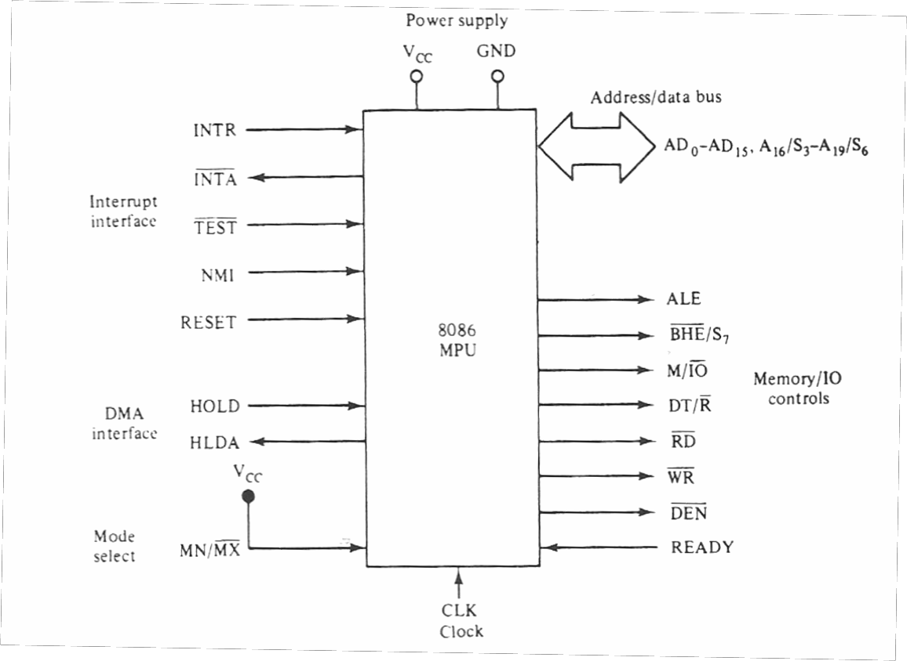
Figure 2 Minimum-Mode Block Diagram
Maximum Mode Interface Signals
When the 8086 microprocessor is set for the maximum-mode configuration, it produces signals for implementing a multiprocessor/coprocessor system environment. By multiprocessor system environment we mean that multiple microprocessors exist in the system and that each processor executes its own program. Table 4 lists the maximum-mode signals.
Table 4 Maximum Mode Signals
Maximum Mode Signals (MN/�̅̅̅̅�̅=Ground)
Name | Function | Type
_{R}̅̅_{Q}̅̅/̅̅_{G}̅̅_{T}̅̅₁̅,̅₀̅ | Request/grant bus access control | Bidirectional
_{L}̅̅_{O}̅̅_{C}̅̅_{K}̅ | Bus priority lock control | Output
_{S}̅̅₂̅ _{− S}̅̅₀̅ | Bus cycle status | Output
QS1, QS0 | Instruction queue status | Output

Slide 74
During the maximum mode operation, theW̅̅̅̅R̅, M/I̅̅O̅, DT/R̅, D̅̅̅E̅̅N̅, ALE, and I̅̅N̅̅T̅̅A̅ signals are no longer produced by the 8086. Instead, it outputs a status code on three signals lines, S̅0, S̅1, and S̅2, prior to the initiation of each bus cycle.
o �̅̅̅�̅, �̅̅̅�̅, �̅̅̅�̅ these three bits are input to the external bus controller device, the 8288, which decodes them to identify the type of next bus cycle. In addition to the signal produced the 8288 bus controller produces DEN, DT/R̅, and ALE.
Table 5 Bus Status Codes
Status Inputs |  |  | CPU Cycle | 8288 Command | Meaning
�̅̅̅�̅ | �̅̅̅�̅ | �̅̅̅�̅
0 | 0 | 0 | Interrupt Acknowledge | ̅_{I}̅_{N}̅̅_{T}̅̅_{A}̅ | Interrupt acknowledge
0 | 0 | 1 | Read I/O port | ̅_{I}̅_{O}̅̅_{R}̅̅_{C}̅ | I/O read control
0 | 1 | 0 | Write I/O port | ̅_{I}̅_{O}̅̅_{W}̅̅̅_{C}̅, ̅_{A}̅_{I}̅_{O}̅̅_{W}̅̅̅_{C}̅ | I/O write control, Advanced I/O write control
0 | 1 | 1 | Halt | None | ---
1 | 0 | 0 | Instruction Fetch | _{M}̅̅̅_{R}̅̅_{D}̅̅_{C}̅ | Memory read control
1 | 0 | 1 | Read Memory | _{M}̅̅̅_{R}̅̅_{D}̅̅_{C}̅ | Memory read control
1 | 1 | 0 | Write Memory | _{M}̅̅̅_{W}̅̅̅_{T}̅̅_{C}̅_{, A}̅̅̅_{M}̅̅_{W}̅̅̅_{C}̅ | Memory write control, Advanced memory write control
1 | 1 | 1 | Passive | None | ---

Slide 75
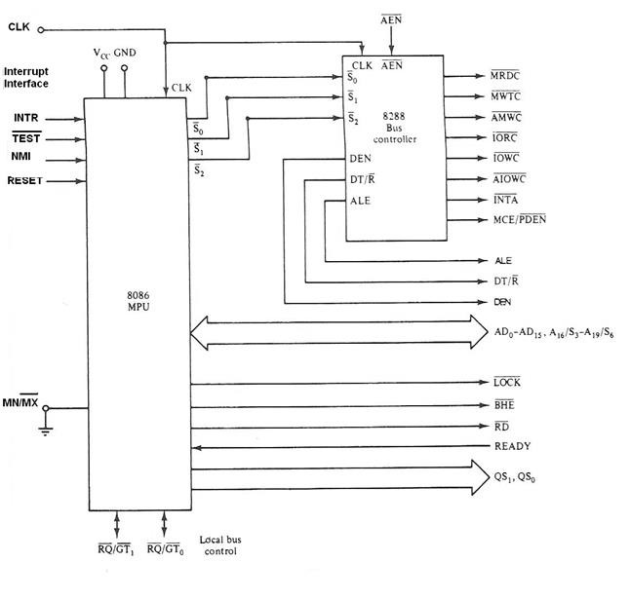
o �̅̅�̅̅̅�̅�̅̅ Signal this signal is meant to be output (logic 0) whenever the processor wants to lock out the other processors from using the bus.
o
Queue Status Signals (QS0, QS1) these two bits tell the external circuitry what type of information was removed from the queue.
o �̅̅̅�̅̅/̅̅�̅̅�̅̅�̅, �̅̅̅�̅̅/̅̅�̅̅�̅̅�̅ these two signals provide a prioritized bus access mechanism for accessing the local bus.
Figure 3 Maximum-Mode Block Diagram
System Clock
The time base for synchronization of the internal and external operations of the microprocessor in a microcomputer system is provided by the clock (CLK) input signal. The 8086 microprocessor is manufactured in three speeds: the 5-MHz 8086, the 8-MHz 8086-2 and the 10-MHz 8086-1.

Slide 76
Bus Cycle and Time State
A bus cycle defines the basic operation that a microprocessor performs to communicate with external devices such as Memory read, Memory write, I/O read, and I/O write.
The bus cycle of 8086 microprocessors consists of at least four clock periods (T1, T2, T3, and T4):
∗ During T1 the 8086 puts an address on the bus.
∗ During T2 the 8086puts the data on the bus (for write memory cycle) and maintained through T3 and T4.
∗ During T2 the 8086puts the bus in high-Z state (for read cycle) and then the data to read must be available on the bus during T3and T4.
These four clock states give a bus cycle duration of 125 ns × 4= 500 ns in an 8-MHz system.
Idle States
If no bus cycles are required, the microprocessor performs what is known as idle state. During these states, no bus activity takes place. Each idle state is one clock period long, and any number of them can be inserted between bus cycles. Idle states are performed if the instruction queue inside the microprocessor is full and it does not need to read or write operands form memory.
Wait States
Wait states can be inserted into a bus cycle. This is done in response to request by an event in external hardware instead of an internal event such as a full queue. The READY input of the 8086is provided specifically for this purpose. As long as READY is held at the 0 level, wait states are inserted between states T3and T4 of the current bus cycle, and the data that were on the bus during T3 are maintained. The bus cycle is not completed until the external hardware returns READY back to the 1 logic level.

Slide 77
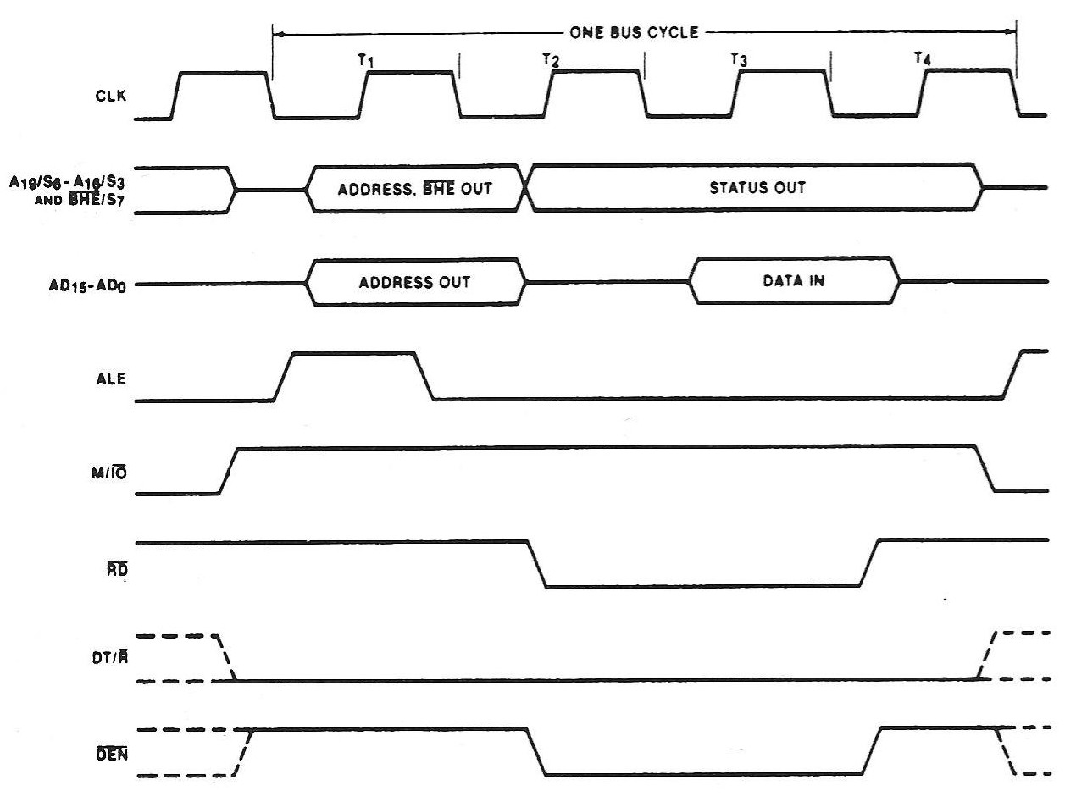
Read Cycle
The read bus cycle begins with state T1. During this period, the 8086 output the 20-bit address of the memory location to be accessed on its multiplexed address/data bus AD0 through AD15 and multiplexed lines A16/S3 through A19/S6.note that at the same time a pulse is also produced at ALE. The signal B̅̅̅H̅̅E̅ is also supplied with the address lines.
Figure 4 Minimum-Mode Memory Read Bus Cycle of the 8086
Write Cycle
The write bus cycle is similar to the read bus cycle except that signal W̅̅̅̅R̅ is set to 0 instead of the signal R̅̅̅D̅ and signal DT/R̅ is set to 1.

Slide 78
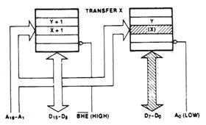
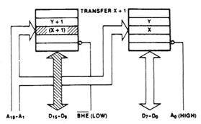
Hardware Organization of the 8086 Memory Address Space
The 8086’s 1Mbyte memory address space is implemented as two independent 512 Kbyte banks: the low (even) bank and the high (odd) bank.
1- When a byte of data at an even address (such as X) is to be accessed:
∗ A0 is set to logic 0 to enable the low bank of memory.
∗ B̅̅̅H̅̅E̅ is set to logic 1 to disable the high bank.
Figure 5 Even-Address Byte Transfer by the 8086
2- When a byte of data at an odd address (such as X+1) is to be accessed:
∗ A0 is set to logic 1 to disable the low bank of memory.
∗ B̅̅̅H̅̅E̅ is set to logic 0 to enable the high bank.
Figure 6 Odd-Address Byte Transfer by the 8086
3- When a word of data at an even address (aligned word) is to be accessed:
∗ A0 is set to logic 0 to enable the low bank of memory.
∗ B̅̅̅H̅̅E̅ is set to logic 0 to enable the high bank.

Slide 79
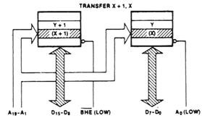
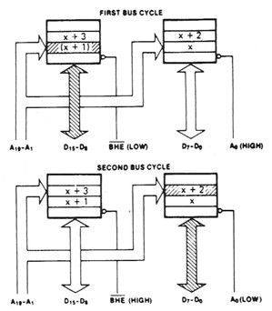
Figure 7 Even-Address Word Transfer by the 8086
When a word of data at an odd address (misaligned word) is to be accessed the 8086 needs two bus cycles to access it:
  During the first bus cycle, the odd byte of the word (in the high bank) is addressed
∗ A0 is set to logic 1 to disable the low bank of memory.
∗ B̅̅̅H̅̅E̅ is set to logic 0 to enable the high bank.
  During the second bus cycle, the even byte of the word (in the low bank) is addressed
∗ A0 is set to logic 0 to enable the low bank of memory.
∗ B̅̅̅H̅̅E̅ is set to logic 1 to disable the high bank.
Figure 8 Odd-Address Word Transfer by the 8086

Slide 80
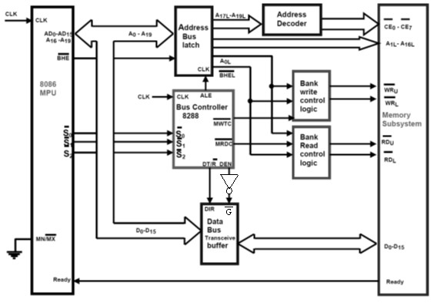
Memory Interface Circuits
The memory interface circuit of microcomputer system is shown below.
an 8086-based
(maximum
mode)
Figure 1 Memory Interface Block Diagram (for Maximum Mode)
Here we find that the interface includes:
8288 bus controller o Address bus latches o Address decoders
Bank write and read control logic
Data bus transceiver/buffer
The status signals �₀̅ , �₁̅ , and �₂̅ are outputs of the 8086 and inputs to the 8288 bus controller which decodes them to produce command and control signals needed to coordinate data transfer over the bus.
The address bus is latched, buffered, and decoded. The address lines A0 through A19 are latched along with control signal �̅̅̅�̅̅�̅ in the address bus
80

Slide 81
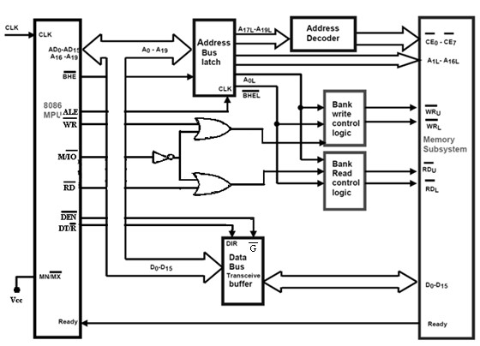
latch. The latched address lines A17L through A19L are decoded to produce chip enable output �̅̅̅�̅0 through�̅̅̅�̅7.
The 8288 bus controller produces the address latch enable ALE control signal from �̅2�̅1�̅0. It is applied to the CLK input of latches.
During read operations, the bank read control logic determines whether the data are read from one of the two memory banks or from both (depending on whether a byte or word data transfer). Similarly, the bank write control logic determines to which memory bank the data are written.
The bus transceivers control the direction of data transfer between the microprocessor and memory subsystem. DEN is applied to the EN input of the transceivers to enable them for operation. DT/�̅ is applied to the DIR input of the bus transceivers to select the direction of data transfer (logic 0 makes data pass from memory to microprocessor, logic 1 makes data be carried from the microprocessor to the memory).
For the minimum mode, the memory interface is similar to above except that the signals ALE,�̅̅̅�̅̅�̅, and DT/�̅ are delivered by 8086 directly. �̅̅̅�̅̅̅�̅̅�̅ and
�̅̅̅�̅̅̅�̅̅�̅ are produced using �̅̅̅�̅, �̅̅̅̅�̅, and M/̅̅��̅ signals as shown below.
Figure 2 Memory Interface Block Diagram (for Minimum Mode)

Slide 82
Bank Write and Bank Read Control Logic
The memory of the 8086 microcomputer is organized in upper and lower banks. It requires separate write and read control signals for the two banks.
The bank write control signals �̅̅̅̅�̅U for the upper bank and �̅̅̅̅�̅L for the lower bank can be generated from the bus controller signals �̅̅̅�̅̅̅�̅̅�̅ , the address bus latch signal A0L, and �̅̅̅�̅̅�̅̅�̅.
Similarly, the bank read control logic circuit can be designed to generate �̅̅̅�̅U, the read for the upper bank memory, and the �̅̅̅�̅L, the read for the lower bank using �̅̅̅�̅̅̅�̅̅�̅ signal from the bus controller.
�̅̅̅�̅̅�̅̅�̅
�̅̅̅̅�̅_{U}
�̅̅̅�̅̅̅�̅̅�̅
A0L
�̅̅̅̅�̅_{L}
Figure 3 Bank Write Control Logic
�̅̅̅�̅̅�̅̅�̅
�̅̅̅�̅_{U}
�̅̅̅�̅̅̅�̅̅�̅
A0L
�̅̅̅�̅_{L}
Figure 4 Bank Read Control Logic

Slide 83
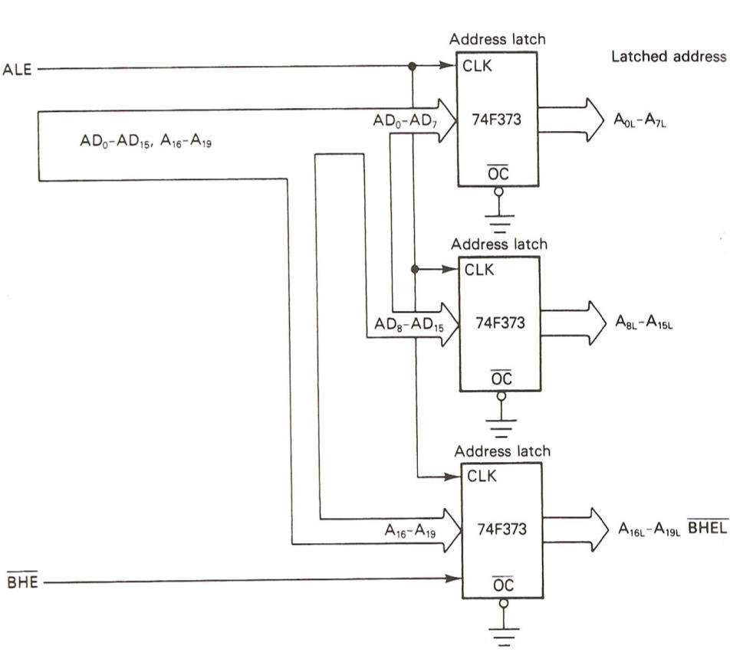
Address Bus Latches
The 74LS373 is an octal latch device that can be used to implement the address latch section of the 8086’s memory interface circuit.
When the clock CLK is at logic 1, the outputs of the D-type flip-flops follow the logic level of input. When the clock is at logic 0, the current contents of the D-type flip-flops are latched. If the output-control ( �̅̅̅�̅ ) input of the buffers is at logic 1, the outputs are in the high-impedance state.
In the 8086 microcomputer system, the 20 address lines (AD0-AD15, A16-A19) and the bank high enable signal �̅̅̅�̅̅�̅are normally latched in the address bus latch. The circuit configuration shown in Figure 5 can be used to latch these signals. These latches also provide buffering for the 8086 address lines. The address information is latched at the outputs when the ALE signal returns to logic 0.
Figure 5 Address Latch Circuit

Slide 84
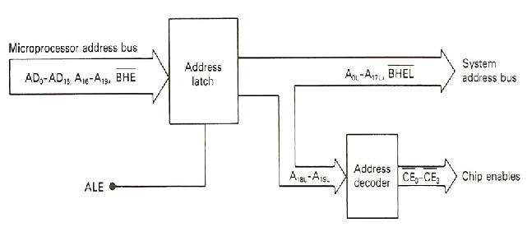
Address Decoders
The address decoder in the 8086 microcomputer system is located at the output side of the address latch.
Figure 6 Address Bus Configuration with Address Decoding
The 74LS138 decoder can be used to perform the address decode function. The circuit in above uses the 74F138 to generate chip enable signals �̅̅̅�̅0 through �̅̅̅�̅7 by decoding address lines A17L, A18L, and A19L.
Data Bus Transceivers
The data bus transceiver block of the bus interface circuit can be implemented with 74LS245 octal bus transceiver ICs. The �̅ input is used to enable the buffer for the operation. On the other hand, DIR input is used to select the direction in which data are transferred through the device (if DIR = 0 the data pass from B lines to A lines, else if DIR =1 data pass from A lines to B lines).
Figure 7 shows a circuit that implements the data bus transceiver block of the bus interface circuit using the 74LS245. For the 16-bit data bus of the 8086 microcomputer, two devices are required.
Here the DIR input is driven by the signal DT/�̅, and �̅ is supplied by data bus enable DEN (from the bus controller 8288 in the maximum mode) or by
�̅̅̅�̅̅�̅ (form 8086 in the minimum mode).

Slide 85
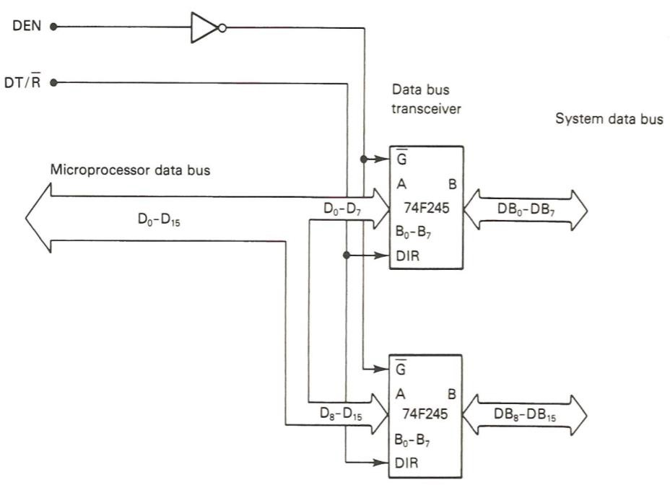
Figure 7 Data Bus Transceiver Circuit
Memory Types
Every microprocessor-based system has a memory system. Memory provides the ability to store and retrieve digital information. The memory unit of the microcomputer is partitioned into a primary storage section and secondary storage section.
Primary Storage Memory | Secondary Storage Memory
Used for working information, such as the instruction of the program currently being run and data that it is processing | Used for storage of data, information, and programs that are not in use
This part normally requires high speed operation but does not normally require very large storage capacity | This part of the memory unit can be slow speed, but it requires very large storage capacity
It is implemented with semiconductor memory devices, such as ROM , RAM and FLASH | It is normally implemented with magnetic storage device, such as the floppy disk and hard disk drive
Almost all systems contain two main types of memory: Read-Only Memory ROM and Random Access Memory RAM. ROM contains system software and permanent system data, while RAM contains temporary data and application software.

Slide 86
o Read Only Memory is one type of semiconductor memory device. It is most widely used in microcomputer systems for storage of the program that determines overall system operation. The information stored within a ROM integrated circuit is permanent (nonvolatile). Three types of ROM devices are in wide use today:
The mask programmable read only memory (ROM)
The one time programmable read only memory (PROM)
The erasable programmable read only memory (EPROM)
o Random Access Memory RAM is similar to ROM in that its storage location can be accessed in a random order, but it is different from ROM in two important ways:
Data stored in RAM is not permanent
RAM is volatile
Two types of RAMs are in wide use today:
∗ Static RAM (SRAM) data remain valid as long as the power supply is not turned off.
∗ Dynamic RAM (DRAM) to retain data in a DRAM, it is not sufficient just to maintain the power supply; we must periodically restore the data in each storage location (Refreshing the DRAM).
Memory Expansion
In many applications, the microcomputer system requirement for memory is greater than what is available in a single device. There are two basic reasons for expanding memory capacity:
The byte-wide length is not large enough
The total storage capacity is not enough bytes.
Both of these expansion needs can be satisfied by interconnecting a number of ICs.

Slide 87
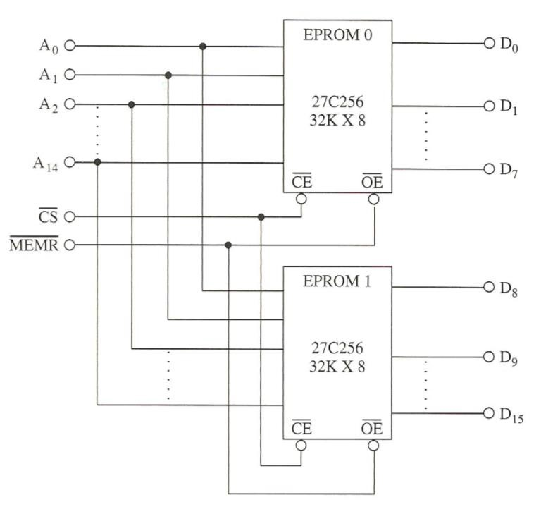
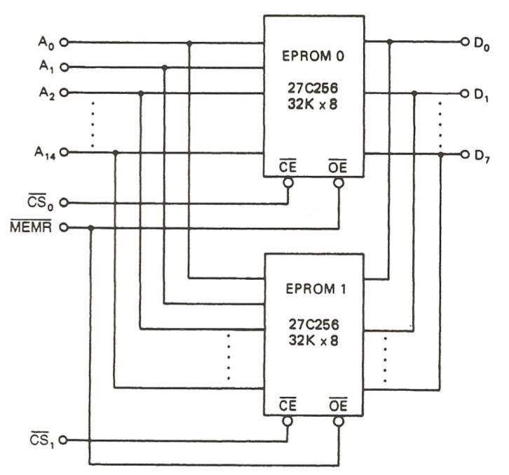
Figure 8 Implementation of 32K× 16 EPROM Using Two 32K×8 EPROM
Figure 9 Implementation of 64K× 8 EPROM Using Two 32K×8 EPROM

Slide 88
Ex. 1 Design an 8086 memory system consisting of 1MB, using 64K×8 memory.
Sol.
The 8086 has 20 address bits (A0-A19) and 16 data bits (D0-D15) 1MB = 1KB×1KB = 2¹⁰× 2¹⁰ = 2²⁰
64KB×8 means 64K locations (bytes), each byte is 8 bits
64KB = 2¹⁶ 16 address bits
To get 1MB out of 64KB units
1�� 2¹⁰��
= = 16
64�� 2⁶��
16 units are needed (8 for low bank and same for high bank) Two decoders are used, one for each bank
The three MSbits (A17, A18, and A19) are input to decoders

Slide 89
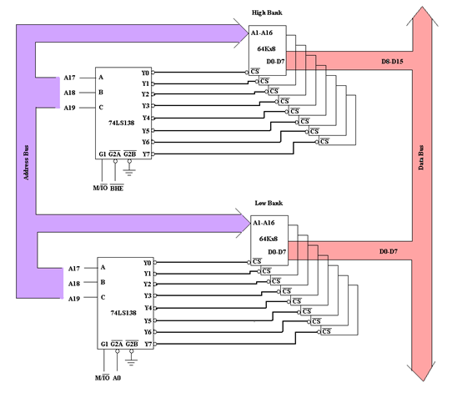
Ex. 2 Design 8086’s memory system consisting of 64KB of ROM memory, make use of the devices in figure below. The memory is to reside over the address range 60000H through 6FFFFH.
Address
�̅̅̅�̅
�̅̅̅�̅
Data
EPROM (27C256) 32K×8

Slide 90
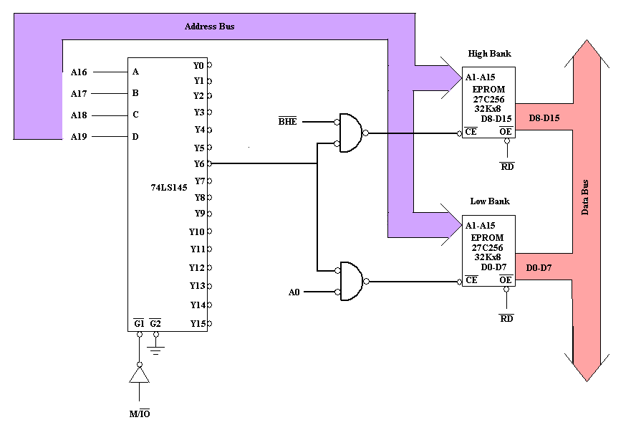
Sol.
To get 64KB out of 32KB×8 units
64�� 2⁶��
32�� ⁼ 2⁵�� ⁼ ²
2 units are needed (1 for low bank and 1 for high bank)
The four MSbits (A16, A17, A18, and A19) are input to decoder (to get 16 chip enable signals)
Exercise 1 Draw the design using separate decoders for low and high banks.
90

Slide 91
Ex. 3 Design 8086’s memory system consisting of 512KB of RAM memory and 128KB of ROM use the devices in figure below. RAM memory is to reside over the address range 00000H through 7FFFFH and the address range of the ROM is to be A0000H through BFFFFH.
Address
�̅̅̅�̅
Address
�̅̅̅�̅
�̅̅̅̅�̅
�̅̅̅�̅
Data
�̅̅̅�̅
Data
SRAM (431000A) 128K×8
EPROM (27C512) 64K×8
Sol.
The RAM used is 128K×8
⁵¹² = 4 units of RAM (2 for low bank and 2 for high bank)
128
The ROM used is 64K×8
¹²⁸ = 2 units of ROM (1 for low bank and 1 for high bank)
64
The three MSbits (A17, A18, and A19) are input to decoder (to get 8 chip enable signals)

Slide 92
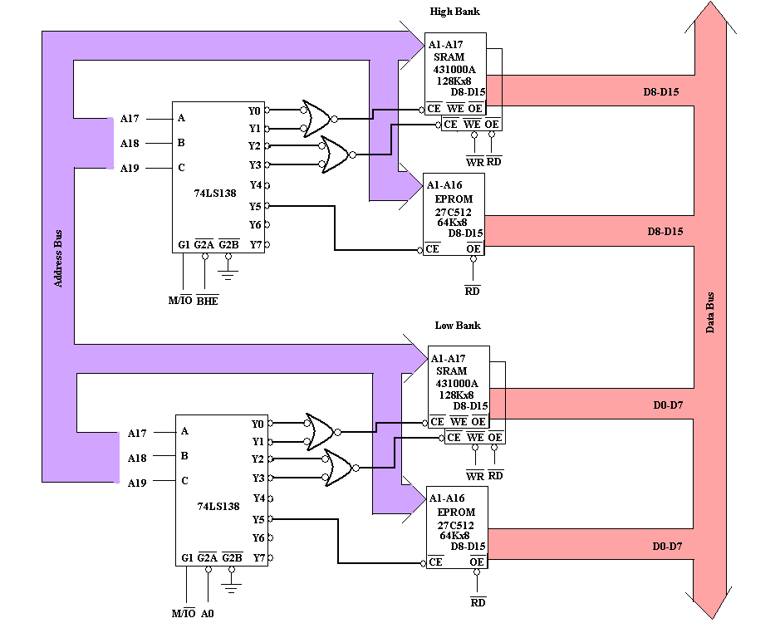
Exercise 2 Draw the design using single decoder for low and high banks.

Slide 93
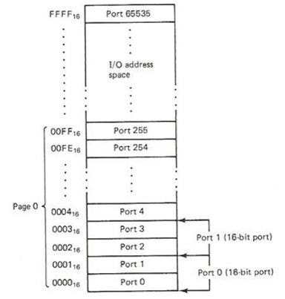
Input/Output Types
The input/output (I/O) system of the microprocessor allows peripherals to provide data or receive results of processing the data; this is done using I/O ports. Through the I/O interface, the MPU can input or output data in bit, byte, or word.
The 8086 microcomputers can employ two different types of (I/O); Isolated I/O and Memory-mapped I/O. These I/O methods differ in how I/O ports are mapped into the 8086’s address spaces.
o Isolated Input/Output the I/O devices are treated separate from memory. The address space from a software point of view for the I/O ports is organized as bytes of data in the range 0000H through FFFFH. The part of the I/O address space from address 0000H through 00FFH is referred to as Page 0 as shown in Figure 1.
Figure 1 Isolated I/O Ports

Slide 94
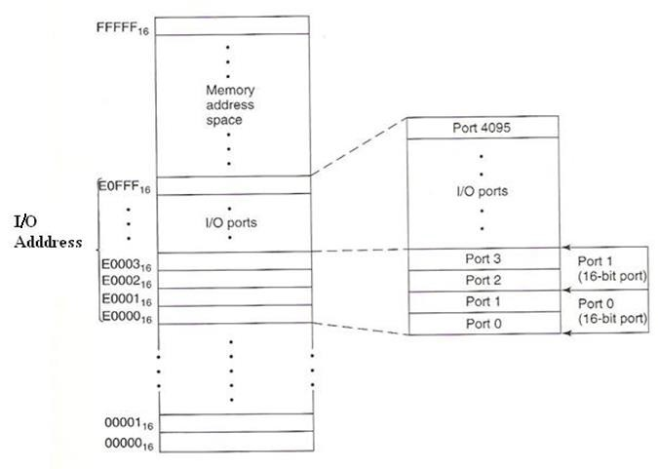
o Memory-Mapped Input/Output the I/O devices are placed in the memory address space of the microcomputer. The MPU looks at the I/O port as though it is a storage location in memory. For example, in Figure 2 the 4096 memory addresses in the range form E0000H through E0FFFH are assigned to I/O devices.
Figure 2 Memory-Mapped I/O Ports
Isolated I/O | Memory-mapped I/O
Use only the special input/output instructions (IN and OUT) | All memory instructions and addressing modes are available to perform I/O operation (MOV, AND, XCHG, SUB…)
Faster because I/O instructions is specifically designed to run faster than memory instructions | Slower because memory instructions execute slower than the special I/O instructions
The memory address space is not affected | Part of the memory address space is lost
All data transfers must take place between AL or AX register and the I/O port | Data transfers can take place between an I/O port and an internal register other than just AL or AX

Slide 95

Minimum-Mode Isolated Input/Output Interface
The minimum mode isolated I/O interface is shown in Figure 3. Unlike the memory interface, just the 16 least significant lines of the address bus (A0 through A15) are used. This interface uses the signals ALE, B̅̅̅H̅̅E̅, M/̅̅IO̅, R̅̅̅D̅, W̅̅̅̅R̅, DT/R̅, and D̅̅̅E̅̅N̅.
Figure 3 Minimum- Mode Isolated I/O Interface
Maximum-Mode Isolated Input/Output Interface
Figure 4 shows the maximum mode isolated I/O interface. This interface uses the 8288 bus controller. Here the bus controller decodes the status bits S0, S1, S2 to produce bus cycle commands (IORC, IOWC, and AIOWC) and the signals ALE, DT/R, and DEN. The command signals are used to enable I/O ports to deliver/receive data to/from the system bus during write and read operations.

Slide 96

Figure 4 Maximum- Mode Isolated I/O Interface
Input/Output Instructions
Isolated Input/output operations are performed using special input and output instructions (IN and OUT). All data transfers take place between an I/O device and the accumulator (byte transfers involve AL, and word transfers involve AX).
Mnemonic | Meaning | Format | Operation
IN | Input direct | IN Acc, Port | (Acc) (Port)
 | Input indirect (variable) | IN Acc, DX | (Acc) | ((DX))
OUT | Output direct | OUT Port, Acc | (Port) | (Acc)
 | Ouput indirect (variable) | OUT DX, Acc | ((DX)) | (Acc)
There are two different forms of IN and OUT instructions; the Direct I/O instructions and Variable I/O instructions.
∗ Direct I/O instructions The address of the I/O port is specified as part of the instruction. Eight bits are provided for this direct address. For this reason, its value is limited to the address range from 00H to FFH (Page 0).

Slide 97
∗ Variable I/O instructions use a 16-bit address that resides in the DX register within the MPU (the value in DX is not an offset). Since the address is 16 bits in length, variable I/O instructions can access ports located anywhere in the 64 KB I/O address space.
Ex. 1 Write a series of instructions that will output FFH to an output port located at address B000H of the I/O address space.
Sol.
MOV DX, B000H MOV AL, FFH OUT DX, AL
Ex. 2 Data are to be read from two byte-wide input ports at addresses AAH and A9H and then output as a word to a word-wide output port at address B000H. Write a series of instructions to perform this I/O operation.
Sol.
IN AL, AAH MOV AH, AL IN AL, A9H
MOV DX, B000H OUT DX, AX

Slide 98

Input/Output Bus cycles
The input/output bus cycles are essentially the same as those involved in the memory interface. Figure 5 shows the output bus cycle of the 8086. It’s similar to the write cycle except for the signal M/I̅̅O̅.
Figure 5 Output Bus Cycle of the 8086

Slide 99

Byte-Wide Output Ports using Isolated I/O
Here we explain the circuits that can be used to implement parallel output ports (8 bit) in microcomputer system employing isolated I/O.
Time Delay Loop and Blinking an LED at an Output Port
Figure 6 shows how to attach an LED to output line O7 of parallel output port. The port address is 8000H, and the LED corresponds to bit7 of the byte of data that is written to this port. The circuit uses 74LS374 edge clocked octal latch to provide the output ports.
For the LED to turn on, O7 must be switched to logic 0, and it will remain on until this output is switched back to 1. To make O7 logic 0, simply write 0 to that bit of the octal latch.
Figure 6 A LED Connected to an Output Port

Slide 100
Ex. 3 Write a program to make the LED in Figure 6 blinks.
Sol.
The program must first makes O7 logic 0 to turn on the LED, delays for a short period of time, and then switches O7 back to 1 to turn off the LED. This piece of program can run as a loop to make the LED continuously blink.
MOV DX, 8000H MOV AL, 00H
ON_OFF: OUT DX, AL
MOV CX, FFFFH HERE: LOOP HERE
XOR AL, 80H JMP ON_OFF
% Initialize address of output port
% Load data with bit 7 as logic 0
% Output the data to output port
% Load delay count of FFFFH
% Time delay loop
% Complement bit 7 of AL
% Repeat to Output the new bit 7

Slide 101

Byte-Wide Input Ports using Isolated I/O
Here we explain the circuits that can be used to implement parallel input ports (8 bit) in microcomputer system employing isolated I/O.
Polling the Setting of a Switch
Figure 7 shows how to attach a switch to input line I2 of parallel input port. The port address is 8000H, and the switch corresponds to bit2 of the byte of data that is read from the port. The circuit uses 74LS244 unidirectional octal buffer to implement the input ports.
Figure 7 A Switch Connected to an Input Port

Slide 102
Ex. 4 Write a program to poll a switch at I2 waiting for it to close.
Sol.
MOV CL, 03H MOV DX, 8000H
POLL_I2: IN AL, DX
SHR AL, CL JC POLL_I2
CONTINUE: ...
...
If the switch is open, then bit 2 in AL is 1 and this value is shifted into CF. The program will keep looping until the switch is closed. If the switch is closed, then the polling operation is complete and the instruction following the JC is executed.
Ex. 5 Write a sequence of instructions to read in the contents of input ports at addresses 8002H and 8004H, and save them at consecutive memory addresses A0000H and A0001H in memory.
Sol.
MOV AX, A000H MOV DS, AX MOV DX, 8002H IN AL, DX
MOV [0000H], AL MOV DX, 8004H IN AL, DX
MOV [0001H], AL
% Set up the segment to start at A000H
% Input from first port
% Save the input at A0000H
% Input from second port
% Save the input at A0001H

Slide 103

82C55A Programmable Peripheral Interface
The 82C55A interfaces peripheral I/O devices to the microcomputer system. It is programmable by the system software. It reduces the external logic normally needed to interface peripheral devices and supports a variety of byte oriented I/O interfaces (printers, keyboards, displays, floppy disk controllers, D-to-A and A-to-D converters, etc.). It is manufactured using CMOS technology, and the circuitry on its chips is equivalent to approximately 5200 transistors.
The standard configuration of the 82C55A makes it compatible with the 8086, 8088 and other microprocessors.
Figure 1 82C55A Pin Diagram
82C55A consists of 3 8-bit I/O ports (A, B, and C).They are grouped as group A (Port A with the 4 upper bits of port C) and group B (Port B with the 4 lower bits of port C).

Slide 104
8-bit
D7 | ^{-D0} 82C55 Port A R Port B ESET Port C Control Reg.
RD
W R A1 A0
CS
8-bit
8-bit
8-bit
Figure 2 82C55 Ports and Signals
D0-D7 are bidirectional three-state data bus lines. RD is an active low control signal used by the CPU to read status information or data via the data bus. WR is an active low control signal used by the CPU to load control words and data into the 82C55A.
The RESET signal (active high) clears the control register and all ports (A, B, and C) are set to the input mode. Chip select (̅C̅̅S̅̅) is an active low input used to enable the 82C55A for communications.
A0 and A1 signals control the selection of one of the three ports or the control word register.
A1A0 | 82C55A Register
00 | A
01 | B
10 | C
11 | Control register
The bits of control register and their control functions are shown below.

Slide 105

Figure 3 Control Word of the 82C55 PPI
Ex. 1 Write down 82C55A control word that sets port A, port B and port C lower as input, port C upper as output; all in mode 0.
Sol.
Mode set flag is active | D7 = 1
Group A is in mode 0 | D6 D5 = 00
A is an input | D4 =1
C upper is an output | D3 =0
Group B is in mode 0 | D2 =0
B is an input | D1 =1
C lower is an input | D0 =1
Control word = 93H
D7 | D6 | D5 | D4 | D3 | D2 | D1 | D0
1 | 0 | 0 | 1 | 0 | 0 | 1 | 1

Slide 106

Ex. 2 In 8086's 8-bit isolated I/O system, an 82C55A PPI is connected so that the addresses of A, B, C ports, and Control register are 4D08H, 4D09H, 4D0AH and 4D0BH respectively.
Draw the circuit diagram.
Write program to set ports A, B as input, C as output (all in mode 0) then continuously receive two unsigned number from Registers A and
B, compare them and output the larger to Register C.
Sol.
a)
b)
Control word = 92H
D7 | D6 | D5 | D4 | D3 | D2 | D1 | D0
1 | 0 | 0 | 1 | 0 | 0 | 1 | 0

Slide 107

MOV AL, 92H MOV DX, 4D0BH OUT DX, AL MOV DL, 08H
IN AL, DX
MOV BL, AL INC DL
IN AL, DX CMP AL, BL
JNC no_exchange MOV AL, BL
again:
no_exchange: INC DL
OUT DX, AL MOV CX, 0FFFFH
here:
LOOP here JMP again
Ex. 3 Repeat Ex. 2 using memory-mapped I/O.
Sol.

Slide 108

MOV AX, 04D0H MOV DS, AX MOV [000BH], 92H
MOV AL, [0008H] CMP AL, [0009H]
JNC no_exchange MOV AL, [0009H]
again:
no_exchange: MOV [000AH], AL
MOV CX, 0FFFFH
here:
LOOP here JMP again
Seven-Segment Display Interface
A seven-segment display is a form of electronic display device for displaying decimal numerals. It is widely used in digital clocks, electronic meters, and other electronic devices for displaying numerical information.
Figure 4 Seven-Segment Display
There are two types of LED seven-segment displays: common cathode (CC) and common anode (CA). The difference between the two displays is the common cathode has all the cathodes of the seven-segments connected directly together and the common anode has all the anodes of the seven- segments connected together.
When working with a CA seven segment display, power must be applied externally to the anode connection that is common to all the segments. Then

Slide 109
by applying a ground to a particular segment connection (a-g), the appropriate segment will light up.
A common cathode seven-segment is different from a common anode segment in that the cathodes of all the LEDs are connected together. For the use of this seven-segment the common cathode connection must be grounded and power must be applied to appropriate segment in order to illuminate that segment.
For example to display number (9) on CC seven-segment display, the bits must be set as follow
a | b | c | d | e | f | g
1 | 1 | 1 | 1 | 0 | 1 | 1 | x
If the byte F6H (or F7H because bit D0 is neglected) is written to address of the seven-segment display then it will display number nine.
Ex. 4 Figure 5 shows an interface of 4-digit common cathode seven-segment numeric display. The circuit uses Port A to output value to the display, and Port C lower to select which digit is active.
Draw the details of the address decode circuit that make the address of port A is 0054H, port C is 0056H and control register is 0057H.
Write program to display the word “PASS” .Note that the program must continuously set each one of the four digits because they are
multiplexed.

Slide 110

110
Figure 5 Four –Digit Seven-Segment Display Interface to 8086 Microprocessor using 82C55 PPI

Slide 111
Sol. a)
A15
A7 A6 A5 A4
A2 A1 A0
82C55
CS A1 A0
PA PB PC
D7-D0
RD WR
b)
Control word = 80H
D7 | D6 | D5 | D4 | D3 | D2 | D1 | D0
1 | 0 | 0 | 0 | X | 0 | X | 0
‘P’ character: CE H
‘A’ character: EE H
a | b | c | d | e | f | g
1 | 1 | 0 | 0 | 1 | 1 | 1 | x
a | b | c | d | e | f | g
1 | 1 | 1 | 0 | 1 | 1 | 1 | x
‘S’ character: B6 H
a | b | c | d | e | f | g
1 | 0 | 1 | 1 | 0 | 1 | 1 | x
MOV AL, 80H OUT 57H, AL
% set the control register
again: MOV AL, 08H
OUT 56H, AL
% enable fourth digit

Slide 112
MOV AL, CEH OUT 54H, AL
% display character P
MOV AL, 04H OUT 56H, AL MOV AL, EEH OUT 54H, AL
% enable third digit
% display character A
MOV AL, 02H OUT 56H, AL MOV AL, B6H OUT 54H, AL
% enable second digit
% display character S
MOV AL, 01H OUT 56H, AL MOV AL, B6H OUT 54H, AL
% enable first digit
% display character S
JMP again
Exercise 1 Repeat Ex. 4 using memory-mapped I/O.
Exercise 2 Depending on circuit and addresses of Ex. 4
Write program that displays the 16-bit number at memory location 0450CH.
Write program that displays a sequence counter that count from 0 to 9 on the first digit only. (Note: turn off the other
unused digits and use delay between counts).
Hint: you may need to store the display code for each number in a lookup table (use the XLAT instruction and set table start at address 00080H).

Slide 113
Interrupt Mechanism, Types, and Priority
Interrupts provide a mechanism for quickly changing program environment. Transfer of program control is initiated by the occurrence of either an event internal to the microprocessor or an event in its external hardware.
The 8086 microcomputers are capable of implementing any combination of up to 256 interrupts. They are divided into five groups; external hardware interrupts, Nonmaskable interrupt, Software interrupts, Internal interrupts, and Reset. Their priority hierarchy is shown below.
Increasing priority
Reset Internal interrupts and exceptions
Software interrupts Nonmaskable interrupt
External hardware interrupts
Figure 1 Types of Interrupts and Their Priority
The user defines the function of the external hardware, software, and nonmaskable interrupt. For instance, hardware interrupts are often assigned to devices such as the keyboard, printer, and timers. On the other hand, the functions of the internal interrupts and reset are not user defined. They perform dedicated system functions.
An example of a high-priority service routine that should not be interrupted is that for a power failure. Once initiated, this routine should be quickly run to completion to assure that the microcomputer goes through an orderly power- down. A keyboard should also be assigned to a high-priority interrupt. This will assure that the keyboard buffer does not get full and lock out additional entries. On the other hand, devices such as the floppy disk or hard disk controller are typically assigned to a lower priority level.

Slide 114

Interrupt Vector Table
An address pointer table is used to link the interrupt type numbers to the locations of their service routines in the program-storage memory. Figure 2 shows a map of the pointer table in the memory of the 8086 microcomputer.
Figure 2 Interrupt Vector Table of the 8086
The interrupt vector table contains 256 address pointers (vectors). Which are identified as vector 0 through vector 255. That is, one pointer corresponds to each of the interrupt types 0 through 255. These address pointers identify the starting location of their service routines in program memory.

Slide 115
The pointer table is located at the low-address end of the memory address space. It starts at address 00000H and ends at 003FEH. This represents the first 1Kbytes of the memory.
Each of the 256 pointers requires two words (4 bytes) of memory and is always stored at an even-address boundary. For example, the offset and base address for type number 255, IP255 and CS255, are stored at word addresses 003FCH and 003FEH, respectively. When loaded into the MPU, it points to the instruction at CS255:IP255.
The first 31 pointers either have dedicated functions or are reserved. The 27 reserved pointers, 5 through 31, represent a reserved portion of the pointer table and should not be used. The remainder of the table, the 224 pointers in the address range 00080H through 003FFH, is available to the user for storage of software or hardware interrupt vectors.
Ex. 1 At what address are CS50 and IP50 stored in memory?
Sol.
Address = 4 × 50 = 200
= C8H
Therefore, IP50 is stored at 000C8H and CS50 at 000CAH
Software Interrupts
The 8086 microcomputer system is capable of implementing interrupts their service routines are initiated (without
software interrupt
acknowledgments bus cycles) in response to the execution of a software interrupt instruction (not external hardware). Software interrupts are not masked out by IF.

Slide 116
Interrupt Instructions
A number of instructions are provided in the instruction set of the 8086 microprocessors for use with interrupt processing.
Mnemonic | Meaning | Format | Operation | Flags affected
CLI | Clear interrupt flag | CLI | 0 (IF) | IF
STI | Set interrupt flag | STI | 1 (IF) | IF
INT n | Type n software interrupt | INT n | (Flags) ((SP)-2) 0 TF,IF (CS) ((SP)-4) (2+4*n) CS (IP) ((SP)-6) (4*n) (IP) | TF, IF
IRET | Interrupt return | IRET | ((SP)) (IP) ((SP)+2) (CS) ((SP)+4) (Flags) (SP)+ 6 (SP) | All
INTO | Interrupt on overflow | INTO | INT 4 steps | TF , IF
HLT | Halt | HLT | Wait for an external interrupt or reset to occur | None
WAIT | Wait | Wait | Wait for T̅̅E̅̅S̅̅T̅ input to go active | None
CLI Instruction permits manipulation of interrupt flag. It disables the external interrupt input (INTR) by resetting IF.
STI Instruction also permits manipulation of interrupt flag. It enables the external interrupt input (INTR) for operation-that is, it sets IF.
INT n Instruction used to initiate a vectored call of a subroutine. It causes program control to be transferred to the subroutine pointed to by the vector for the number n specified in the instruction.

Slide 117
For example, execution of the instruction INT 50 initiates execution of a subroutine whose starting point is identified by vector 50 in the pointer table in Figure 2. First the MPU saves the old flags on the stack, clears TF and IF, and saves the old program context (CS and IP) on the stack. Then it reads the values of IP50 and CS50 from addresses 000C8H and 000CAH, respectively, in memory, loads them into the IP and CS registers, calculates the physical address CS50:IP50, and starts to fetch instruction from this new location in program memory.
IRET Instruction must be included at the end of each interrupt service routine. It causes the old values of IP, CS, and flags to be popped from the stack back into the internal register of the MPU.
INTO Instruction must be included after arithmetic instructions that can result in an overflow condition, such as divide. It tests the overflow flag, and if the flag is found to be set, a type 4 internal interrupt is initiated.
HALT Instruction makes the MPU suspends operation and enters the idle state.
WAIT Instruction makes the MPU checks the logic level of the TEST input prior to going into the idle state. Only if it is logic 1 then the MPU will go into the idle state.
External Hardware-Interrupt Interface Sequence
The interrupt interface is a special input interface. When an interrupt request has been recognized on the NMI pin, the 8086 initiate type 2 interrupt (CS2:IP2). The NMI cannot be masked out with IF. Its input is positive edge triggered. Therefore, a request for service is automatically latched internal to the MPU.

Slide 118

If the INTR pin is logic 1, a request for service is recognized. The 8086 checks the IF if it = 0 then the interrupt request is ignored and the next sequential instruction is executed. If IF = 1 then the service routine is initiated and the 8086:
saves the flag register on the stack,
saves the old program context on the stack,
clears TF and IF.
responds with two pulses at I̅̅N̅̅T̅̅A̅ during interrupt acknowledge bus cycle.
Figure 3 Interrupt Acknowledgment Bus Cycle
During T1 of the first bus cycle, a pulse is output on ALE along with putting the address/data bus on high impedance state and for the rest of the bus cycle. During T2 and T3, INTA is switched to logic 0. This signals external circuitry that the request is granted and the logic 1 at INTR can be removed.
The LOCK signal is produced only in the maximum mode. It is used to lock other devices off the system bus, ensuring that the interrupt acknowledge sequence continues to completion without interruption.

Slide 119

During the second bus cycle, a similar sequence occurs. External circuitry puts the type number of the active interrupt on the data bus AD0-AD7. This code must be valid during periods T3 and T4 of the second bus cycle.
The RESET (active high) input of the 8086 MPU provides a hardware means for initializing the microcomputer. when RESET goes back to logic 0 the MPU clears all flags, sets IP to 0000H, CS to FFFFH, DS, SS, and ES all are set to 0000H, and the instruction queue is emptied.
Ex. 2 Draw a circuit that places interrupt type number 60H on the data bus in response to the INTR then:
Write service routine at address 2000:1000H that increments the content of memory location 0100H by 1 and outputs the new content at output port 5000H.
Make this program an ISR for the type 60H interrupt.
Sol.

Slide 120
(a)
2000:1000H
PUSH AX PUSH DX
MOV DX, 5000H
MOV AX, [0100H] INC AX
MOV [0100H], AX OUT DX, AX
POP DX POP AX
IRET
(b)
Type 60H interrupt vector is stored at address Address = 60H × 4 = 180H
Then IP60 (1000H) is stored at addresses 00180H and 00181H and CS60 (2000H) is stored at addresses 00182H and 00183H.
Internal Interrupt Functions
Internal interrupts occur due to a condition detected before, during, or after execution of an instruction. They are not masked out with the interrupt flag. No interrupt acknowledgments bus cycles are produced during the control transfer sequence. There are four types of internal interrupts:
Divide Error represents an error condition that can occur in the execution of the division instruction. If the quotient of division result is larger than the specified destination it causes automatic initiation of type 0 interrupt.
Single Step relates to an operation option of the 8086. If the trap flag (TF) is set, the single-step mode of operation is enabled and the MPU

Slide 121
initiates type 1 interrupt service routine at the completion of execution of every instruction of the user program.
Breakpoint is inserted at strategic points in a program that is being debugged to cause execution to be stopped automatically. The breakpoint service routine can stop execution of the main program, permit the programmer to examine the contents of registers and memory, and allow for the resumption of execution of the program down to the next breakpoint.
Overflow Error can result from the execution of any arithmetic instruction. The transfer of program control to a service routine is not automatic at occurrence of overflow condition. Instead, INTO instruction must be executed to test the OF, if it is found to be set, a type 4 interrupt service routine is initiated.

Slide 122

The 8085 Description
The 8085 has simple architecture and it is easy to use. It operates with a power supply of +5 volts and GND. It uses approximately 6500 transistors. It has 8-bit data and uses 16-bit address to access the memory. With the help of 16-bit address, 8085 can access 2¹⁶ = 65536 = 64K memory locations. The 8- bit data bus is multiplexed with the lower part of the 16-bit address bus to limit the number of pins to 40.
Figure 1 8085 Pin Diagram
The pins can be grouped into 6 categories:
1- Address Bus (16 pins) The 8085 has 16 signal lines that are used as the address bus, so address ranges from 0000H to FFFFH. These lines are split into 2 groups, AD0 – AD7 and A8 – A15. The 8 signal lines, A8 – A15, are unidirectional and used for the most significant address bits. The signal lines AD0 – AD7 are used for a dual purpose; as a lower-order address lines and also as a data bus. The demultiplexing of AD0 – AD7 is determined by ALE (Address Latch Enable) signal. When this control signal goes high, the content of the address bus is address bits. When ALE is low, data is placed on the bus.

Slide 123
Question Calculate the address lines required for an 8 Kbytes memory chip.
Data Bus (8 pins) The signal lines AD0 – AD7 are bidirectional. They are used as the low-order address bus as well as the data bus. The data flows both ways between the microprocessor and memory or I/O. The 8 data lines enable the 8085 to manipulate 8 bits data only at a time, ranging from 00H to FFH.
Control & Status Bus (6 pins) This group of signals is used to identify the nature of operation. It is responsible for overall control and synchronization of the system. This group of signals includes: two control signals (RD and WR), three status signals (IO/M, S0 and S1) and one special signal (ALE).
Power Supply & Frequency (5 pins) These signals are: Vcc (+5 V power supply), Vss (Ground Reference), X1, X2 (A crystal or RC, LC network) is connected at these pins, and CLK OUT (Clock Output). This signal can be used as the system clock for other devices.
Externally Initiated & Acknowledgement Signals (11 pins) The 8085 has 5 interrupt signal that can be used to interrupt a program execution. (INTR, RST7.5, RST 6.5, RST 5.5, TRAP). Restart interrupts (RST5.5, RST 6.5,
RST 7.5) are vectored interrupts that transfer the program control to specific memory locations. They have higher priorities than the INTR interrupt.
Among these three, the priority order is 7.5, 6.5, 5.5. TRAP is a nonmaskable interrupt and has the highest priority. INTA is used to acknowledge an
interrupt. HOLD indicates that a peripheral is requesting the use of the address and data buses. HLDA acknowledges the HOLD request. READY is used to delay the 8085 Read or Write cycles until a slow responding peripheral is ready to send or accept data. RESET IN when the signal on this
pin goes low, the 8085 is reset. RESET OUT signal indicates that the 8085 is being reset. it can be used to reset other devices.
Serial I/O ports (2 pins) The 8085 has two signals to implement the serial transmission: SID (Serial Input Data) and SOD (Serial Output Data). In serial transmission, data bits are sent over a single line, one bit at a time.

Slide 124

Internal Diagram of 8085
8085 microprocessor consists of six main components:
Figure 2 Architecture of 8085 Microprocessor
∗ Arithmetic and Logic Unit ALU performs many of the functions that involve arithmetic and logic operations. It also handles all data manipulation, such as shift, rotate, and the 2’s complement operations.
∗ Timing and Control Unit is responsible for timing of all components within and outside the microprocessor, Clock input, Input and Output traffic flow on all busses.
∗ Instruction Register and Decoder when an instruction is fetched from memory, it is loaded in the instruction register. The decoder decodes the instruction and establishes the sequence of events to follow. The instruction register is not programmable and cannot be accessed through any instructions.

Slide 125

∗ Register Array
data registers are locations where data is stored
temporary within the microprocessor.
∗ Interrupt Control is used to handle the interrupts. Interrupt controller receives interrupts according to their priority and applies them to the microprocessor.
∗ Serial I/O Control is used to convert serial data into parallel and parallel data into serial. Microprocessor works with 8-bit parallel data and serial I/O devices works with serial transfer of data; therefore, this unit is the interface between microprocessor and serial I/O devices.
Programming Model
The 8085 programming model includes six registers, one accumulator, one flag register, and two 16-bit registers (stack pointer and program counter).
Figure 3 8085 Programming Model
The 8085 uses six General-Purpose Registers to store 8-bit data; these are identified as B, C, D, E, H, and L. They can be combined as register pairs (BC, DE, and HL) to perform some 16-bit operations. The programmer can

Slide 126
use these registers to store or copy data into the registers by using data copy instructions.
The Accumulator is an 8-bit register that is a part of arithmetic logic unit (ALU). It is used to store 8-bit data and to perform arithmetic and logical operations. The result of an operation is stored in the accumulator.
The ALU includes five Flags, which are set or reset after an operation according to data conditions of the result in the accumulator and other registers. These are Zero flag (Z), Carry (CY), Sign (S), Parity (P), and Auxiliary Carry (AC) flags. The microprocessor uses these flags to test data conditions so they have critical importance in the decision-making process of the microprocessor. Five bit positions out of eight are used to store the five flags.
S | Z | X | AC | X | P | X | CY
b7 | b6 | b5 | b4 | b3 | b2 | b1 | b0
The Program Counter (PC) is a 16-bit register deals with sequencing the execution of instructions. This register is a memory pointer. Memory locations have 16-bit addresses, and that is why this is a 16-bit register. To execute a program, the starting address of the program is loaded in program counter. The PC sends out an address to fetch a byte of instruction from memory and increment its content automatically. Hence, when a byte of instruction is fetched, the PC holds the address of the next byte of the instruction or next instruction.
The Stack Pointer (SP) is also a 16-bit register used as a memory pointer. It points to a memory location in the stack. The beginning of the stack is defined by loading 16-bit address in the stack pointer.

Slide 127
Instruction Format
Each instruction has two parts; the operation code (op-code) and the operand. The operand (or data) can be specified in various ways. It may include 8-bit (or 16-bit) data, an internal register, a memory location, or 8-bit (or 16-bit) address. In some instructions, the operand is implicit.
Addressing Modes
Every instruction of a program has to operate on a data. The method of specifying the data to be operated by the instruction is called Addressing mode. The 8085 has 5 different types of addressing:
1- Immediate addressing mode. MVI B, 3EH 2- Register addressing mode. MOV A, B
3- Direct addressing mode. LDA 1050H 4- Indirect addressing mode. MOV A, M
5- Implied addressing mode. CMA
Instruction Set
The 8085 instruction set can be classified into the following five functional headings:
∗ Data Transfer Instructions includes the instructions that move (copy) data between registers or between memory locations and registers. In all data transfer operations the content of source register is not altered. For example: MOV A, B LDA 4600H LHLD 4200H
∗ Arithmetic Instructions includes the instructions which perform the addition, subtraction, increment or decrement operations. The flag conditions are altered after execution of an instruction in this group. For example: ADD B SUB C INR D INX H

Slide 128
∗ Logical Instructions performs the logical operations like AND, OR, Exclusive-OR, complement, compare and rotate instructions. The flag conditions are altered after execution of an instruction in this group. For example: ORA B XRA A RAR
∗ Branching Instructions used
to alter the sequence of program or unconditionally. For example:
CALL 4300H
execution either JZ 4200H
conditionally RST 7
∗ Machine Control Instructions Includes the instructions related to interrupts and the instruction used to halt program execution. For example: SIM RIM HLT
Interrupts
Interrupt is a signal sent by an external device to the processor (or special instruction executed in a program) to stop the execution of the current process in the microprocessor and perform a particular task to the called device. The 8085 has 5 hardware interrupts (TRAP, RST7.5, RST6.5, RST5.5, INTR) and 8 software interrupts (RST0, RST1, RST2 …… RST7).
The 80286 Microprocessor
The 80286 microprocessor has 16-bit data bus and 24-bit address bus so it can address memory up to 16 MB. None of its signal lines are multiplexed with another signal. The instruction set of the 80286 is almost identical to the 8086, except for a few additional instructions that managed the extra 15M bytes of memory. The clock speed of the 80286 was increased, so it executed some instructions in as little as 250 ns with the original release 8.0 MHz. The 80286 was designed to run multitasking applications, including communications, real-time process control, and multi-user systems.

Slide 129


The 80386 Microprocessor
The 80386 was Intel’s first practical 32-bit microprocessor that contained a 32-bit data bus and a 32-bit memory address that allowed it to address up to 4GB of memory. The instruction set of the 80386 was upward-compatible with the earlier 8086, 80286 microprocessors.
The 80386 contains a total of sixteen registers that may be grouped into three basic categories:
o General registers These eight 32-bit general-purpose registers are used primarily to contain operands for arithmetic and logical operations.
o Segment registers These special-purpose registers determine, at any given time, which segments of memory are currently addressable.

Slide 130

o Status and instruction registers These special-purpose registers are used to record and alter certain aspects of the 80386 processor state.
The 80386 was available in a few modified versions such as 80386CX, 80386DX, 80386EX, 80386SX, and others.
∗ 80386SX is a low cost version of the 80386 with a 16-bit data bus to simplify circuit board layout and reduce total cost. This simplified designs but hampered performance. Only 24 pins were connected to the address bus, therefore limiting addressing to 16 MB.
∗ 80386SL was introduced as a power efficient version for laptop computers. The processor offered several power management options, as well as different "sleep" modes to conserve battery power. It also contained support for an external cache of 16 to 64 KB.
The 80486 Microprocessor
The 80486 family is the Intel’s second generation of 32-bit microprocessors. The 80486 has a 32-bit data bus and a 32-bit address bus. The 32-bit address bus of the 80486 enabled up to 4 GB of memory to be directly addressed. An 8 KB on-chip cache stores the most recently used instructions and data.
The internal architecture of the 80486 was modified so that about half of its instructions executed in one clock instead of two clocks. Also the 80486 was available in different versions.
The Pentium Microprocessor
The Pentium introduced in 1993, the Pentium processor’s 32-bit architecture is enhanced with a 64-bit external data bus and a variety of internal data paths

Slide 131
that are 64-bits, 128-bits, or 256-bits wide. It is able to address 4 GB and has 16 KB cache.
The Pentium processors employ an advanced superscaler pipelined internal architecture which gives the Pentium processors the ability to execute more than one instruction per clock cycle.
Another feature that enhances performance is a jump prediction technology that speeds the execution of programs that include jump.
Real Mode
The 80286 and above operate in either the real or protected mode. Only the 8086 operate exclusively in the real mode. Real mode operation allows the microprocessor to address only the first 1M byte of the memory space. The DOS operating system requires the microprocessor to operate in the real mode. Real mode operation allows application software written for the 8086, which contain only 1M byte of memory, to function in the 80286 and above without changing the software. In all cases, each of these microprocessors begins operation in the real mode by default whenever power is applied or microprocessor is reset.
Protected Mode
When configured for protected-mode the microprocessor provides more instruction and advanced software architecture (like memory management, paging and multitasking for 80386).
Virtual 8086 Mode
This special mode is designed so that multiple 8086 real-mode software applications can execute at one time. The virtual 8086 mode can be used to share one microprocessor with many users by portioning the memory so that each user has its own DOS partition. When in this mode, the 80386DX (and above) support an 8086 microprocessor programming model and can directly run programs written for the 8086. That is, it creates a virtual 8086 machine for executing the program.

Slide 132
Microprocessors and Microcontrollers
Microprocessor | Microcontroller
Hardware architecture: Microprocessor is a single-chip CPU | Hardware architecture: Microcontrollers contain, in a single IC, a CPU and much of remaining circuitry of a complete microcomputer system, like RAM, ROM, a serial interface, a parallel interface, timer, and interrupt scheduling circuitry all within in the same IC
Instruction set features: Instruction sets are processing intensive implying they have powerful addressing modes with instructions catering to operations on large volumes of data. Their instructions operate on bytes, words and double words. Addressing modes provide access to large arrays of data, using address pointers and offset. | Instruction set features: Microcontrollers have instruction sets catering to the control of inputs and outputs. They have instructions to set and clear individual bits and perform other bit-oriented operations such as logically ANDing, ORing or XORing bits. The instructions are highly compact. The majority of instructions are implemented in a single byte.
Applications: Microprocessors are most commonly used as the CPU in microcomputer systems. They are suited to processing information in computer systems. | Applications: Microcontrollers are found in small, minimum-component designs performing control-oriented activities. They are suited to control of I/O devices in designs requiring minimum component count.
Example: 8086, 80286 . . . | Example: 8048, 8051 . . .

