Slide 1
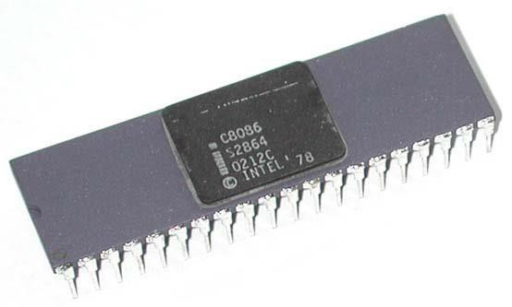
Intel 8086
Microprocessor and It’s Architecture
Diagram

Slide 2
8086 Microprocessor
A Microprocessor:
programmable logic
is a multipurpose
device which reads the
binary instructions from a storage device called ‘Memory’. It accepts binary data as input and process data according to the instructions and gives the results as output.
A microcomputer system consists of a CPU
(microprocessor), memories and I/O devices.

Slide 3
8086 Microprocessor
The CPU communicates with only one peripheral at a time by enabling the peripheral by the control signal sends data to the output device, it places the device address on the address bus, data on the data bus and enables the output device.
The other peripherals that are not enabled
remain in high impedance state called tri-state.

Slide 4
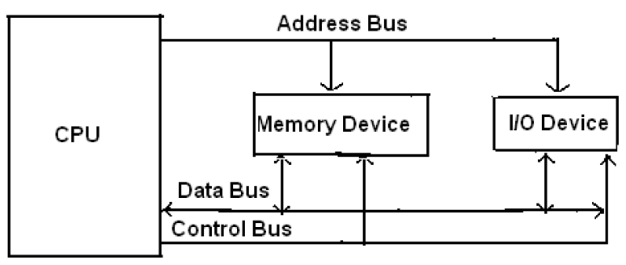
8086 Microprocessor
Block diagram of a Microcomputer

Slide 5
8086 Microprocessor
➢Belongs to a popular microprocessor
series 8086, 80186, 80286, 80386, 80486,
Pentium.
➢INTEL launched 8086 in 1978
➢8086 is a 16-bit microprocessor with
16-bit Data Bus
20-bit Address Bus

Slide 6
8086 Internal Architecture
8086 employs parallel processing.
8086 CPU has two parts which operate at the
same time
Bus Interface Unit
Execution Unit
CPU functions
8086 CPU
Bus Interface Unit (BIU)
1. Fetch
Decode
Execute
Execution Unit
(EU)

Slide 7
Bus Interface Unit
The BIU performs all bus operations such as instruction fetching, reading/writing operands for/to memory and calculating the addresses of the memory operands.
The instruction bytes are transferred to the
instruction queue.
It provides a full 16 bit bidirectional data bus and
20 bit address bus.
The bus interface unit is responsible for performing all external bus operations.

Slide 8
Execution Unit
➢Tells BIU (addresses) where to fetch
instructions or data.
➢Decoding and executing all instructions.
➢Dividing the work
between
BIU & EU
speeds up processing.

Slide 9
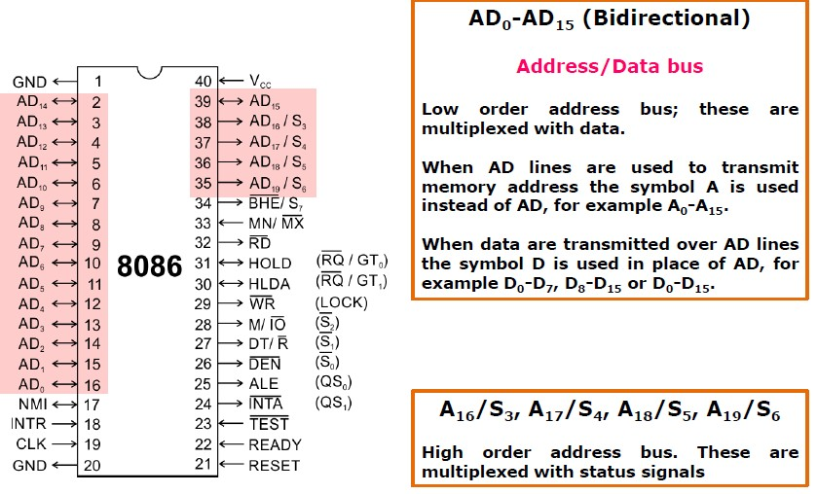
Logic Pins and Signals

Slide 10
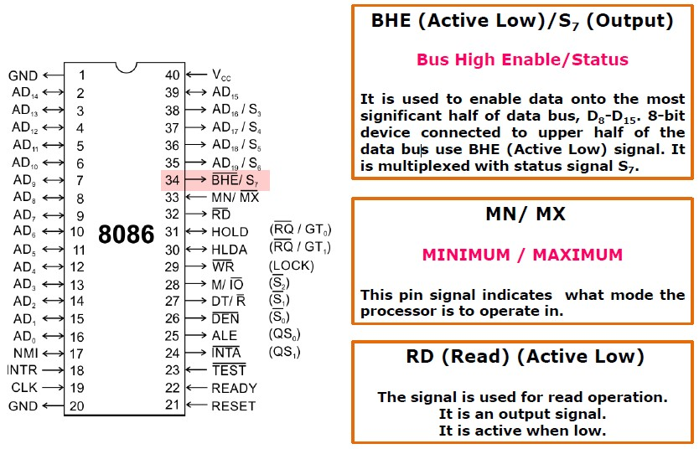
Logic Pins and Signals

Slide 11
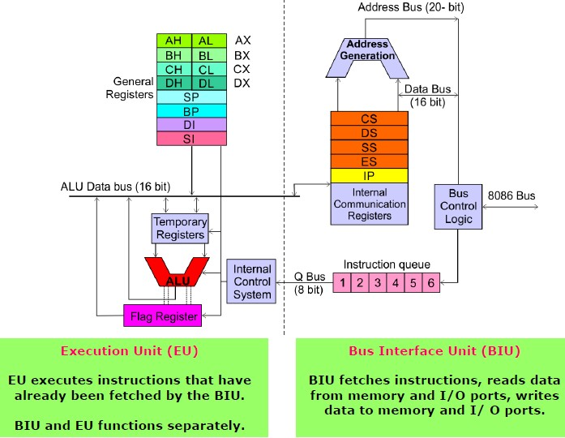
Architecture Overview

Slide 12
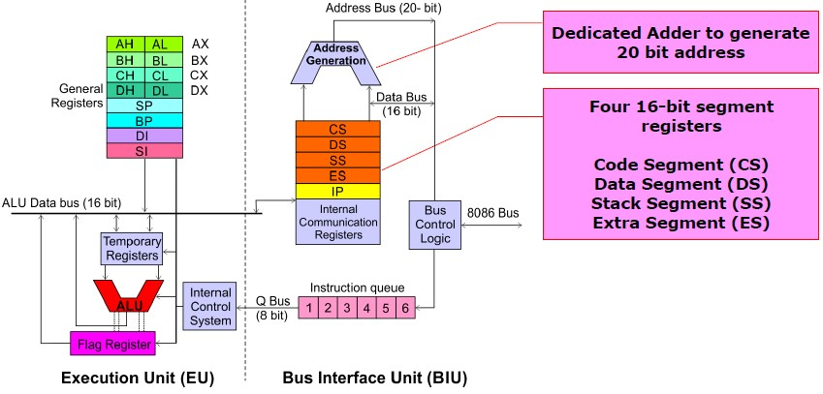
Architecture Overview

Slide 13
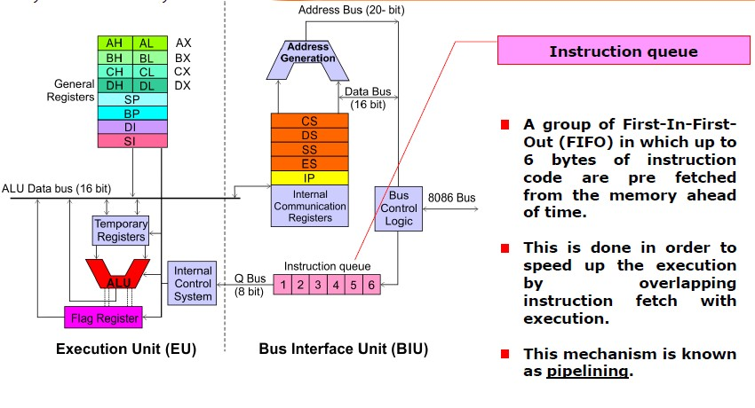
Architecture Overview

Slide 14
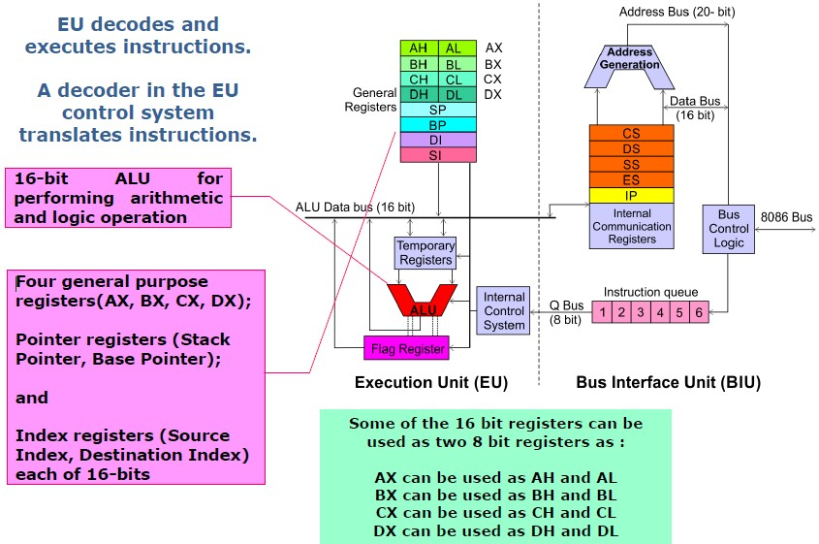
Architecture Overview

Slide 15
∑
EXTRA SEGMENT (ES)
CODE SEGMENT (CS)
STACK SEGMENT (SS)
DATA SEGMENT (DS)
INSTRUCTION POINTER (IP)
Memory Interface
BIU
6 | 5 | 4 | 3 | 2 | 1
Instruction Queue
Instruction Decoder
ARITHMETIC
LOGIC UNIT
CONTROL
SYSTEM
OPERANDS
AH | AL
BH | BL
CH | CL
DH | DL
STACK POINTER (SP)
BASE POINTER (BP)
SOURCE INDEX (SI)
DESTINATION INDEX (DI)
FLAGS
EU

Slide 16
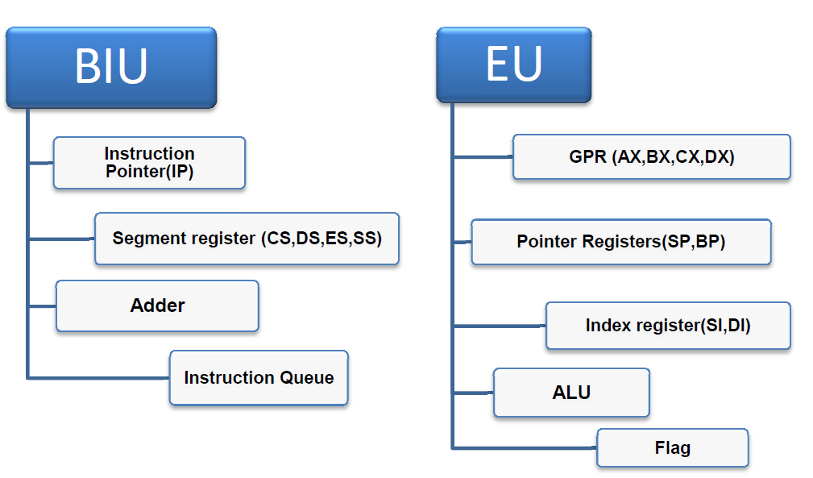

Slide 17
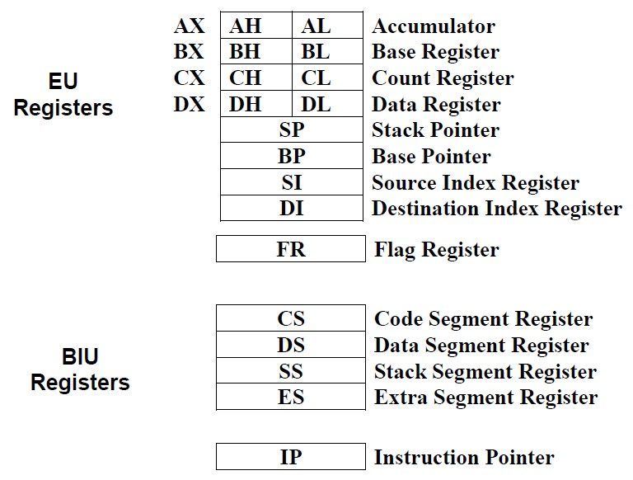
Internal Registers of 8086

Slide 18
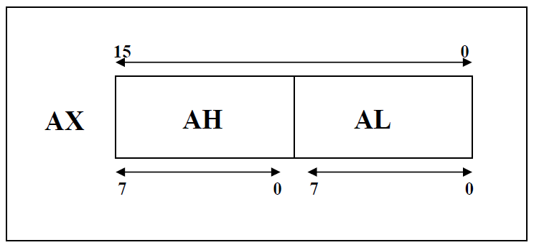
Data Registers in 8086
The general purpose registers, are used for arithmetic and data movement. Each register can be addressed as either 16-bit or 8 bit value. Example, AX register is a 16- bit register, its upper 8-bit is called AH, and its lower 8-bit is called AL. Bit 0 in AL corresponds to bit 0 in AX and bit 0 in AH corresponds to bit 8 in AX. See figure below.

Slide 19
General Purpose Registers
EU has 8 general purpose registers.
Two registers can also be combined to form 16-bit registers.
Can be individually used for storing 8-bit data.
AX register is also called Accumulator.
The valid register pairs are – AX, BX, CX, DX
AH | AL
BH | BL
CH | CL
DH | DL
AH | AL | AX
BH | BL | BX
CH | CL | CX
DH | DL | DX 19

Slide 20
Data Registers in 8086
Instructions can address either 16-bit data register as AX, BX, CX, and DX or 8-bit register as AL, AH, BL, BH, CL, CH, Dl, and DH.
If we move 126FH to AX then AL would immediately
6FH and AH = 12H.
* Each
general
purpose
register
has special
attributes:

Slide 21
Data Registers
AX (Accumulator): it is favored by the CPU for arithmetic operations. Other operations are also slightly more efficient when performed using AX.
BX (Base): the BX register can hold the address of a procedure or variable. Three other registers with this ability are SI, DI and BP. The BX register can also perform arithmetic and data movement.

Slide 22
Data Registers
3. CX (Counter):
the CX register
or looping
acts as a
counter for
repeating
instructions.
These instructions decrement CX.
automatically
repeat and
4. DX (Data): the DX register has a special role in multiply and divide operation. When multiplying for example DX hold the high 16 bit of the product.

Slide 23
Data Registers
Example:
MOV CL, 05H
START NOP
LOOP START
(No action except fetch and decode)
(here CL is automatically decremented by 1without DCR instruction).

Slide 24
Segment Registers
the CPU contain four segment registers, used as base location for program instruction, and for the stack.
CS (Code Segment): The code segment register holds the base location of all executable instructions (code) in a program.
DS (Data Segment): the data segment register is the default base location for variables. The CPU calculates their location using the segment value in DS.

Slide 25
Segment Registers
SS (Stack Segment): the stack segment register contain the base location of the stack.
ES (Extra Segment): The extra segment register is an additional base location for memory variables.

Slide 26
Index registers
index registers contain the offset of data and instructions. The term offset refers to the distance of a variable, label, or instruction from its base segment. The index registers are:
1. BP (Base Pointer):
the BP register contain an
assumed offset from the stack segment register (SS), as does the stack pointer. The base pointer register is often used by a subroutine to locate variables that were passed on the stack by a calling program.

Slide 27
Index registers
SP (Stack Pointer): the stack pointer register contain the offset of the top of the stack. The stack pointer and the stack segment register combine to form the complete address of the top of the stack.
SI (Source Index): This register takes its name from the string movement instruction, in which the source string is pointed to by the source index register.
4. DI (Destination Index): the DI register acts
destination for string movement instruction.
as the

Slide 28
Status and Control register:
IP (Instruction Pointer): The instruction pointer register always contain the offset of the next instruction to be executed within the current code segment. The instruction pointer and the code segment register combine to form the complete address of the next instruction.
The Flag Register: is a special register with individual bit positions assigned to show the status of the CPU or the result of arithmetic operations. The following figure describes the 8086/8088 flags register:

Slide 29
Flag Register
8086 has a 16-bit flag register.
Contains 9 active flags.
There are two types of flags in 8086:
  Conditional flags – six flags, set or reset by EU on the basis of results of some arithmetic operations.
  Control flags – three flags, used to control
certain operations of the processor.

Slide 30
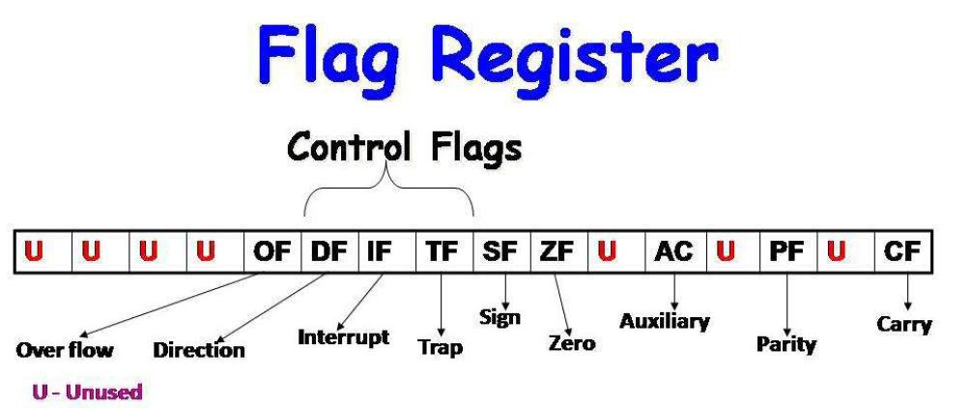

Slide 31
Flag Register
❑ Control Flags: individual bits can be set in the flag register by the programmer to control the CPU operation
, these are:
The Direction Flag (DF): affects block data transfer instructions, such as MOVS, CMPS, SCAS. The flag values are 0 = up and 1 = down.
The Interrupt flag (IF): dictates whether or not a system interrupt can occur. Such as keyboard, disk drive, and the system clock timer. A program will sometimes briefly disable the interrupt when performing a critical operation that cannot be interrupted. The flag values are 1 = enable, 0 = disable.

Slide 32
Flag Register
3. The Trap flag (TF): Determine whether or not the CPU is halted after each instruction. The flag values are 1 = on, 0 = off.
❑ Status Flags: The status flags reflect the outcomes of arithmetic and logical operations performed by the CPU, these are:
1. The Carry Flag (CF): is set when the result of an unsigned arithmetic operation is too large to fit into the destination for example, if the sum of 71 and 99 where stored in the 8-bit register AL, the result cause the carry flag to be 1. The flag values = 1 = carry, 0 = no carry.

Slide 33
Flag Register
The Overflow (OF): is set when the result of a signed arithmetic operation is too wide (too many bits) to fit into destination. 1 = overflow, 0 = no overflow.
Sign Flag (SF): is set when the result of an arithmetic of logical operation generates a negative result, 1= negative, 0 = positive.
4. Zero Flag (ZF): is set when the result of an arithmetic of logical operation generates a result of zero, the flag is used primarily by jump or loop instructions to allow branching to a new location in a program based on the comparison of two values. The flag value = 1 = zero, & 0 = not zero.

Slide 34
Flag Register
Auxiliary Flag: is set when an operation causes a carry from bit 3 to bit 4 (or borrow from bit 4 to bit 3) of an operand. The flag value = 1 = carry, 0 = no carry.
Parity Flag: reflect the number of 1 bits in the result of an operation. If there is an even number of bit, the parity is even. If there is an odd number of bits, parity is odd.

Slide 35
Segmented Memory
Reason for Segmented Memory:
8086 has a 20-bit address bus. So it can address a maximum of 1MB of memory and each memory location is addressed by a 20 bit address.
To hold a 20-bit address there must be a 20-bit address register available within processor but 8086 only has 16- bit registers. So 20-bit address can’t be stored inside the 16-bit register. To avoid this problem segmented memory is used in 8086.

Slide 36
Segmented Memory
Total 1MB memory can be divided into some equal size segments each of having capacity 64 KB. So max no of segments is 16. (1mb/64 kb=16)
8086 can work with only four 64KB segments at a time within this 1MB range. Each location in a particular segment can be expressed by two addresses.
1. Segment Address (16 bit):
It refers the starting
address of a segment and it is fixed for whole of the segment.
2. Offset or Displacement Address (16 bit): It refers the individual location in that segment and it is varied location wise.

Slide 37
By using these two addresses the 20 bit physical
address can be calculated as below:
According to this formula segment address is multiplied by 10 and is added to offset.This is equivalent to shifting of segment register content towards left 4 times so that four zero are added to right side (MSB) of the segment address and added with the offset address to get the physical address which is 20 bit.

Slide 38
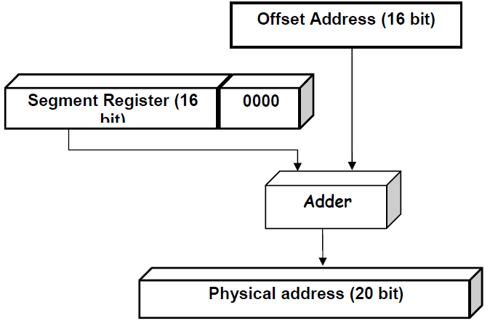
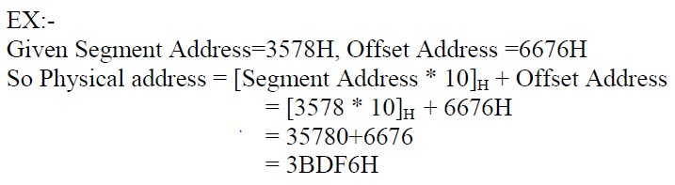

Slide 39
Memory
64KB Memory Segment
Only 4 such segments can be addressed at a time
1
2
3
4
5
6
7
8
9
10
11
12
13
14
15
16
00000H
5
6
7
1MB
Address
Range
8
FFFFFH

Slide 40
Memory
Code Segment
1
2
3
4
5
6
7
8
9
10
11
12
13
14
15
16
00000H
Data & Extra Segments
1MB
Address
Range
Stack Segment
FFFFFH

Slide 41
Memory
1
Code Segment
3
4
Data Segment
Extra Segment
7
8
9
10
11
12
13
14
15
Stack Segment
00000H
CS
DS
ES
1000 0H
4000 0H
5000 0H
Starting Addresses of Segments
1MB
Address
Range
SS
F000 0H
FFFFFH

Slide 42
Address of a segment is of 20-bits. A segment register stores only upper 16-bits.
BIU always inserts zeros for the lowest 4-bits of the 20-bit starting address.
E.g. if CS = 348AH, then the code segment will
start at 348A0H.
A 64-KB segment can be located anywhere in the memory, but will start at an address with zeros in the lowest 4-bits.
42

Slide 43
Memory
Start of Code Segment
348A0H
1
Data Segment
3
4
Code Segment
Extra Segment
7
8
9
10
11
12
13
14
15
Stack Segment
00000H
MOV AL, BL
IP = 4214H
Code Byte
38AB4H
1MB
Address
Range
CS
IP
Physical Address
348A0 H
+ 4214 H
38AB4 H
FFFFF⁴³H

Slide 44
Advantage of memory Segmentation
Allows the memory capacity to be 1 Mbytes although the actual addresses handled are of 16-bit size.
Allows the placing of code, data and stack portions of the same program in different parts (segments) of memory, for data and code protection.
Permits a program and/or its data to be put into different areas of memory each time the program is executed.

Slide 45
Addressing Data in Memory
Depending on the model, the processor can access one or more bytes of memory at a time. Consider the Hex value (0529H) which requires two bytes or one word of memory. It consist of high order (most significant) byte 05 and a low order (least significant) byte 29.
The processor store the data in memory in reverse byte sequence i.e. the low order byte in the low memory address and the high order byte in the high memory address. For example, the processor transfer the value 0529H from a register into memory address 04A26H and 04A27H like this:

Slide 46
Addressing Data in Memory
The processor expects numeric data in memory to be in reverse byte sequence and processes the data accordingly, again reverses the bytes, restoring them to correctly in the register as hexa. 0529H.
When programming in assembly language, you have to distinguish between the address of a memory location and its contents. In the above example the content of address 04A26H is 29, and the content of address 04A27H is 05.

Slide 47
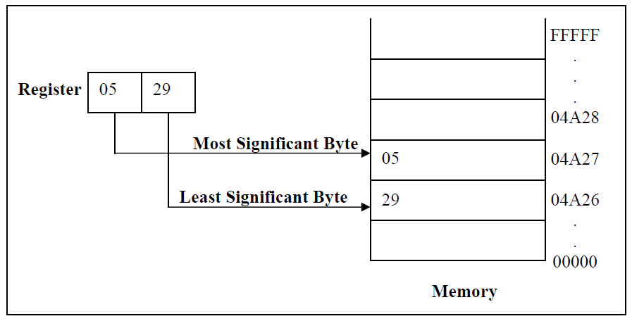
Addressing Data in Memory

Slide 48
Addressing Data in Memory
➢There are two types of addressing
schemes:
An Absolute Address, such as 04A26H, is a 20 bit value that directly references a specific location.
A Segment Offset Address, combines the starting address of a segment with an offset value.

Slide 49
Segments and Addressing
Segments are special area defined in a program for containing the code, the data, and the stack.
Segment Offset is memory locations within a segment are relative to the segment starting address.
The distance in bytes from the segment address to another location within the segment is expressed as an offset (or displacement).

Slide 50
Specifying addresses
To represent a segment address and its relative offset we use the notation:
Segment: offset
Thus 020A:1BCD denotes offset 1BCDH from segment 020AH.The actual address it refers to is obtained in the following way:
Add zero to the right hand side of the segment address.
Add to this the offset.
Hence the actual address referred to by 020A:1BCD is 03C6D.

Slide 51
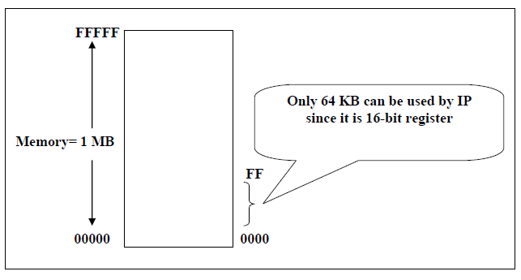
Instruction Pointer = 16 bit register which means the processor can only address 0 – 216 (65535) bytes of memory. But we need to write instructions in any of the 1MB of memory. This can be solved by using memory segmentation., where each segment register is 16-bit (this 16-bit is the high 16-bit of Address Bus (A4- A19))
i.e. each of the segment registers represent the actual address after shifting the address 4-bit to get 20 bits.

Slide 52
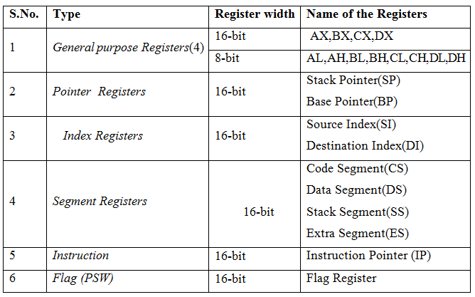
REGISTER ORGANISATION
The 14 registers of 8086 microprocessor are categorized into four groups as shown in the table below.

Slide 53
Instruction Execution and Addressing
An assembly language programmer write the a program in symbolic code and uses the assembler to translate it into machine code as EXE program. For program execution, the system looks only the machine code into memory.
Every instruction consists of at least one operation, such as MOV, ADD. Depending on the operation, an instruction may also have one or more operands that reference the data of the operation is to process.

Slide 54
Instruction Execution and Addressing
The basic steps the processor takes in executing on
instruction are:
1. Fetch
the next
instruction
to be
executed from
memory and place it in the instruction queue.
Decode the instruction, calculates addressed that reference memory, deliver data to the Arithmetic Logic Unit, and increment the instruction pointer (IP) register.
Execute the instruction, performs the request operation, store the result in a register or memory, and set flags such as zero or carry where required.

Slide 55
8086 Microprocessor
✓Outline of the Lecture:
Flag Registers and bit fields
80x86 addressing modes.

Slide 56
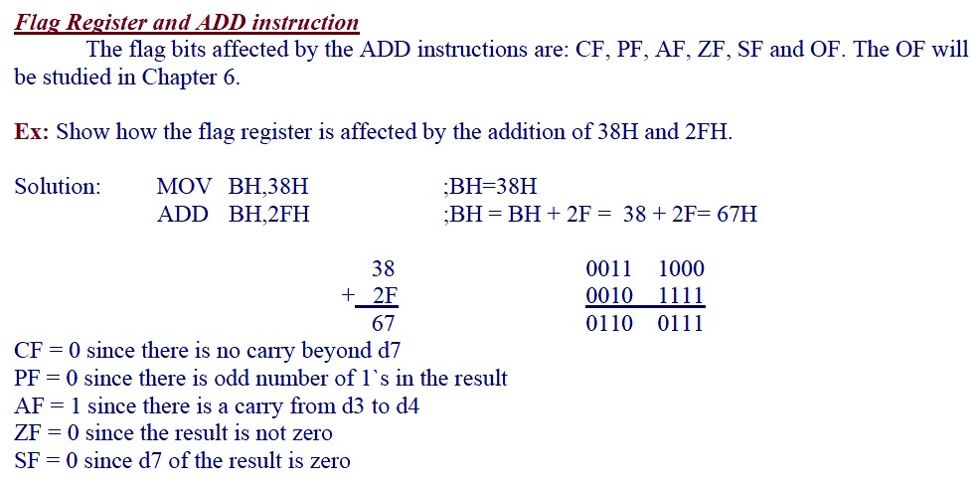

Slide 57
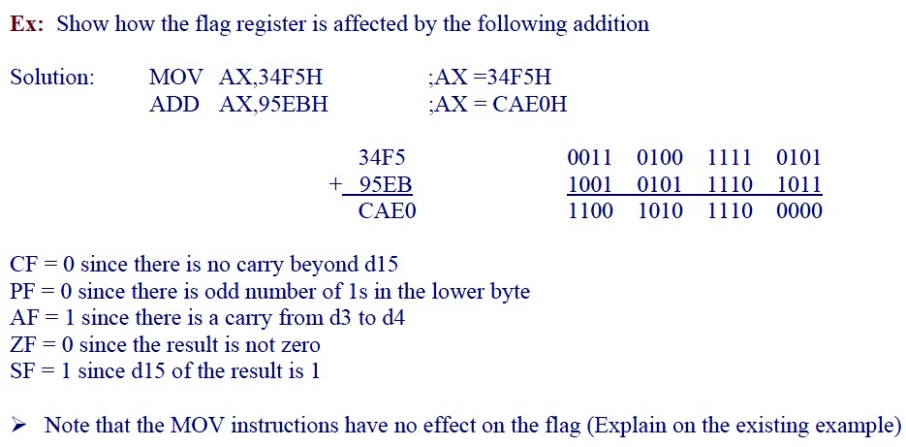

Slide 58
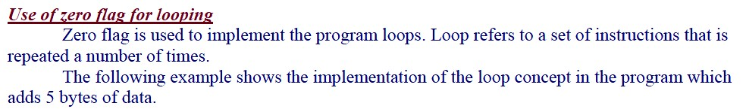
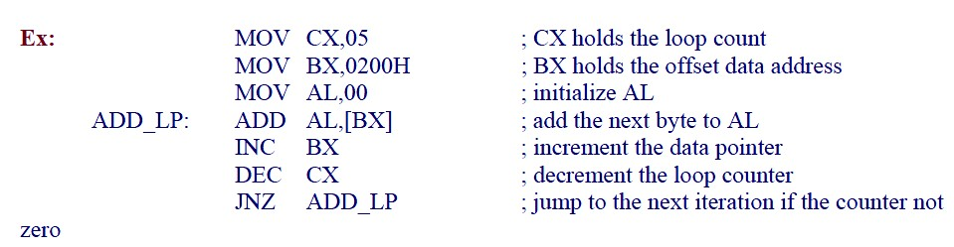

Slide 59
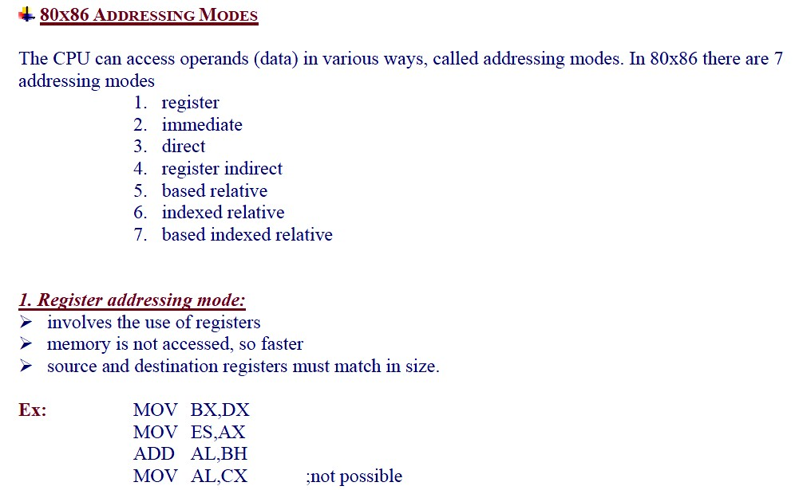

Slide 60
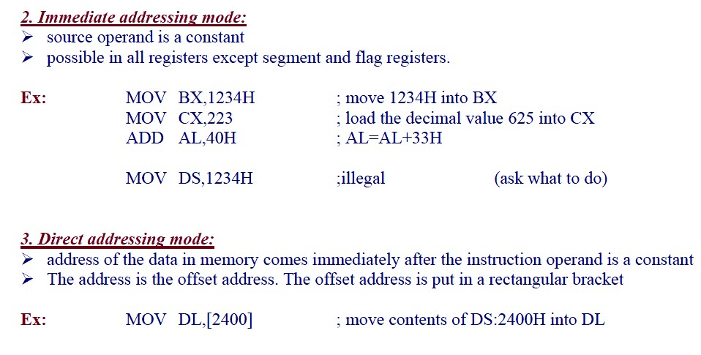

Slide 61
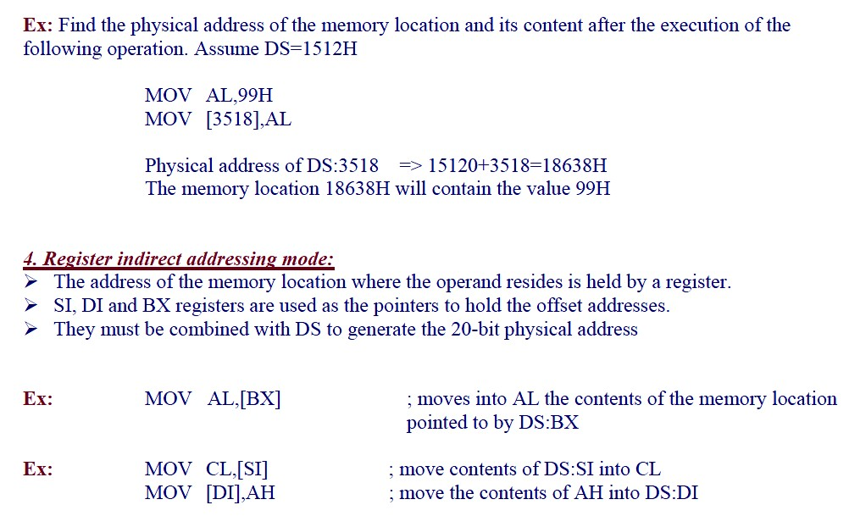

Slide 62
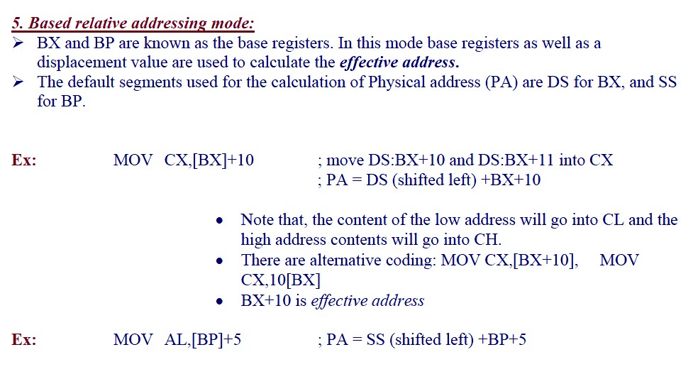

Slide 63
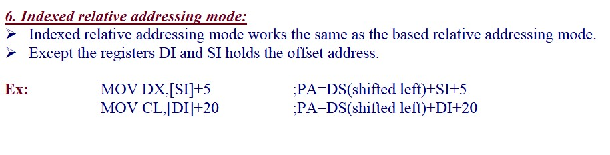

Slide 64
