Slide 1
University of Diyala
Information Theory
Marwa Mohammed Communication department / Engineering collage
The University of Diyalia
2017-2018

Slide 2
Convolutional codes
Convolutional codes offer an approach to error control coding substantially different from that of block codes.
  A convolutional encoder:
    encodes the entire data stream, into a single codeword.
    does not need to segment the data stream into blocks of fixed size.
    is a machine with memory.

Slide 3
Convolutional codes-cont’d
A Convolutional code is specified by three parameters (n, k, K ) or (k / n, K ) where
■
R_{c}
= k / n is the coding rate, determining the
number of data bits per coded bit.
In practice, usually k=1 is chosen.
K is the constraint length of the encoder and the encoder has K-1 memory elements.

Slide 4
A Rate ½ Convolutional encoder
Convolutional encoder (rate ½, K=3)
  3 shift-registers where the first one takes the incoming data bit and the rest, form the memory of the encoder.
u₁
First coded bit
(Branch word)
Input data bits
Output coded bits
m
u₁, u₂
Second coded bit
u₂

Slide 5
A Rate ½ Convolutional encoder
Message sequence:
m = (101)
Time
Output (Branch word)
Time
Output (Branch word)
1 |  | 0 | 0
u₁
0 |  | 1 | 0
u₁
t₁
u₁ u ₂
1 1
t₂
u₁ u ₂
1 0
u ₂
u ₂
1 |  | 0 | 1
u₁
0 |  | 1 | 0
u₁
t₃
u₁ u ₂
0 0
t₄
u₁ u ₂
1 0
u ₂
u ₂

Slide 6
A Rate ½ Convolutional encoder
Time
Output (Branch word)
Time
Output (Branch word)
0 |  | 0 | 1
u₁
0 |  | 0 | 0
u₁
t₅
u₁ u ₂
1 1
t₆
u₁ u ₂
0 0
u ₂
u ₂
m = (101)
Encoder
U = (11 10
00 10 11)

Slide 7
Effective code rate
Initialize the memory before encoding the first bit (all- zero)
Clear out the memory after encoding the last bit (all- zero)
  Hence, a tail of zero-bits is appended to data bits.
data
tail
Encoder
codeword
Effective code rate :
  L is the number of data bits and k=1 is assumed:
L
^{R}eff ⁼
< R = ¹
c
n(L + K −1) n

Slide 8
Encoder representation
Vector representation:
  We define n binary vector with K elements (one vector for each modulo-2 adder). The i-th element in each vector, is “1” if the i-th stage in the shift register is connected to the corresponding modulo- 2 adder, and “0” otherwise.
    Example:
g = (111)
u₁
1
m
u₁ u₂
g = (101)
2
u₂

Slide 9
State diagram
A finite-state machine only encounters a finite number of states.
State of a machine: the smallest amount of information that, together with a current input to the machine, can predict the output of the machine.
In a Convolutional encoder, the state is represented by the content of the memory.
Hence, there are
₂K −1
states.

Slide 10
State diagram – cont’d
A state diagram is a way to represent the encoder.
A state diagram contains all the states and all possible transitions between them.
Only two transitions initiating from a state
Only two transitions ending up in a state

Slide 11

State diagram – cont’d
0/00
Current state | input | Next state | output
S₀ 00 | 0 | S | 00
 | 1 | S₂ | 11
S₁ 01 | 0 | S₀ | 11
 | 1 | S₂ | 00
S₂ 10 | 0 | S₁ | 10
 | 1 | S₃ | 01
S₃ 11 | 0 | S₁ | 01
 | 1 | S₃ | 10
Output
Input
(Branch word)
S₀
0
1/11
00
0 / 11
1/00
S₂
S₁
01
10
0/10
1/01
S₃
0/01
11
1/10

Slide 12
Trellis – cont’d
Trellis diagram is an extension of the state diagram that shows the passage of time.
  Example of a section of trellis for the rate ½ code
State
S₀ = 00
S₂ = 10
0/00
1/11
0/11
1/00
0/10
S₁ = 01
S₃ = 11
1/01
0/01
1/10
t_{i}
^{t}i+1
Time

Slide 13







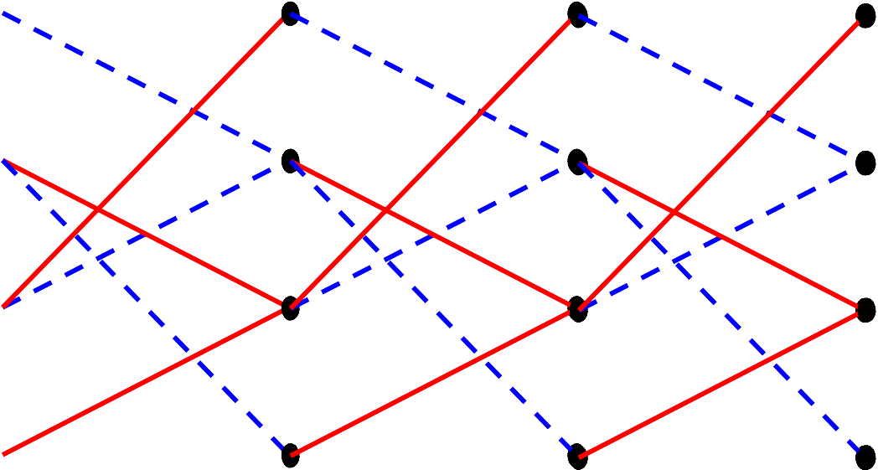
Trellis –cont’d
A trellis diagram for the example code.
Input bits
Tail bits
1 | 0 | 1 | 0 | 0
Output bits
11 | 10 | 00 | 10 | 11
0/00
0/00
0/00
0/00
0/00
1/11
0/11
1/00
_{1/01} 0/10
0/01
1/10
1/11
0/11
1/00
_{1/01} 0/10
0/01
1/10
1/11
0/11
1/00
_{1/01} 0/10
0/01
1/10
1/11
0/11
1/00
_{1/01} 0/10
0/01
1/10
1/11
0/11
1/00
_{1/01} 0/10
0/01
1/10
t ₁
t ₂
t ₃
t ₄
t ₅
t ₆

Slide 14






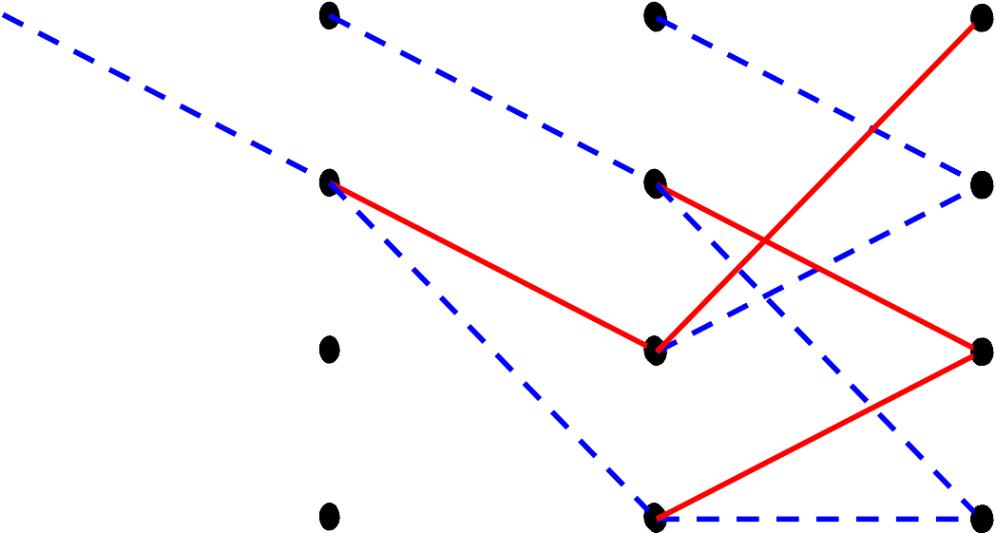
Trellis – cont’d
Input bits
Tail bits
1 | 0 | 1 | 0 | 0
Output bits
11 | 10 | 00 | 10 | 11
0/00
0/00
0/00
0/00
0/00
1/11
1/11
1/11
0/11
1/00
_{1/01} 0/10
0/01
1/10
t ₄
0/11
0/10
0/11
0/10
1/01
0/01
t ₁
t ₂
t ₃
t ₅
t ₆

Slide 15
The Viterbi Decoding Algorithm
The Viterbi algorithm performs Maximum Likelihood decoding.
It finds a path through trellis with the largest metric (maximum correlation or minimum distance).
It processes the demodulator outputs in an iterative manner.
At each step in the trellis, it compares the metric of all paths entering each state, and keeps only the path with the largest metric, called the survivor, together with its metric.
It proceeds in the trellis by eliminating the least likely paths.
■
■
■
It reduces the decoding complexity to
_{L2}K −1 !

Slide 16
The Viterbi algorithm - cont’d
Viterbi algorithm:
A. Do the following set up:
For a data block of L bits, form the trellis.
■
The trellis
has L+K-1 sections or levels and starts at time t₁ and ends up at time t_{L+ K} .
Label all the branches in the trellis with their corresponding branch metric.
■
■
For each state in the trellis at the time
t_{i}
which is
denoted by S (t ) ∈{0,1,...,2^{K −1}}, define a parameter Γ(S (t_{i} ), t_{i} )
i
B. Then, do the following:

Slide 17
The Viterbi algorithm - cont’d
Set
At time t_{i}
Γ(0, t₁ ) = 0 and
i = 2.
, compute the partial path metrics for
all the paths entering each state.
Set Γ(S (t_{i} ), t_{i} ) equal to the best partial path metric entering each state at time t_{i} .
Keep the survivor path and delete the dead paths from the trellis.
If i < L + K , increase i by 1 and return to step 2.
C. Start at state zero at time t_{L+ K} . Follow the surviving branches backwards through the trellis. The path thus defined is unique and correspond to the ML codeword.

Slide 18
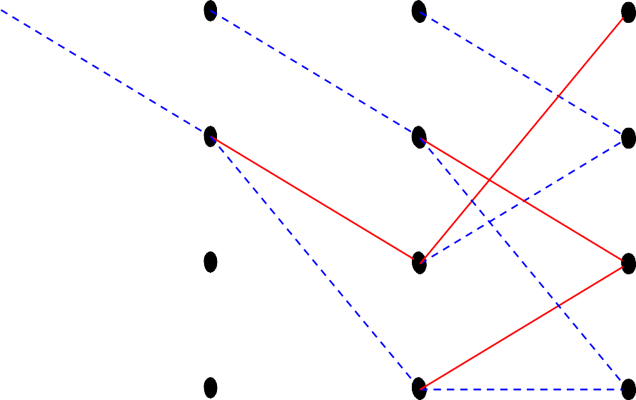
Example of Viterbi decoding
m = (101)
Source message
U = (11 10 | 00 | 10 11) | Codeword to be transmitted
Z = (11 10 | 11 | 10 01) | Received codeword
0/00
0/00
0/00
0/00
0/00
1/11
1/11
1/11
0/11
1/00
0/10
1/01
0/01
1/10
0/11
0/11
0/10
1/01
0/10
0/01
t ₁
t ₂
t ₃
t ₄
t ₅
t ₆

Slide 19
Example of Viterbi decoding-cont’d
Label all the branches with the branch metric (Hamming distance)
Γ(S (t_{i} ), t_{i} )
1
0
2
1
2
1
0
1
0
0
1
1
2
1
0
0
1
1
2
1
t ₁
t
2
t
3
t
4
5
t
6

Slide 20
Example of Viterbi decoding-cont’d
i=2
0
2
2
1
2
1
1
0
1
0
0
0
1
1
2
1
0
0
1
1
2
1
t ₁
t
2
t
3
t
4
5
t
6

Slide 21
Example of Viterbi decoding-cont’d
i=3
0
2
2
1
3
2
1
1
0
1
0
0
3
0
1
1
2
1
0
0
0
1
1
2
2
1
t ₁
t
2
t
3
t
4
5
t
6

Slide 22
Example of Viterbi decoding-cont’d
i=4
0
2
2
1
3
2
0
1
1
0
1
0
0
3
0
2
1
1
1
2
0
0
3
0
1
1
2
2
1
3
t ₁
t
2
t
3
t
4
5
t
6

Slide 23
Example of Viterbi decoding-cont’d
i=5
0
2
2
1
3
2
0
1
1
1
0
1
0
0
3
0
2
1
1
1
2
0
0
3
0
2
1
1
2
2
1
3
t ₁
t
2
t
3
t
4
5
t
6

Slide 24
Example of Viterbi decoding-cont’d
i=6
0
2
2
1
3
2
0
1
1
1
2
0
1
0
0
3
0
2
1
1
1
2
0
0
3
0
2
1
1
2
2
1
3
t ₁
t
2
t
3
t
4
5
t
6

Slide 25
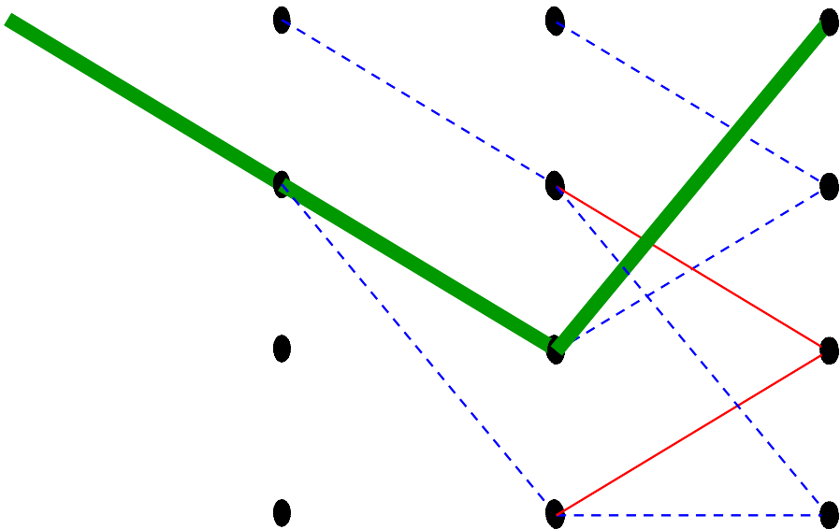
Example of Viterbi decoding-cont’d
Trace back and then:
mˆ = (100)
U^{ˆ} = (11 10 11 00
00) There are some decoding errors.
0
2
2
1
3
2
0
1
1
1
2
0
1
0
0
3
0
2
1
1
1
2
0
0
3
0
2
1
1
2
2
1
3
t ₁
t
2
t
3
t
4
5
t
6

