Slide 1
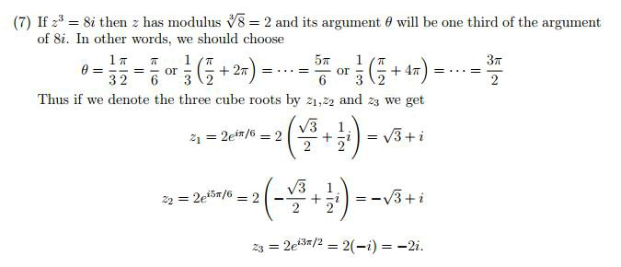
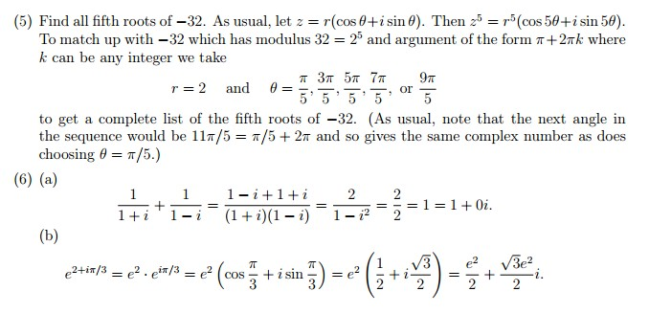
Tutorial Sheet Two

Slide 2
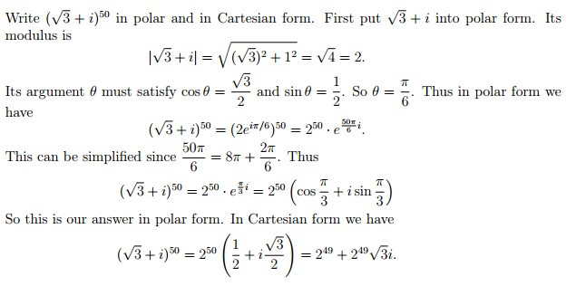
Tutorial Sheet Two

Slide 3
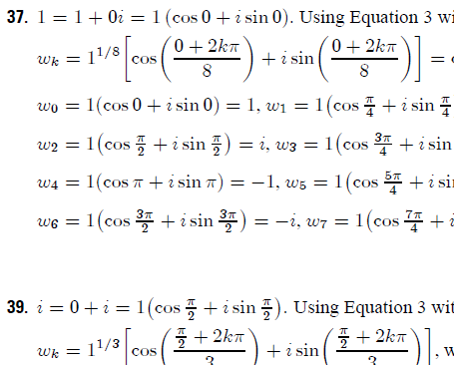
Tutorial Sheet Two

Slide 4
Tutorial Sheet Two

Slide 5
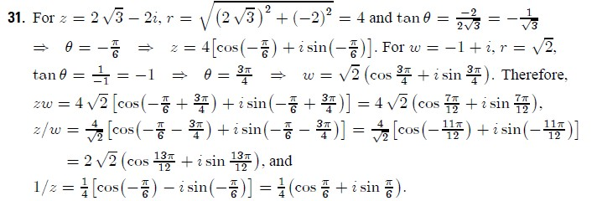
Tutorial Sheet Two

Slide 6
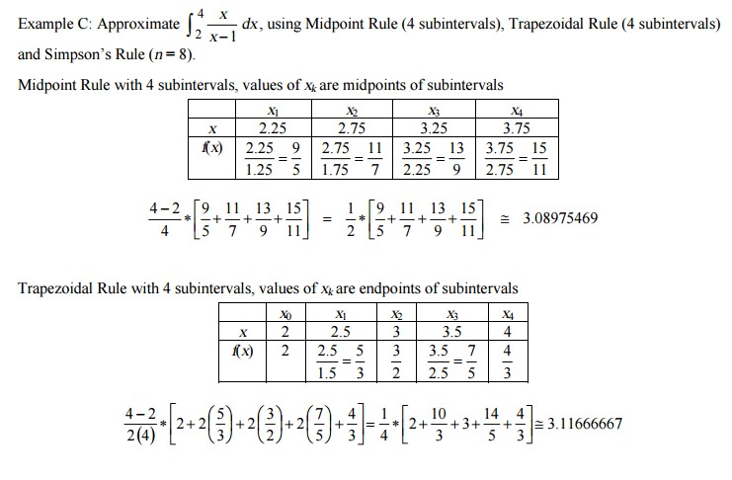
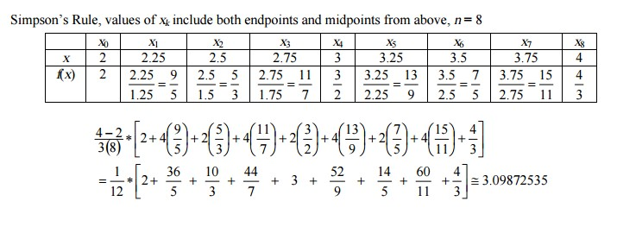
Tutorial Sheet Two

