Slide 1
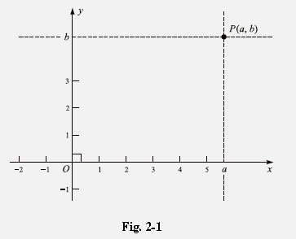
Chapter One
Basic Principles and Review
1.1 COORDINATE SYSTEMS :-
a) Coordinate System on a Line:
Let L be a line. Choose a point O on the line and call this point the origin and select a direction along L; say, the direction from left to right on the diagram. For every point P to the right of the origin O, let the coordinate of P be the distance between O and P.
In the diagram: The origin O is assigned the number (0) as its coordinate. This assignment of real numbers to the points on the line L is called a coordinate system on L.
Choosing a different origin, a different direction along the line, or a different unit distance would result in a different coordinate system.
b) Cartesian Coordinate in a Plane:
By found a correspondence between the points of a plane and pairs of real numbers. Choose two perpendicular lines in the plane of Fig. 2-1. Let us assume for the sake of simplicity that one of the lines is horizontal and the other vertical. The horizontal line will be called the x-axis and the vertical line will be called the y-axis.

Slide 2
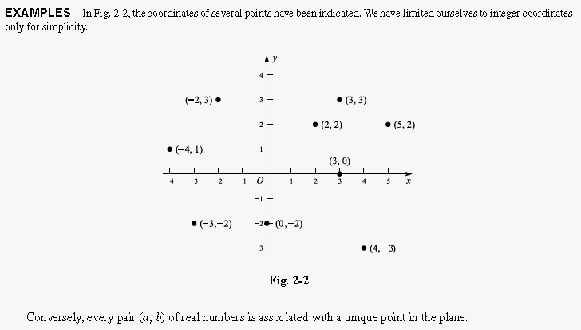
Next choose a coordinate system on the x-axis and one on the y-axis. The origin for both coordinate systems is taken to be the point O, where the axes intersect. The x-axis is directed from left to right, the y-axis from bottom to top. Consider any point P in the plane. Take the vertical line through the point P, and let be the coordinate of the point where the line intersects the x-axis. The number b is called the y coordinate of P. Every point has a unique pair (a, b) of coordinates associated with it.

Slide 3
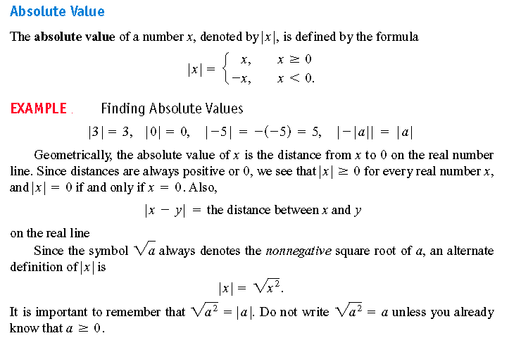
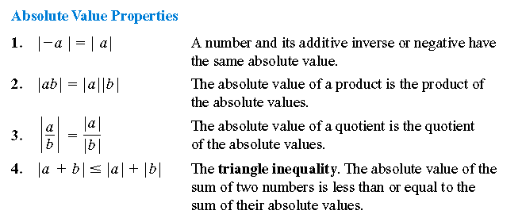

Slide 4
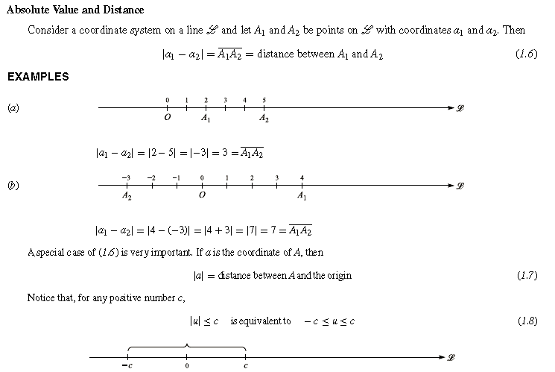

Slide 5
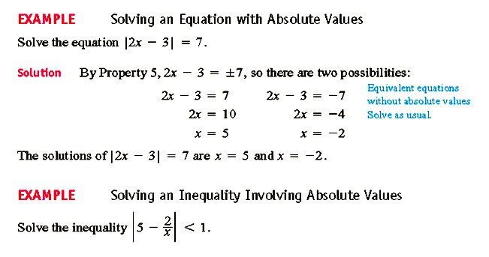
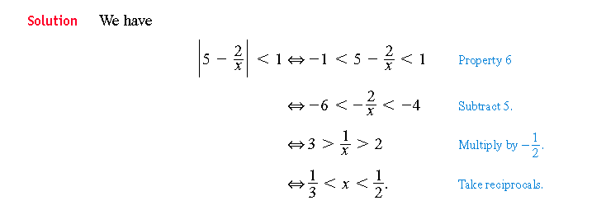
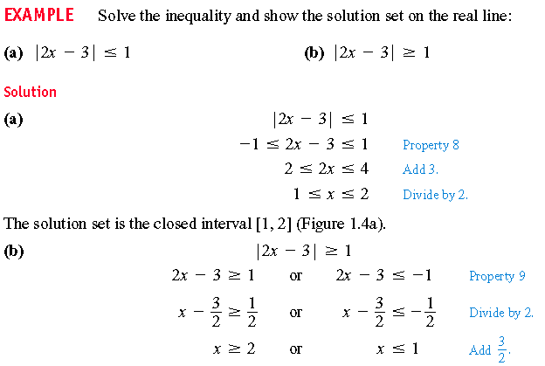

Slide 6
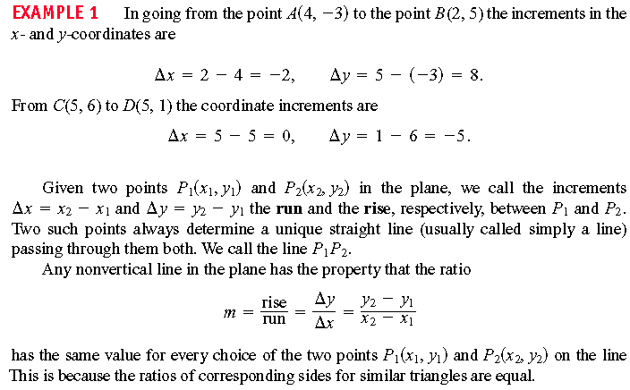
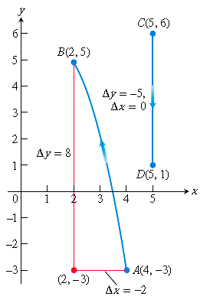
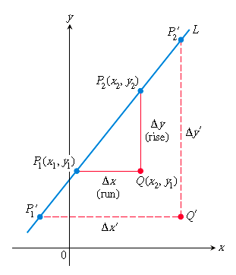
2.2 Increments and Straight Lines:
When a particle moves from one point in the plane to another, the net changes in its coordinates are called increments. They are calculated by subtracting the coordinates of the starting point from the coordinates of the ending point. If x changes from to the increment in x is :
∆� = �� − ��

Slide 7
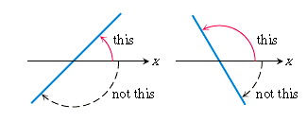
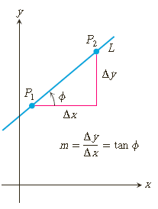
The slope tells us the direction of a line. The direction of a line can be measured with an angle. The angle of a line that crosses the x-axis is the smallest counterclockwise angle from the x-axis to the line as shown in figure.
The relationship between the slope m of a non vertical line and the line’s angle of inclination ∅ is shown in Figure:

Slide 8
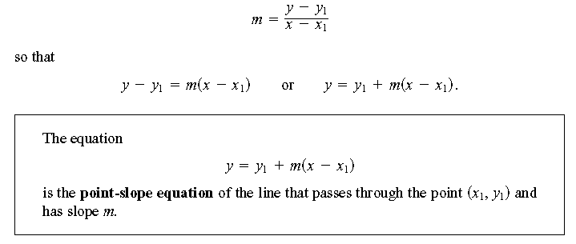
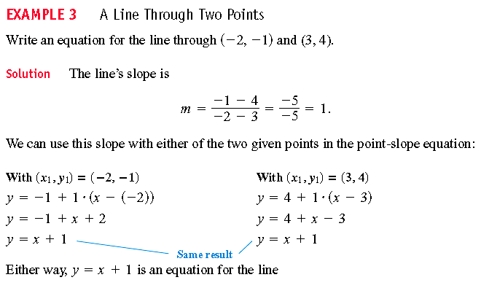
We can write an equation for a non vertical straight line L, if we know its slope m and the coordinates of one point 𝐩�(��, ��)on it . If 𝐩(x, y) is any other point on L, then we can use the two points 𝐩� and
𝐩to compute the slope,

Slide 9
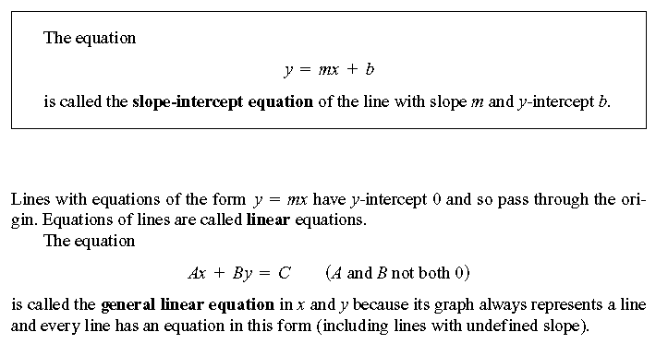
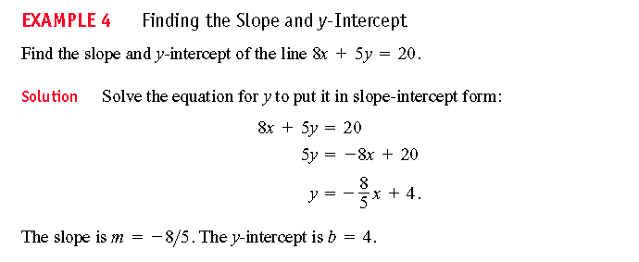
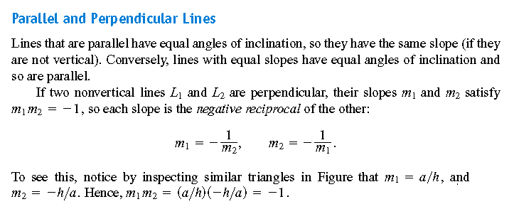

Slide 10
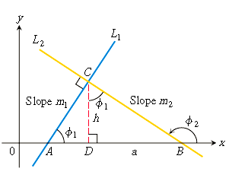
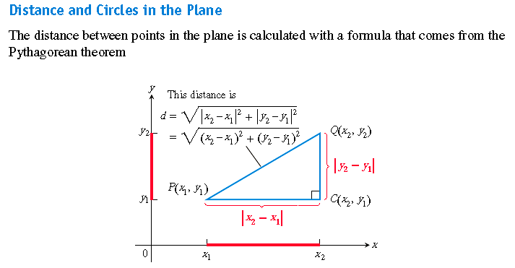
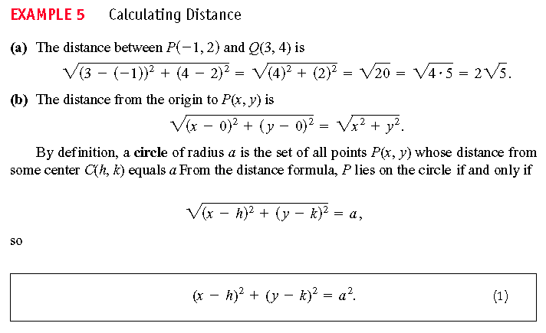
10

Slide 11
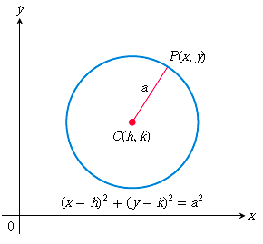
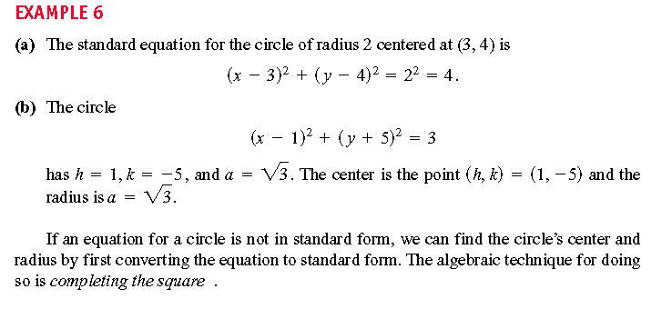

Slide 12
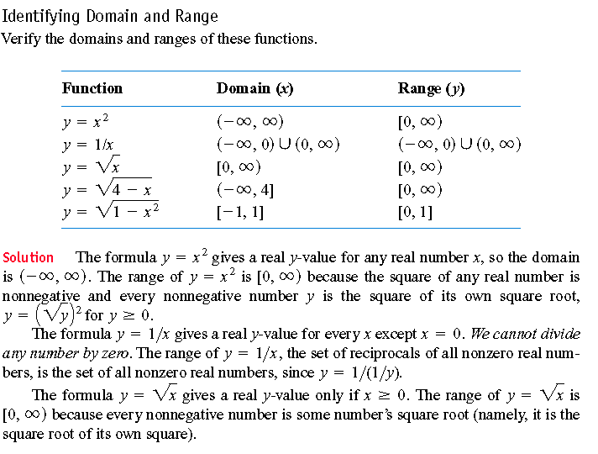
Functions and Their Graphs:
The value of one variable quantity, which we might call (y), depends on the value of another variable quantity, which we might call (x). Since the value of (y), is completely determined by the value of (x), we say that y is a function of x. A symbolic way to say “y is a function of x” is by writing:-
The set D of all possible input values is called the domain of the function. The set of all values of ƒ(x) as x varies throughout D is called the range of the function. The range may not include every element in the set Y.

Slide 13
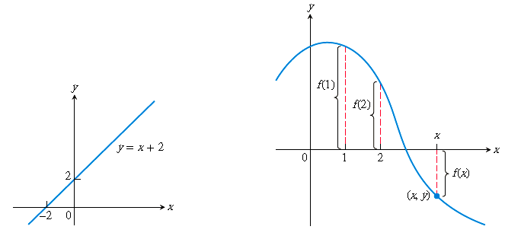
Graphs of Functions:

Slide 14
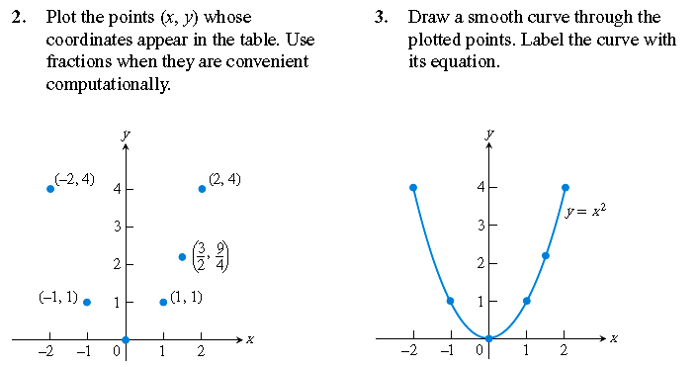
3- LIMITS AND CONTINUITY :
It is fundamental to finding the tangent to a curve or the velocity of an object. The geometric application of using limits to define the tangent to a curve leads at once to the important concept of the derivative of a function.

Slide 15
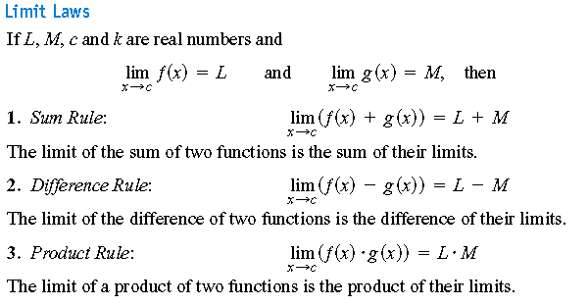
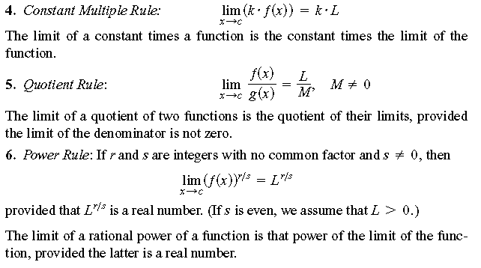

Slide 16
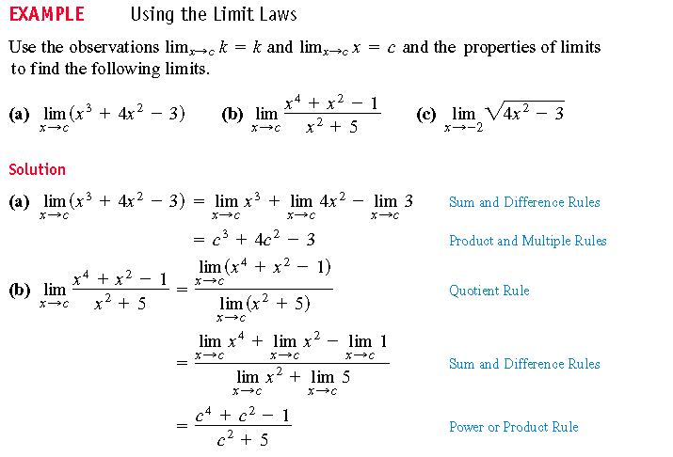

Slide 17
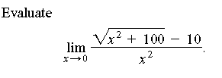
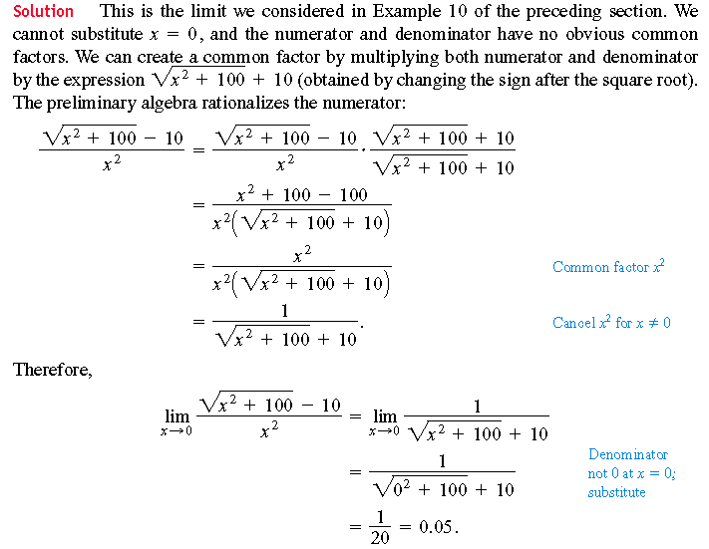

Slide 18
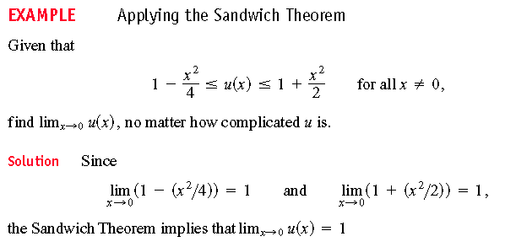

Slide 19
