Slide 1
Investigation of Advanced Modulation Formats
for Terabit Short Reach Optical
Communication Systems
By
Majidah Hameed Majeed
28-12-2017
Majidah Hameed Majeed

Slide 2
Contents
Aim of the work
Introduction
CAP modulation: Problem definition, CAP modulator
Investigation, design and simulation of 112 Gb/s multiband CAP/QAM system
Investigation, design, and simulation of extended 1.8 Tb/s system
Applications
Conclusions
Future work
Majidah Hameed Majeed

Slide 3
Aim of the work
Investigate + analysis of terabit transmission for short reach optical communication systems
Investgate CAP/QAM system
2
Investigate, plan the careful consideration in performing and setting the accurate values of the parameters for WDM to simulate the extended system
1
Design +analysis of 112 Gb/s optical communication system based CAP format
Theoretical modeling framework and performance assessment
100 GHz channel spacing
200 GHz channel spacing
Derive mathematical expressions of the system using
Present the design and investigation of 1.8 Tb/s WDM system based on multiband CAP-16 using 16 CW lasers and SMF operating at C band and O band to be compared with that of single-band
CAP transmitter
QAM or CAP receiver
Specify simulation Parameters
Simulate the performance of the systems using OptiSystem 14.0

Slide 4
Introduction
Over the last decades, the users’ needs have been varied from emails and commercial dealing documents to extended broadband access.
The demand for 100 Gb/s transmission capacity has been strengthened by the expectations of 40/100 Gigabit Ethernet (GbE).
. When the number of different services of the users and access chances are increased, the high speed of local area network (LAN) interfaces such like 40 GbE and 100 GbE are needed.

Slide 5
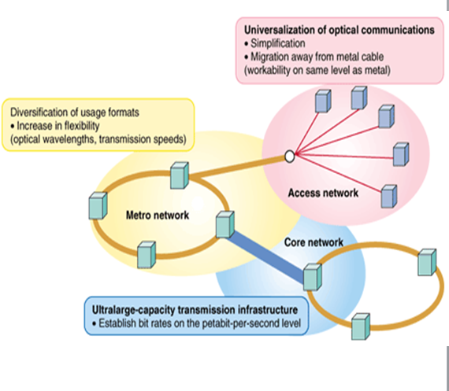
Introduction to short reach-optical communication system
Core networks join towns (long-haul)
Metro networks urban states
as a bridge between core & access
Access networks transfer data between users
Critical roll in data center communications.
Growing bandwidth demand is much more
than that of long-haul.
Key considerations;
Power & cost efficiency and transmission performance
Majidah Hameed Majeed

Slide 6
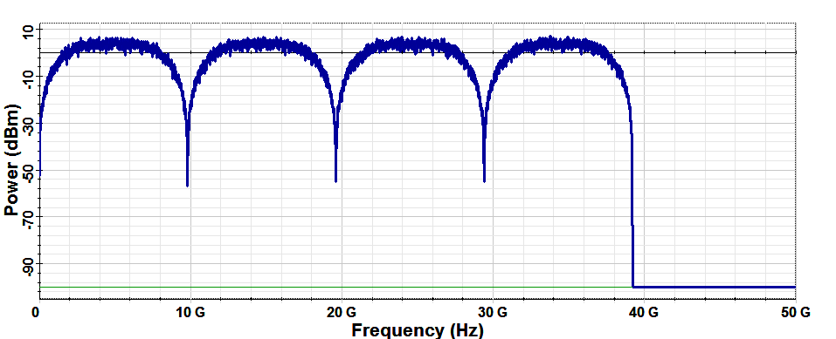
$$\text{P}\text{roblem} \text{definition}$$
PAM limits its SE, high number
of levels are affected by noise.
PAM affected by nonlinear
transfer function of modulator.
PAM affected by CD & LP channel charactersitic
It neither requires DFT as
compared to OFDM
nor complex mixer and
LO compared to QAM
Problem: extra bit
rate, low power
and low cost
PAM mapper
I-Tx. Filter
Solution
PAM mapper
Q-Tx. Filter
Data
S/P
MB-CAP
PAM mapper
I-Tx. Filter
CAP is of Spectral efficiency
PAM mapper
Q-Tx. Filter
Subbands of MB-CAP are of different $f_{k,c}$, lower symbol rate, power may be adapted to each sub-band SNR. Then overcomes the significant defect of SB-CAP (flat frequency response) then MB-CAP lowers PAPR.
It supports single laser
100 Gb/s IM/DD optical link
Simpler DSP does not
require ADC or DAC

Slide 7
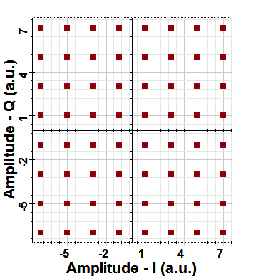
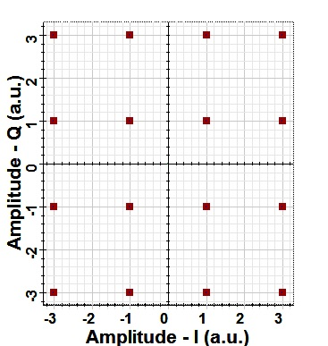
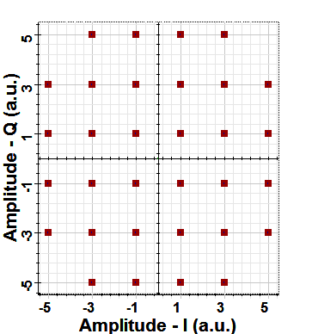
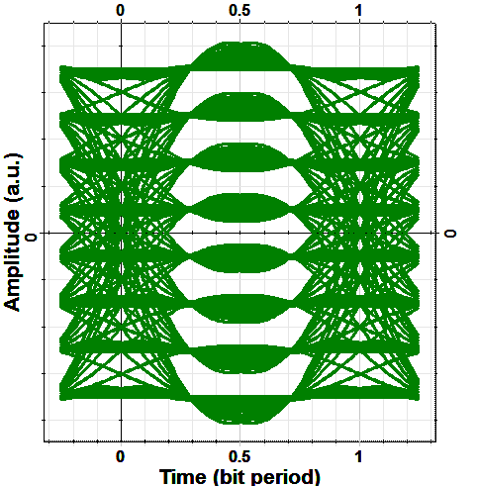
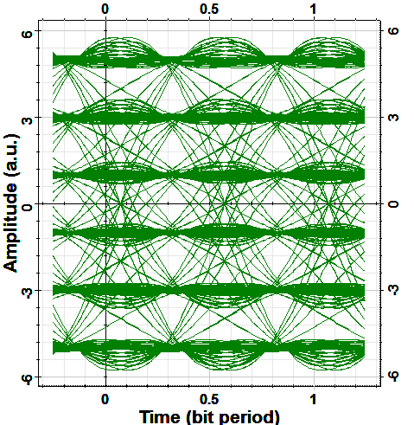
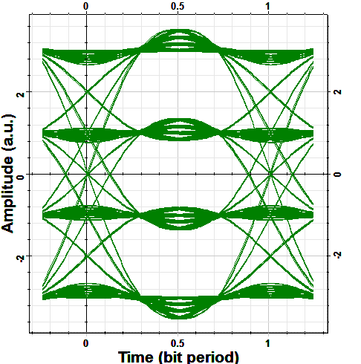
$$\text{Mapping} \text{to} \text{ideal} \text{CAP} \text{format}$$
0 1 1 0 1 0 11110001001111
0 1 1 0
1 0 111
100010
Mapper

Slide 8
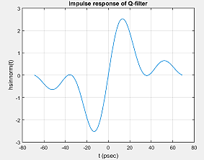
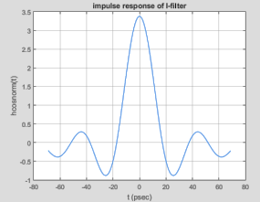
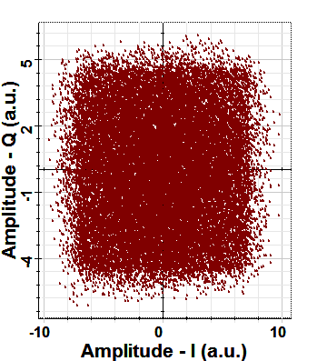
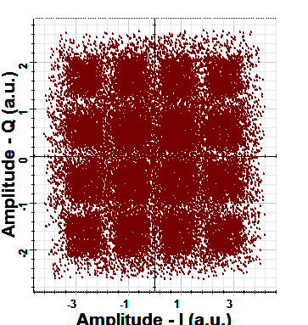
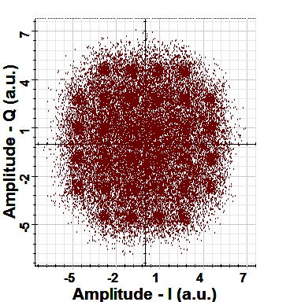
$$\text{CAP} \text{Modulator}$$
0 1 1 0 1 0 11110001001111
0 1 1 0
1 0 111
100010
SRRC shaping filters
CAP modulator

Slide 9
Advantages of CAP modulation
PAM mapper
I-Tx. Filter
It increases the SE by increasing the order of modulation.
PAM mapper
Q-Tx. Filter
Data
S/P
PAM mapper
I-Tx. Filter
Since CAP format is of high bandwidth efficiency low implementation costs.
PAM mapper
Q-Tx. Filter
Transmitter
MZM
CW Laser
SMF
It is of excellent performance using low cost limited bandwidth DML and VCSEL lasers.
QAM de-mapper
Decision
Offline Processing
PD
Clock recovery
QAM Demodulator
Clock recovery
It allows high data rate.
Data
P/S
QAM de-mapper
Decision
Offline Processing
Clock recovery
QAM Demodulator
Clock recovery
Receiver
Majidah Hameed Majeed

Slide 10
Investigation, design and simulation of 112 Gb/s multiband CAP/QAM system
Effect of Roll-off Factor
Effect of Number of Subbands
Maximum Allowable Distance
4 Subbands
CAP-16/QAM-16
Effect of Operating Wavelength
Effect of Roll-off Factor
CAP-32/QAM-32
8 Subbands
CAP-64/QAM-64
16 Subbands
Effect of Modulation Order
Majidah Hameed Majeed

Slide 11
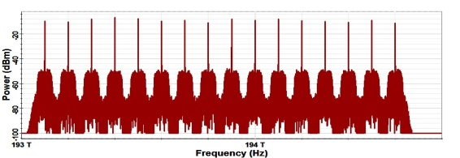
Investigation, design and simulation of 1.8 Tb/s extended system
MB-CAP TX1
PD
LPF
CW Laser
MZM
MB-QAM RX1
MB-CAP TX2
PD
LPF
SMF
CW Laser
MZM
MB-QAM RX2
WDM Multiplexer
WDM De-Multiplexer
…
…
…
…
PD
LPF
MB-CAP TX16
CW Laser
MZM
MB-QAM RX16

Slide 12
Applications
CAP has been widely used in asynchronous digital subscriber link and asynchronous transfer mode local area network.
Data-center applications among which are high quality television, video-on-demand online gaming, and high speed internet.
High speed of local area network (LAN) interfaces.
The multimedia services and cloud computed requirements.

Slide 13
Thank you for Your Listening

