Slide 1

steganography and watermarking
Prepared by:-
Asst. Lec. Jinan N. Shehab
University Of Diyala
College Of Engineering
Department of Communication

Slide 2



CONTENTS
WHAT?
  Introduction to information hiding
HOW?
  Theory behind hiding data
What are the differences?
  Watermarking V. Steganography

Slide 3
INTRODUCTION
With the development of the network technology, people are getting more and more information from the Internet. Information security is an important matter in communication systems
So Information hiding techniques are received increasing attention due to the availability of multimedia and digital form objects and the need to present solutions to criminal copying and copyright problems.

Slide 4
CLASSES OF INFORMATION HIDING
Information hiding is the process of hiding the details of an object or function.
Cryptography
Steganography
Digital watermarking
Covert channels
Digital signature
Fingerprinting

Slide 5

CRYPTOGRAPHY
which provides security to multimedia by converting original data to another data which is difficult to understand
Original Image
Encryption image
Decryption Image

Slide 6
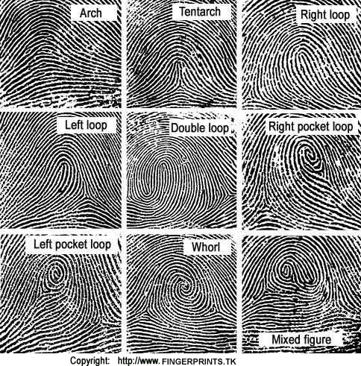
FINGERPRINTS
are a reproduction of friction skin ridges found on the palm of the fingers and thumbs.

Slide 7
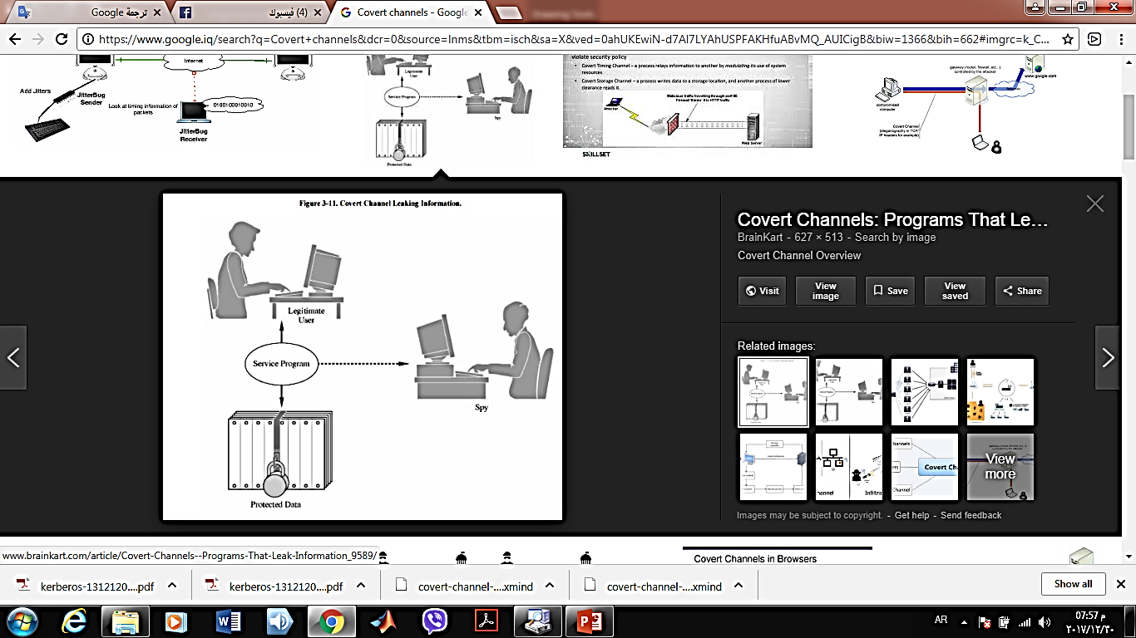
COVERT CHANNELS
A covert channel is a communication channel that allows two cooperating processes to transfer information in a manner that violates the system’s security policy

Slide 8
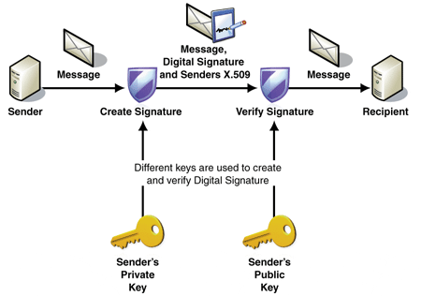

DIGITAL SIGNATURE
A digital signature is a mathematical technique used to validate the authenticity and integrity of a message, software or digital document.
Digital signature schemes normally give two algorithms, one for signing which involves the user's secret or private key, and one for verifying signatures which involves the user's public key

Slide 9
STEGANOGRAPHY
literally means “covered writing”
Steganography’s primary goal is to hide data within some other data such that the hidden data cannot be detected even if it is being sought
Secondary goals:
  prevent extraction from the cover file without destroying the cover
  prevent destruction of the stego-message without destroying the cover
Most frequently, steganography is applied to images, Audio, Video, Text, Executable programs

Slide 10
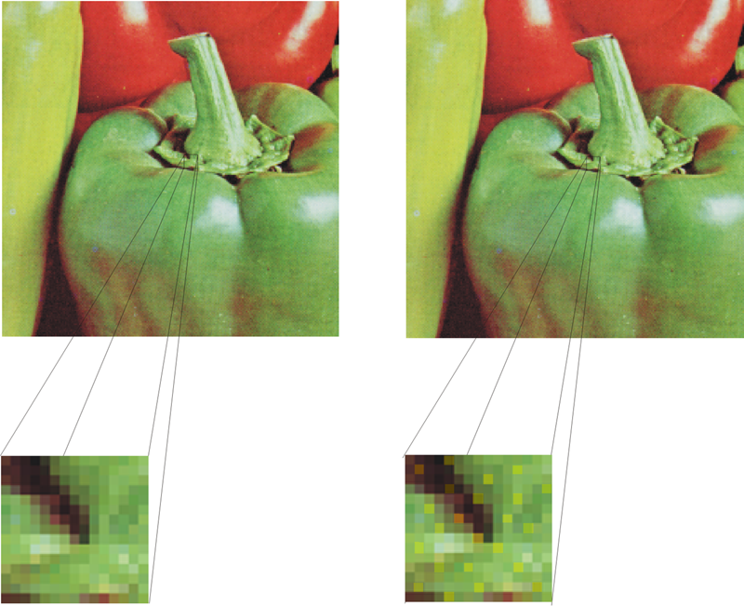
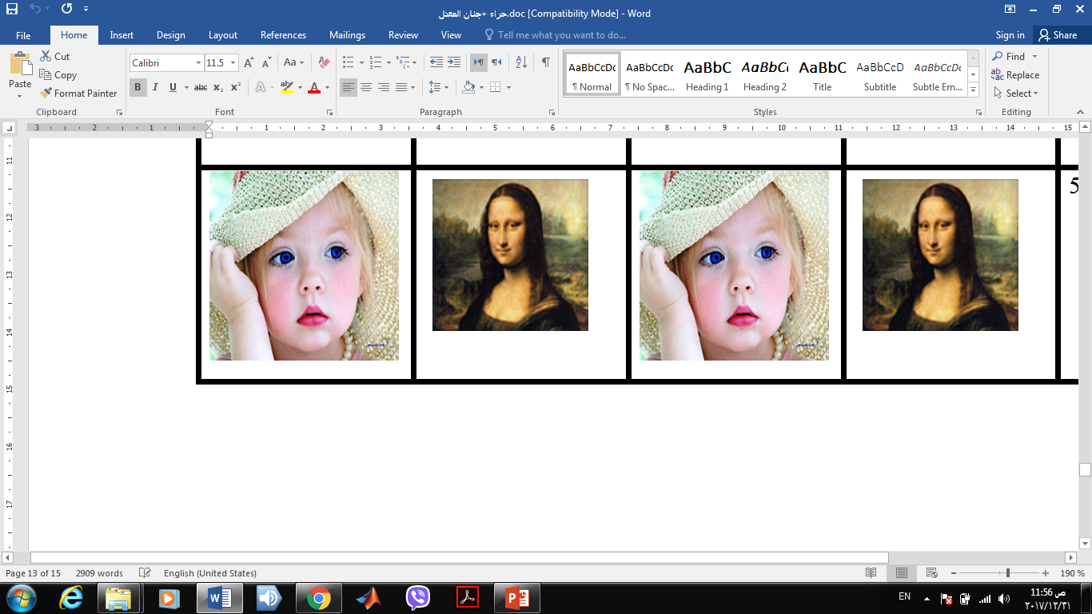

Slide 11
DIGITAL WATERMARK
is a pattern of bits inserted into a digital image, audio or video file that identifies the file's copyright information (author, rights, etc.).
However, it’s primary goal is to not be able to be extracted or destroyed (at least not without destroying the cover too)
Typically, watermarking is designed to protect intellectual property rights for images, sounds, and video

Slide 12
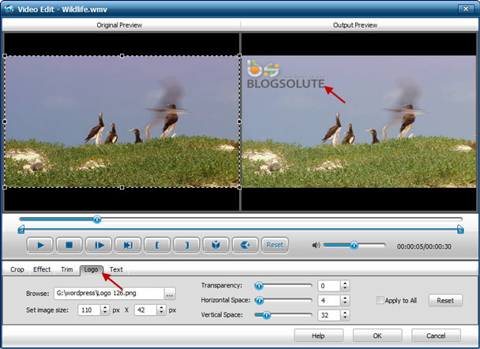

Slide 13
CONCLUSION
The main goal of watermarking is to hide a message m in (cover) data d, to obtain new data d’, in such a way that an eavesdropper cannot remove or replace m in d'.
The main goal of steganography is to hide a message m in (cover) data d’, to obtain new data d', in such a way that an eavesdropper cannot detect the presence of m in d'.
steganography is to hide a message in one-to-one communications and the goal of watermarking is to hide message in one-to-many communications.
Steganography methods usually do not need to provide strong security against removing or modification of the hidden message. Watermarking methods need to be very robust to attempts to remove or modify a hidden message.

Slide 14
Thank you

