Slide 1



INDUSTRIAL AUTOMATION
USING PLC

Slide 2
AUTOMATION
 Automation is basically the delegation of human control functions to technical equipment aimed towards achieving:
Higher productivity.
Superior quality of end product.
Efficient usage of energy and raw materials.
Improved safety in working conditions etc.

Slide 3
TYPES OF AUTOMATION
 Building automation
Example: lifts, smoke detectors
 Office automation
Example: printers, cameras
 Scientific automation
Example: rocket launching
 Light automation
Example: street solar lightening
 Industrial automation
Example: automated bottle filling stations , steel factories etc

Slide 4
INDUSTRIAL AUTOMATION
 The use of Computerized devices to complete manufacturing tasks.
CONTROL SYSTEM
 | HARDWARE CONTROL |  | SOFTWARE CONTROL
PLANT
FIELD INSTRUMENT

Slide 5
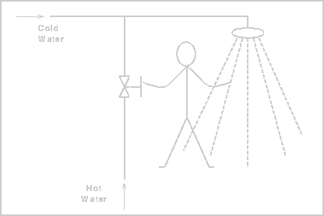
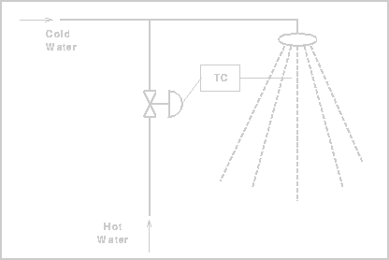
DEVELOPMENT OF CONTROL SYSTEM
☞ Manual control
☞ Pneumatic control
☞ Hard wired logic control
☞ Electronics control
☞ PLC control.

Slide 6

PLC(PROGRAMMABLE LOGIC CONTROLLER(
 Programmable Logic Controller (PLC) is an industrial computer that monitors inputs, makes decisions based on its program and controls outputs to automate a process or machine.
 The automation of many different processes, such as controlling machines or factory assembly lines, is done through the use of small computers called a programmable logic controllers PLCs .

Slide 7
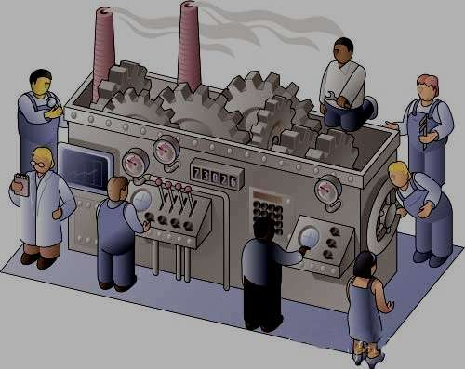
WHY PLC?
 To reduce human efforts .
 To get maximum efficiency from machine
 To reduce complex circuitry of entire system .
 To eliminate the high costs of relay-controlled systems.

Slide 8
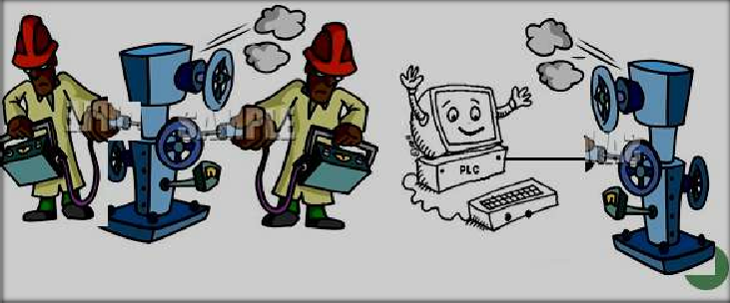
UNDERSTANDING OF PLC Example
The machine can be controlled by PLC without human efforts

Slide 9
MAJOR COMPONENTS OF A PLC
POWER SUPPLY
PROCESSOR
INPUTS
OUTPUTS
SENSORS .
Pushbuttons .
Limit. Switches .
CONTACTS .
Solenoids, contactors, alarms
PROGRAMMING DEVICE

Slide 10
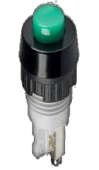
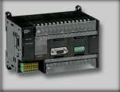
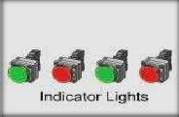
COMPONENTS (INPUT /OUTPUT)
INPUT MODULES accepts and converts signals from sensors into a logic signal
Ex. : Switches, Pushbuttons.
OUTPUT MODULES that convert control instructions a signal that can be used by actuators.
Ex. : lamps, alarm.
INPUT
OUTPUT
PUSH BUTTONS
PLC

Slide 11
COMPONENTS (CPU ,MEMORY)
3. CENTRAL PROCESSING UNIT(CPU)
It is the brain of PLC and governs the activities of the entire PLC systems
The CPU consists of following Arithmetic Logic Unit
Internal memory of CPU
Internal timers ,counters and Flags .
PROCESSOR
The various operations performed are : Scanning I/O bus traffic control, Program execution,
Peripheral and External device communication,
4. MEMORY is the component that stores information, programs and data in a PLC.
Types of memories used in PLCs are read only memory (ROM) and
(random access memory (RAM

Slide 12
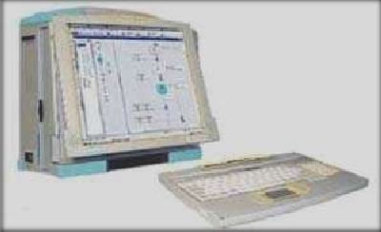
COMPONENTS (POWER SUPPLY, PROGRAMMING DEVICE)
5. POWER SUPPLY
Provides the voltage needed to run the primary PLC components.
POWER SUPPLY
6. PROGRAMMING DEVICE
The programming terminal is used for programming the PLC and monitoring/sequencing PLCs
PROGRAMMING DEVICE
operation.

Slide 13
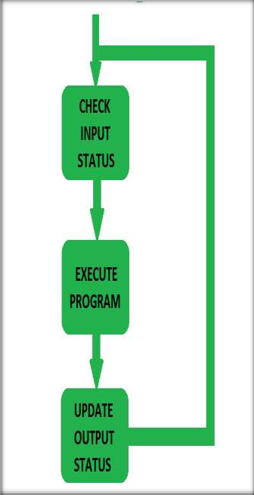
PLC OPERATION
CHECK INPUT STATUS
First the PLC takes a look at each I/O to determine if it is on or off.
EXECUTE PROGRAM
Next the PLC executes the program one instruction at a time.
UPDATE OUTPUT STATUS
Finally the PLC updates the status of the outputs .It updates the outputs based on which inputs were on during the first step.

Slide 14
PLC PROGRAMMING
Ladder logic is a programming language used to develop software for PLC used in industrial control applications.
RUNGES
RAIL
RAIL

Slide 15
ELEMENTS OF LADDER LOGIC
NORMALLY OPEN
(CONTACT)
NORMALLY CLOSED
(CONTACT)
COILS

Slide 16
LADDER LOGIC EXAMPLE
OR OPERATION
C
A
B
In the above diagram, it can be seen that either input A or B is be true (1), or both are true, then the output C is true (1)

Slide 17
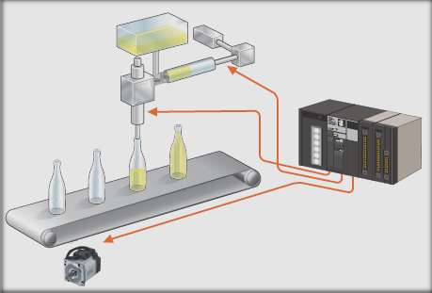
AREAS OF APPLICATION
Manufacturing / Machining
Food / Beverage
Textile Industry
Travel Industry
Aerospace
Printing Industry

Slide 18
ADVANTAGES
☺ Replacing Human Operators Dangerous Environments Beyond Human Capabilities
☺ Fast
☺ Easily programmed and have an easily understood programming language.
☺ Improves Productivity
☺ Improves Quality

Slide 19
CONCLUSION
 The PLC have in recent years a wide growth as universal element in industrial automation .
 It can be effectively used in applications ranging from simple control like replacing a small number of relays to complex automation problems.
 Today the PLCs are used for control & automation job in a single machine & it increases up to full automation of manufacturing / testing process in a factory.

