Slide 1

Computer vision
By Prepared
Msc. Zobeda Hatif

Slide 2
Outline
Introduction
Short story of computer vision
Goal of computer vision
The Tools of Computer Vision
Application of Computer Vision

Slide 3
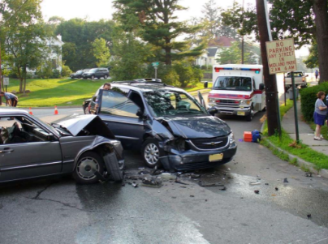
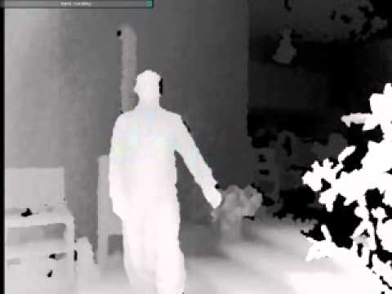
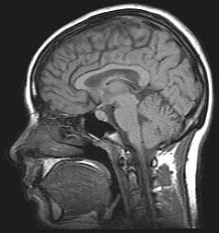
Computer vision
Computer vision is the science and technology of machines that Concerned with the theory for building artificial systems that obtain information from images.
The image is as set of data can take many forms, such as a video sequence, depth images, views from multiple cameras and also medical image

Slide 4
Computer vision
Humans use their eyes and brains to see and visually sense the world around them. while Computer vision is the science that aims to give a similar, if not better, capability to a machine or computer.
Computer vision is concerned with the automatic extraction, analysis and understanding of useful information from a single image or a sequence of images. It involves the development of a theoretical and algorithmic basis to achieve automatic visual understanding

Slide 5
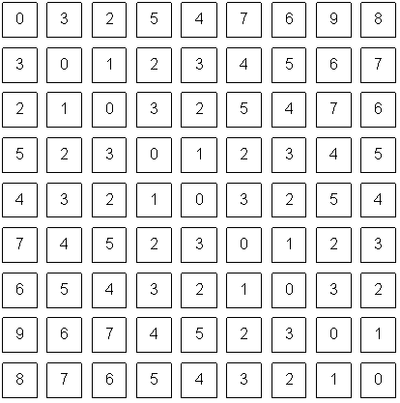
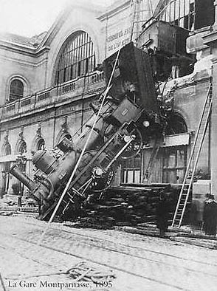
Computer vision what the difference between human vision and computer vision
What we see
computer see

Slide 6
Short story of computer vision
In 1966, Marvin Minsky at MIT asked his undergraduate student Gerald Jay Sussman to “spend the summer linking a camera to a computer and getting the computer to describe what it saw”. We now know that the problem is more difficult than that.

Slide 7

Components of a computer vision system
Camera
Lighting
Computer
Scene
Scene Interpretation
Srinivasa Narasimhan’s slide

Slide 8
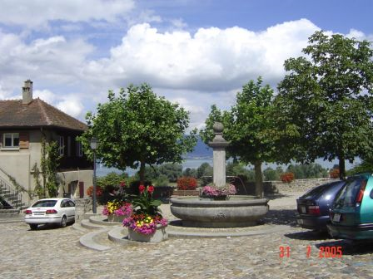
What the goal of computer vision?
.
Where are the cars?
What kind of scene
How far is the building?

Slide 9
The applications of computer vision
Optical character recognition (OCR)
Face detection
Smile detection
Object recognition (in supermarkets)
Vision- based biometrics
Object recognition (in mobile phones)
Special effects: shape capture
Sports
Medical image
Smart cars

Slide 10
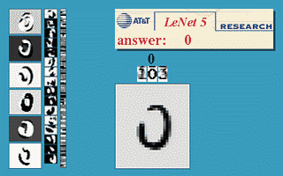
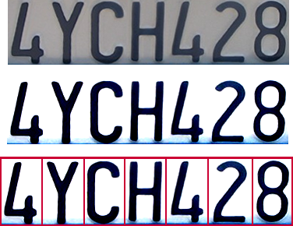
Optical Character Recognition (OCR)
Technology to convert scanned docs to text
  If you have a scanner, it probably came with OCR software

Slide 11
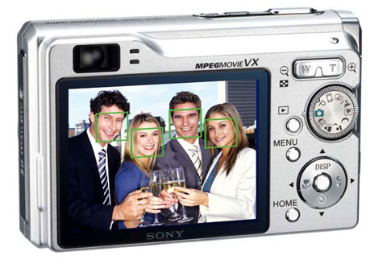
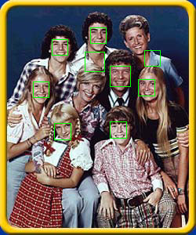
Face Detection
Today we have many camera have ability face detection like canon sony ect

Slide 12
Smile Detection

Slide 13
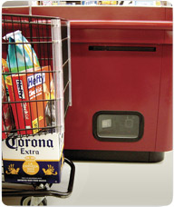
Object Recognition (in supermarkets)
Notes:
LaneHawk by EvolutionRobotics
“A smart camera is flush-mounted in the checkout lane, continuously watching for items. When an item is detected and recognized, the cashier verifies the quantity of items that were found under the basket, and continues to close the transaction. The item can remain under the basket, and with LaneHawk,you are assured to get paid for it

Slide 14

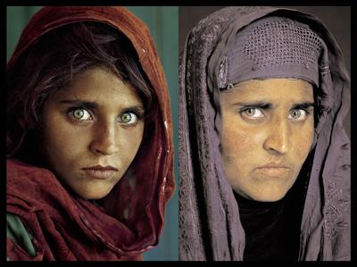
Biometrics is the measurement and statistical analysis of people's unique physical and behavioral characteristics.
Notes:
Biometrics is the measurement and statistical analysis of people's unique physical and behavioral characteristics.

Slide 15
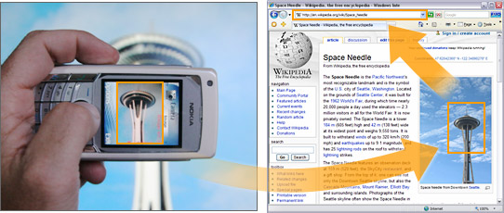
Object recognition (in mobile phones)

Slide 16
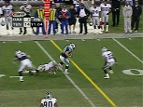
sports

Slide 17
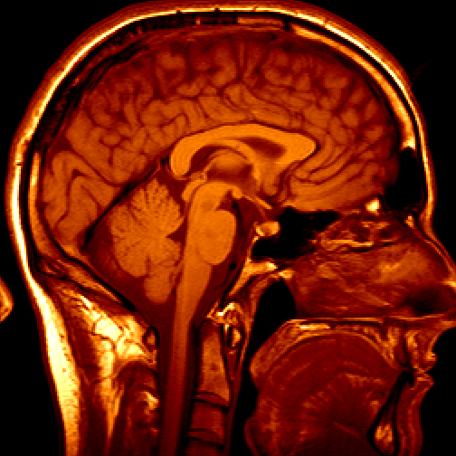
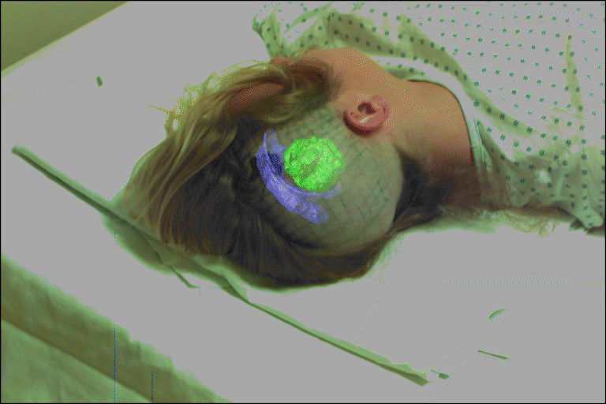
Medical image
3D image
MRI, CT
Image guided surgery
Grimson et al., MIT

Slide 18
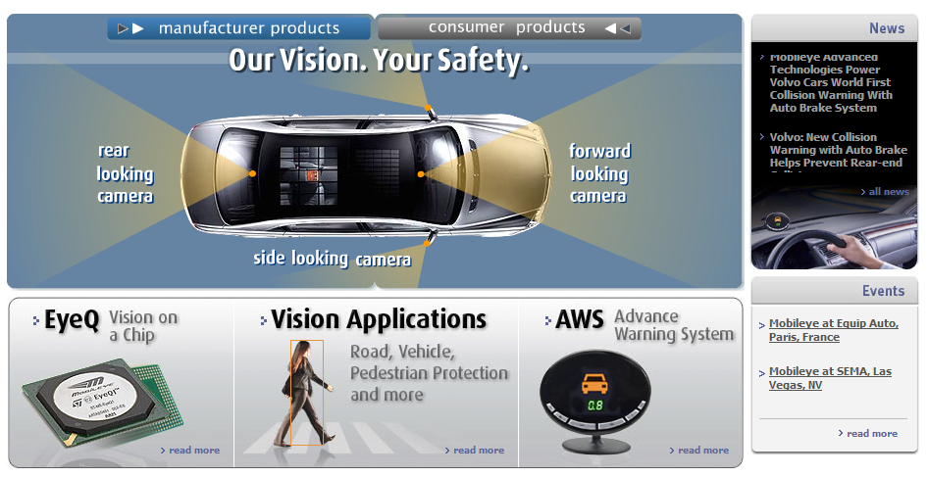
Smart cars
Slide content courtesy of Amnon Shashua
Mobileye
  Vision systems currently in high-end BMW, GM, Volvo models
  By 2010: 70% of car manufacturers.

Slide 19
Thank you for attention and any equation please

