Slide 1
University of Diyala College of Engineering Dep. of Computer
Adaptive learning
Presented by : Lect. Hussein sultan Radhi

Slide 2
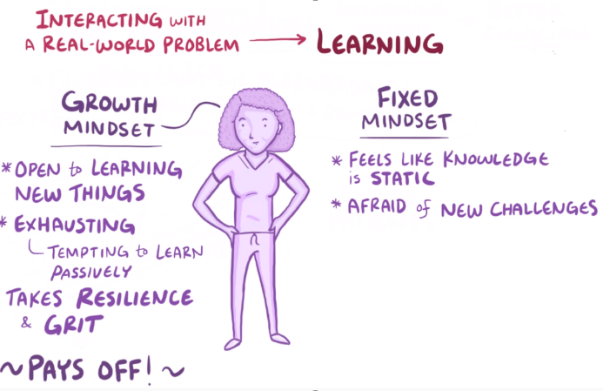
Adaptive learning

Slide 3
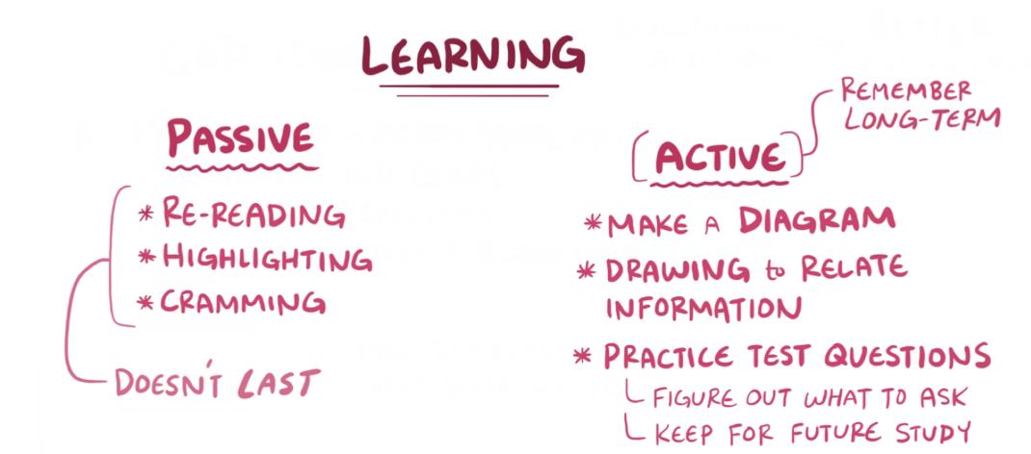

Slide 4
Adaptive learning, also known as adaptive teaching, is an educational method which uses computers as interactive teaching devices, and to orchestrate the allocation of human and mediated resources according to the unique needs of each learner.
Computers adapt the presentation of educational material according to students' learning needs, as indicated by their responses to questions, tasks and experiences. The technology encompasses aspects derived from various fields of study including computer science, education, psychology, and brain science.

Slide 5
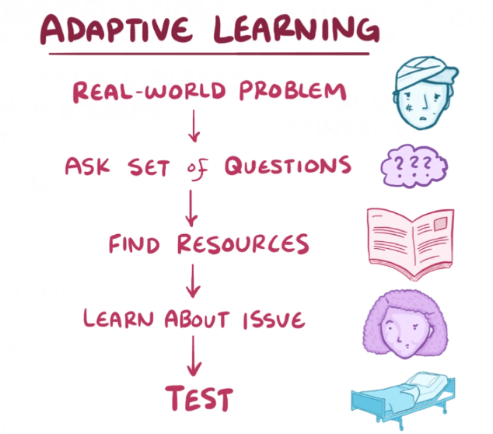

Slide 6
Adaptive learning has been partially driven by a realization that tailored learning cannot be achieved on a large-scale using traditional, non-adaptive approaches. Adaptive learning systems endeavor to transform the learner from passive receptor of information to collaborator in the educational process. Adaptive learning systems' primary application is in education, but another popular application is business training. They have been designed as desktop computer applications, web applications, and are now being introduced into overall curricula

Slide 7
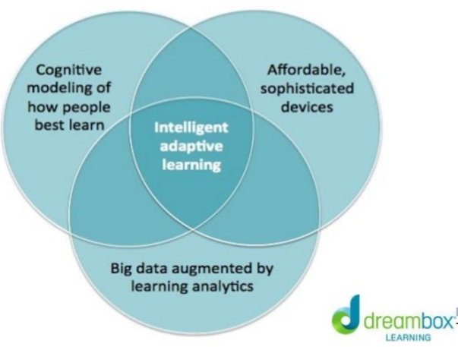

Slide 8
What Is an Adaptive Learning Tool?
“We define adaptive learning tools as education technologies that can respond to a student’s interactions in real-time by automatically providing the student with individual support. … Adaptive learning tools collect specific information about individual students’ behaviors by tracking how they answer questions. The tool then responds to each student by changing the learning experience to better suit that person’s needs, based on their unique and specific behaviors and answers.”

Slide 9
Adaptive Learning Tool(cont.)
“The tools, however, are not a panacea, It’s unlikely that a single tool will ever be able to take over a student’s education, helping students own their learning, make decisions, become lifelong learners, and develop their metacognitive skills.”

Slide 10
Catching Up and ‘Unshackled’
“The decision to use adaptive technology was about helping underachievers catch up, and it was about helping students take responsibility for their own learning.”

Slide 11
ADAPTIVE CONTENT
“When a student makes an error, tools with adaptive content respond with feedback and hints based on the student’s specific misunderstanding. … They also take individual skills and break them down into smaller pieces, depending on how a student responds, without changing the overall sequence of skills.”

Slide 12
ADAPTIVE SEQUENCE
“ These tools are continuously collecting and analyzing student data to automatically change what a student sees next; from the order of skills a student works on, to the type of content a student receives.”
“If a learner was not in class during a period when a particular skill was introduced and years later was learning a new skill that built on that prior knowledge, that learner would struggle. Adaptive sequencing tools could help that student go back and find this gap and learn this content first, rather than in the same sequence as everyone else.”

Slide 13
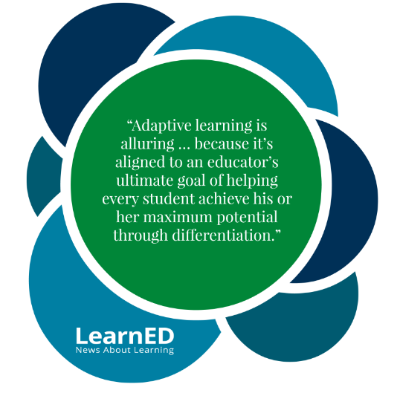

Slide 14
Case Study
In a recent case study, Dr. Erik Moody, an assistant professor at Marist College, explains how he incorporates adaptive learning into his classes to improve student outcomes. He has tested and adjusted different uses of the platform in his Introduction the course to help his students learn and better retain information.
More importantly, he’s designed his course so that the members of his class develop good study habits and begin to think critically about their own learning.
Based on three years of work to optimize his use of adaptive learning, He considers the following four tactics integral to his students’ continued growth and success.

Slide 15
1. Encourage students to think about how they learn
Moody introduces his methods in the first class — discussing, for example, how adaptive learning customizes each student’s learning experience based on his or her performance — which gets students thinking about their own learning and study habits. He’s found that students are more likely to embrace new study skills.
2. Help students understand new technology
Prepare students for technology-enabled learning by explaining how the chosen platform works and "how it will help them become better learners".
Moody spends a portion of his first class making sure his students understand adaptive learning. Getting them to a new learning approach increases its chance of success.

Slide 16
3. Combine data with peer pressure to motivate students
Showing students how their performance compares to their peers motivates, and helps them better understand the relative outcome of their efforts.
Moody has experimented with this in his class, allowing students to compare themselves to their peers’ performance on assessments. After each quiz, he plots every student’s grade on a frequency distribution chart and shares it with the class. The charts are anonymous, but students know how they performed on the quiz and where on the chart their grade falls.
4. Use data to keep tabs on student progress and intervene, if necessary
Use data from online activities and quizzes to monitor in real time who might be at risk and intervene early. He continues to be interested in developing an early alert system to identify struggling students, does this on a small scale in his own classes. He pulls students aside when he sees they aren’t doing well in his course and points them to resources that will help them change their own habits and improve their outcomes.

Slide 17
thank for your listening

