Slide 1
تحسين شبكة ديالى الكهربائية (132 كيلو فولت) باستخدام برنامج power worldوأجهزة SVC &TCSC
Improvement of Diyala Electric Network (123kV) Using Power World Program and svc & Tcsc devices.

Slide 2
INTRODUCTION
The objective function of this project is to find the optimal sizing and location of (TCSC and SVC devices).

Slide 3
PROBLEM FORMULATION
There are three objective function which maintain
bus voltage at desired level
minimizes the power flow in overloaded lines
minimizes the real and reactive power loss

Slide 4
  Voltage Level
This objective function takes voltage levels into account. For voltage levels between (0.95 to 1.1) p.u.

Slide 5
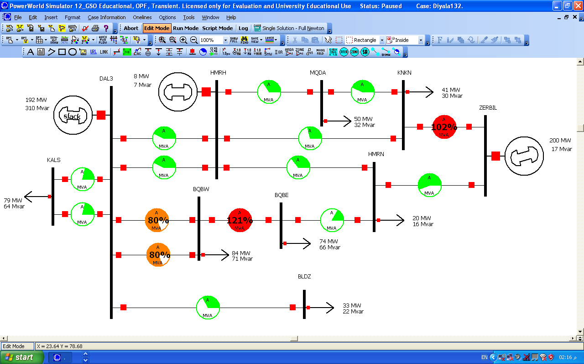
Diyala electrical network (132kV) using PowerWorld without (SVC&TCSC)

Slide 6


Overloaded Lines
The active power and reactive power flow on lines can be applied as follows

Slide 7


Active and Reactive Power Loss
The objective is to minimize the total active and reactive power losses in the transmission lines can be expressed as follows

Slide 8
MODELING OF FACTS CONTROLLER
There are two different FACTS devices have been selected to place in suitable location and suitable size to improve the performance of Diyala Electric Network (132 kV).
SVC (Static VAR Compensator) shown in Fig. 1 SVC can be used to control reactive power .
TCSC (Thyristor Controlled Series Compensator) shown in Fig. 2.TCSC can change line reactance.

Slide 9
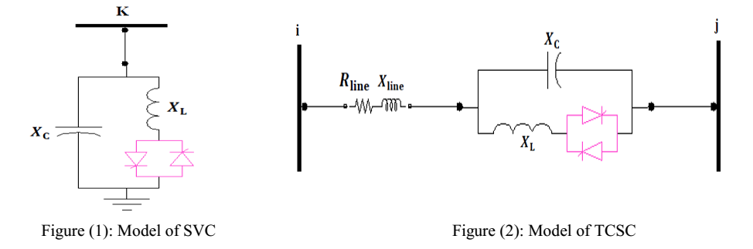

Slide 10


SVC firing angle model
;
.
Where; σ is the conduction angle and is the firing angle.

Slide 11
TCSC firing angle model

Slide 12
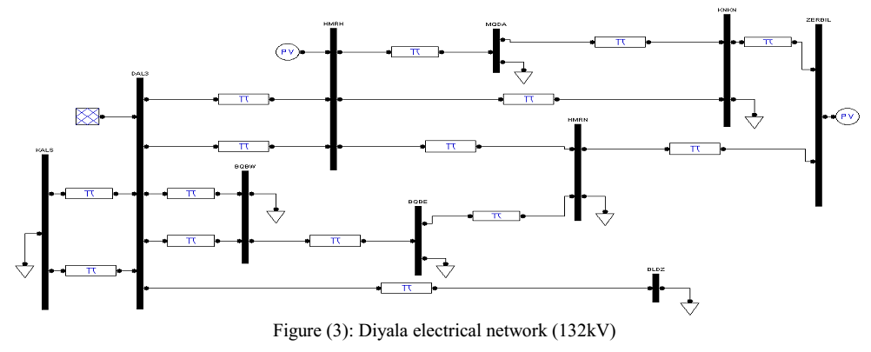
Diyala electrical network (132kV)

Slide 13
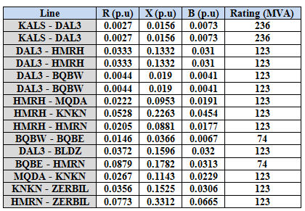
Line data for Diyala electrical network (132kV)

Slide 14
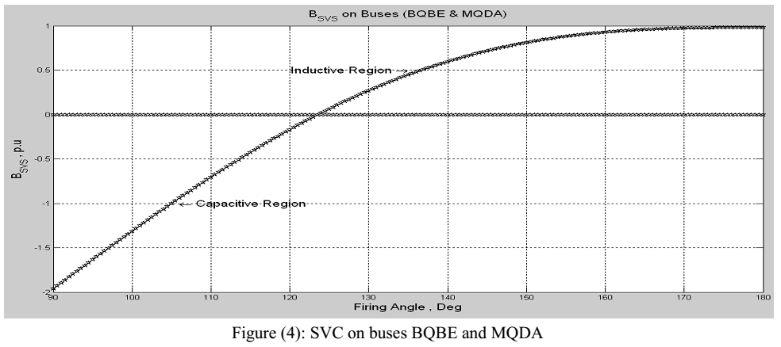

Slide 15
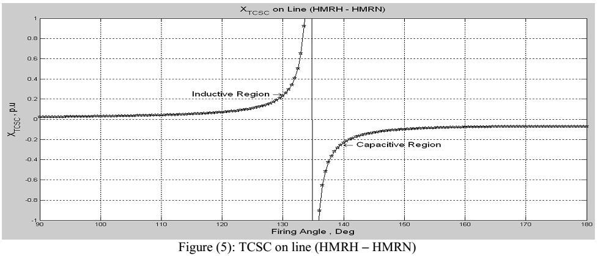

Slide 16
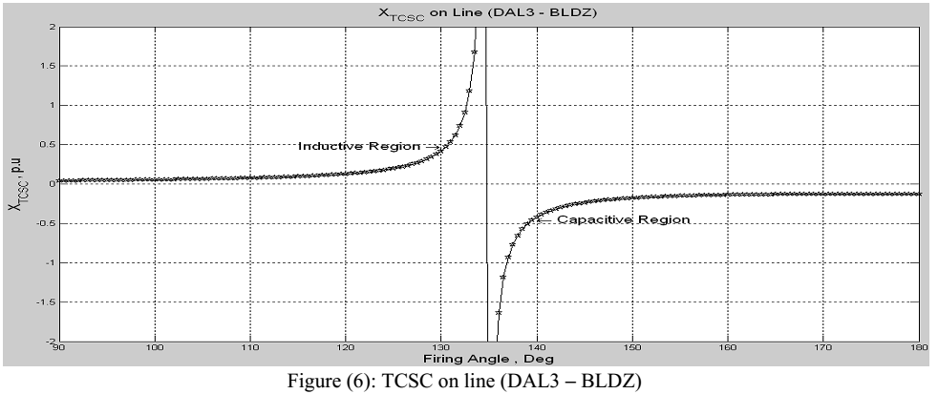

Slide 17
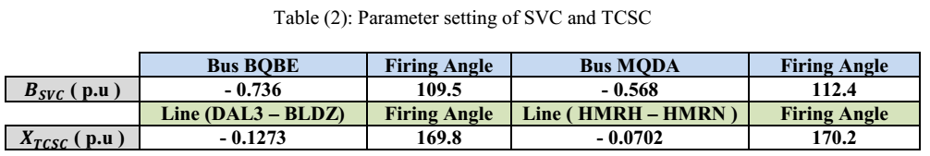

Slide 18
Diyala electrical network (132kV) using PowerWorld without (SVC&TCSC)

Slide 19
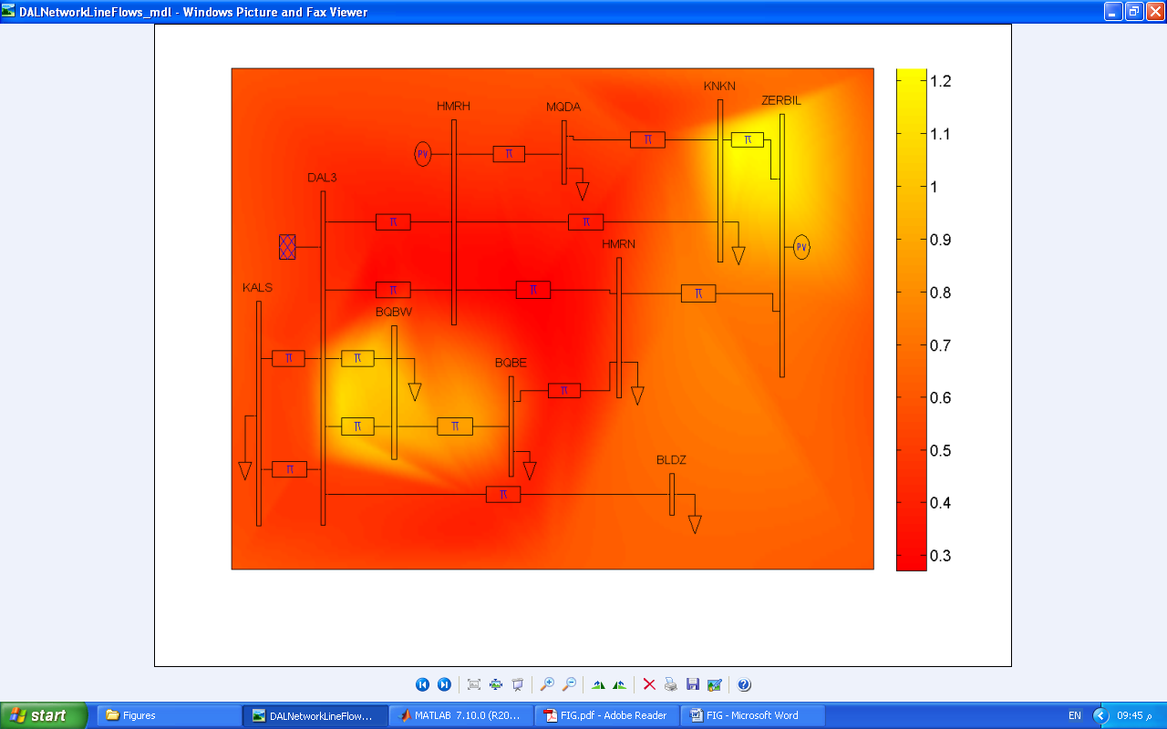
Diyala electrical network (132kV) using MATLAB without (SVC&TCSC)

Slide 20
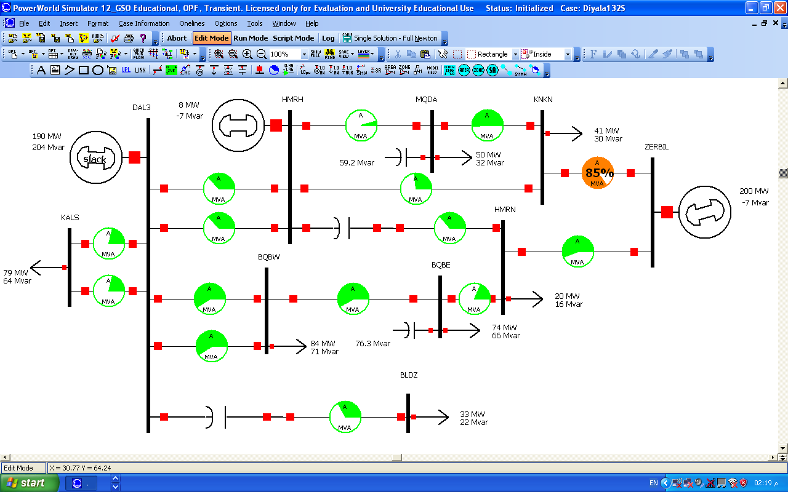
Diyala electrical network (132kV) using PowerWorld with (SVC&TCSC)

Slide 21
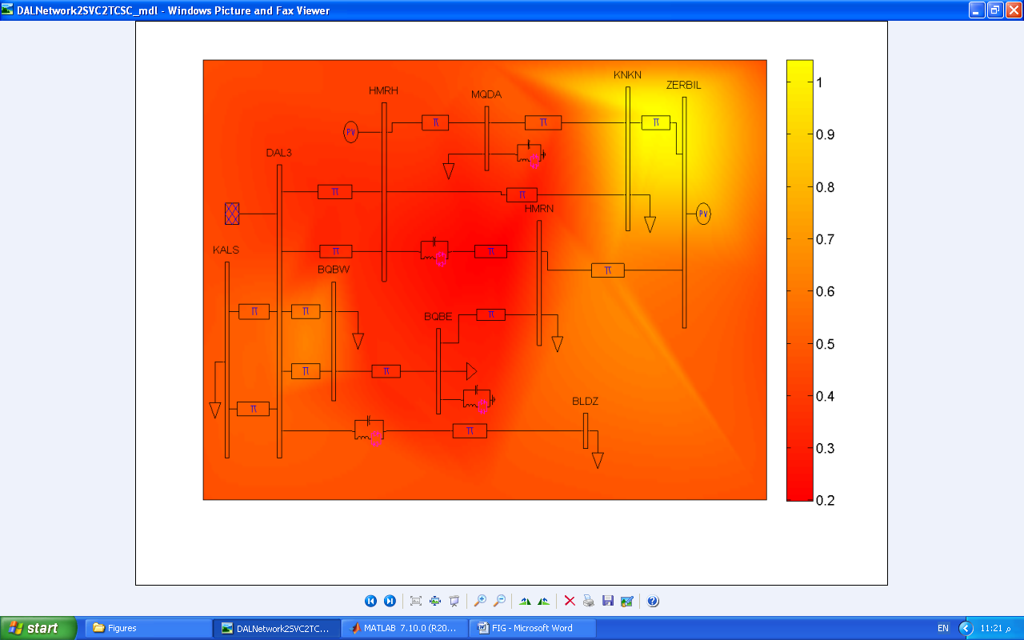
Diyala electrical network (132kV) using MATLAB with (SVC&TCSC)

Slide 22
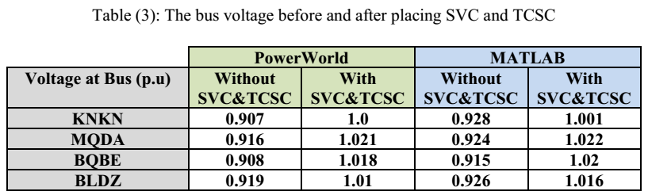

Slide 23
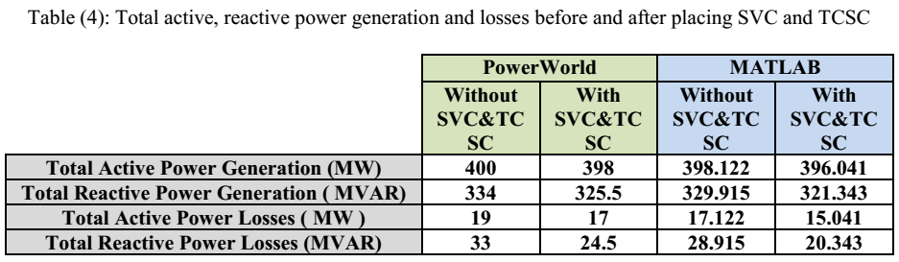

Slide 24
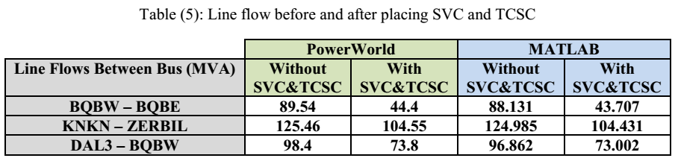

Slide 25
Thank you

