Slide 1

SOFTWARE-DEFINED NETWORKING
(SDN)
Asst. Lect. Ahmed M. Jasim
Department of Computer Engineering
College of Engineering - University of Diyala
2017

Slide 2
PRESENTATION OUTLINE
COMPUTER NETWORKS PROBLEMS
NETWORK TRAFFIC
SDN
SDN COMPONENTS
INTERFACE TYPES
SDN ARCHITECTURE
SDN MODELS

Slide 3

COMPUTER NETWORKS PROBLEMS
SLOW NETWORK SPEED
Fiber optics

Slide 4

COMPUTER NETWORKS PROBLEMS
STORAGE CAPACITY
Giant Servers

Slide 5
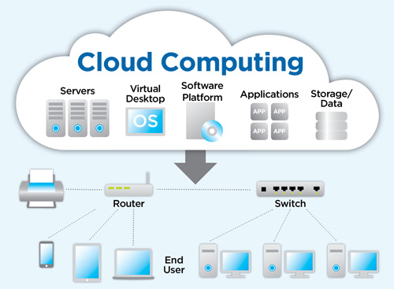
COMPUTER NETWORKS PROBLEMS
STORAGE CAPACITY

Slide 6

COMPUTER NETWORKS PROBLEMS
ADDRESSING

Slide 7
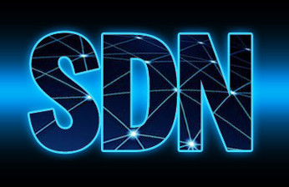
COMPUTER NETWORKS PROBLEMS
STRONG INFRASTRUCTURE

Slide 8
NETWORK TRAFFIC
All network traffic is classified to:
Control plane
Data plane

Slide 9
SDN
SDN moves the intelligence of the network (control plane) from individual devices to a central device (controller).

Slide 10
SDN
The controller will be responsible of network monitor, configuration, troubleshooting, resolution and software updates.
The GUI application is a layer above the controller which shows the admin every thing running in the network. For example, a red line indicates a congested path

Slide 11
SDN COMPONENTS
The controller (Ex: APIC-EM).
The API (Application Program Interface)
The interface protocol

Slide 12
INTERFACE TYPES
SBI (Southbound Interface)
It is the communication to/from the controller and infrastructure equipment like routers, switches and firewalls.
Examples on SBI are OpenFlow, NetConf, PCEP, BGP-LS, OVSDB.
NBI (Northbound Interface)
It is the communication to/from the controller and upstream SDN-aware applications.

Slide 13
SDN ARCHITECTURE
Application layer: Business application.
Control layer: SDN controller.
Infrastructure layer: Network devices.

Slide 14
SDN MODELS
1- Complete centralization of the control plane (Open SDN solution)
A lot of companies with the Open Networking Foundation work together to build that controller.
That model will use the open flow protocol
The “Open Day Light Controller”: It supports Open flow, NetConf, PCEP, BGP-LS and OVSDB protocols.
The Cisco implementation of the “Open Day Light Controller” is “Cisco open SDN controller (OSC)” .It uses Open flow as the SBI protocol.

Slide 15
SDN MODELS
2- Partial centralization of the control plane (Cisco ACI model)
The Cisco implementation of the partial control plane is the “Application Centric Infrastructure” controller.
The network devices have some control plane.
The ACI controller uses the OPFlex protocol.
Designed for Nexus switches only.

Slide 16
SDN MODELS
3- Distributed control plane (Cisco APIC-EM)
Suitable for already configured enterprises.
Doesn’t require special plate forms.
Uses the management plane to communicate with devices like telnet, SSH and SNMP protocols.
Cisco implementation of that model is “Application Policy Infrastructure Controller-Enterprise Model”.
The controller pushes commands to the devices and collects statistics about the devices then uses NBI protocol tells the upper application about the network which then can modify the devices configuration.

Slide 17
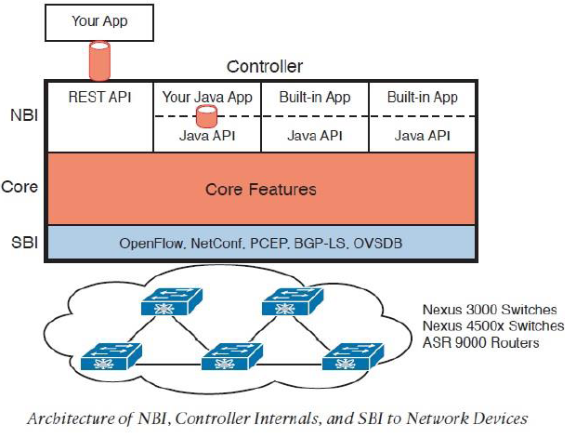

Slide 18
THANK YOU

Slide 19


