Slide 1
Solar energy as a renewable energy resource for building’s heating and air-conditioning الطاقة الشمسية كطاقة متجددة لتدفئة المنازل و تكييفها. Seminar presented by Dr. Ahmed Shihab Al-Samari Mechanical Engineering Department/ Engineering College/ Diyala University 15/11/2017

Slide 2
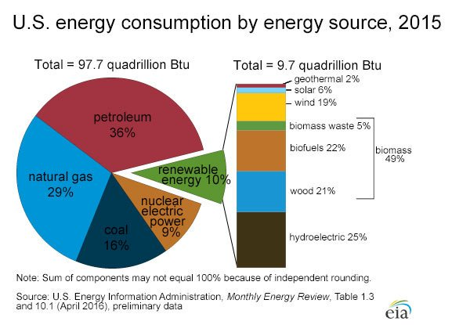

Slide 3
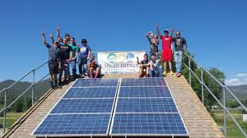
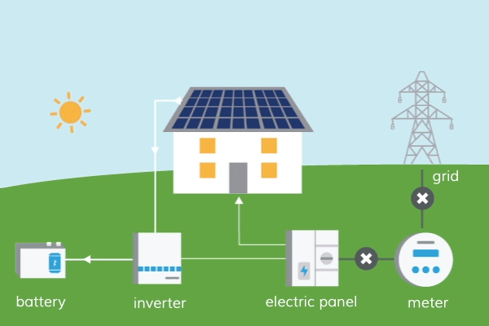
Photo Solar Panel

Slide 4
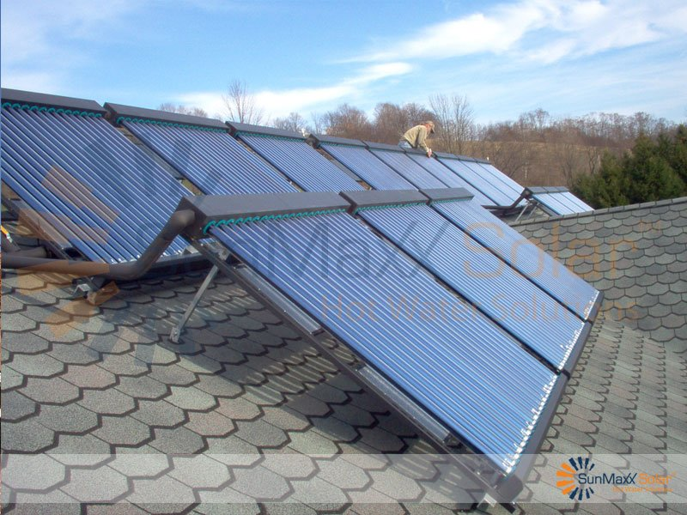
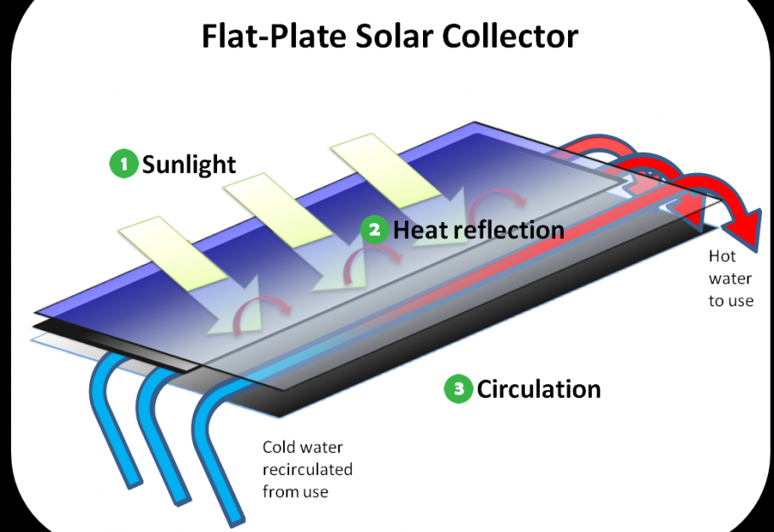
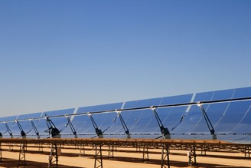
Solar Collector

Slide 5
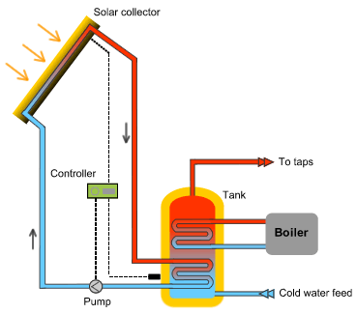

Slide 6
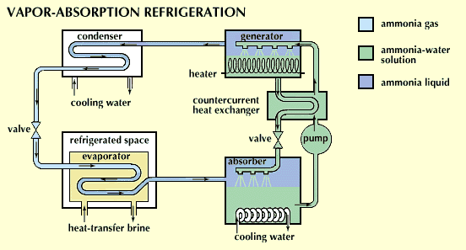

Slide 7
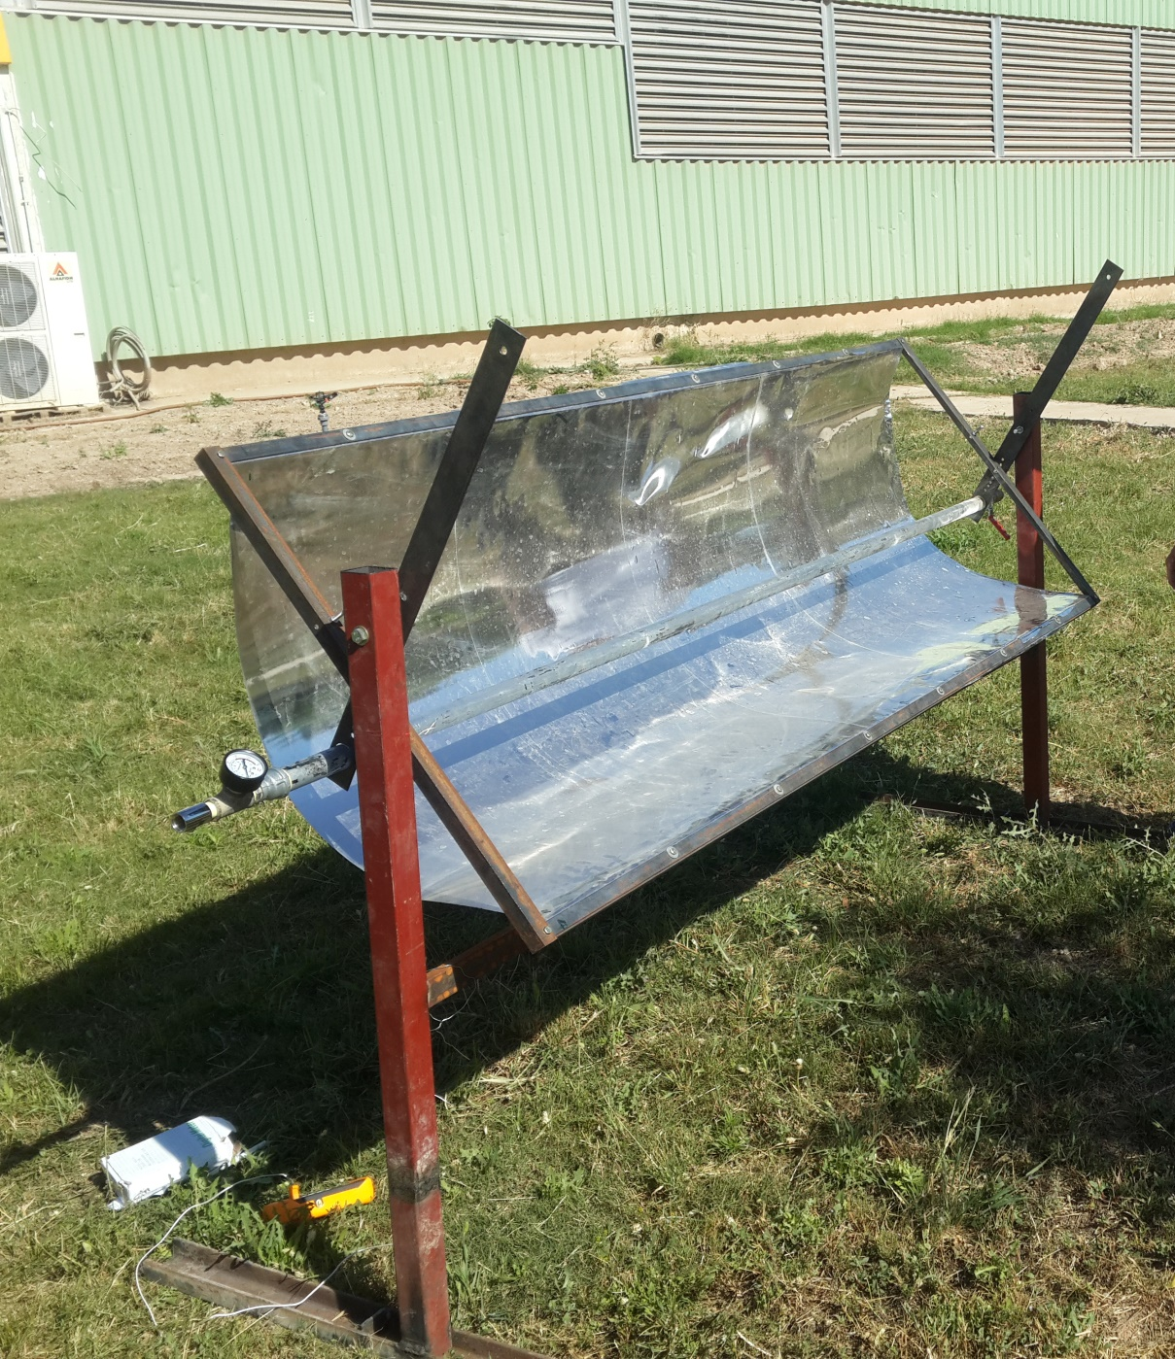

Slide 8
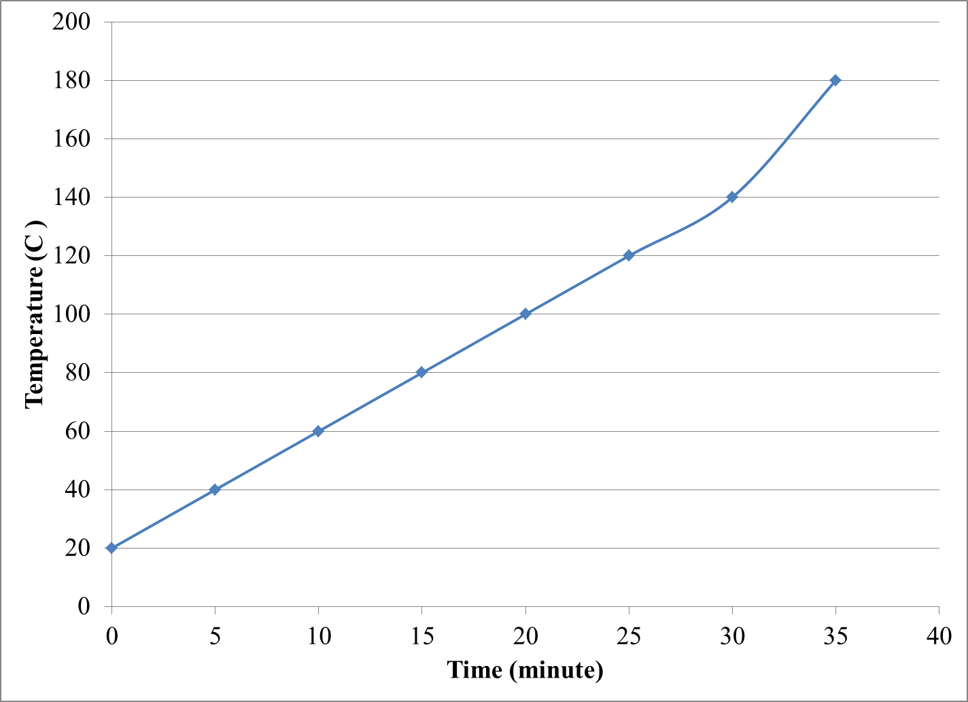
Results

Slide 9
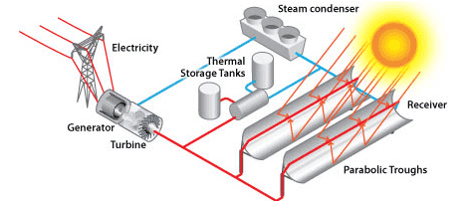
Proposed project

Slide 10
Thanks

